Slide 1
40R Smart Growth & Starter Home Zoning Districts
Housing Development Incentive Program (HDIP)
Urban Center Housing - Tax Increment Financing (UCH-TIF)
Bill Reyelt
617.573.1355
william.reyelt@state.ma.us
Notes:
have to meet three basic criteria relative to location, affordability and as-of-right allowable density
3 types of payments:
1) an upfront Zoning Incentive Payment for simply adopting the zoning overlay (this payment ranges in size from $10-$600K depending on net increase in as of right units on Developable/Underutilized Land);
2) Density Bonus Payment based on $3,000K per unit that receives a building permit consistent with the zoning requirements; and
3) under c. 40S the potential for reimbursement of any net increase in eligible school cost attributable to any children living in 40R units. = positive difference b/t standard state cost projection (avg. cost x # of students) & product of the educational % (% of overall state $ on education) & sum of the associated real estate and excise taxes + any additional c. 70$ otherwise received.

Slide 2
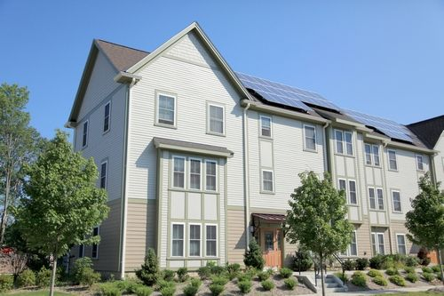
40R Smart Growth &
Starter Home Zoning Districts
Encourage housing production & smart growth
Financial incentives to municipalities for adoption & implementation of smart growth zoning overlay districts
Smart growth locations
Allow by-right densities based on housing type
Minimum 20% affordable
Zoning incentive payment
Density bonus payment
40S/school-reimbursement

Slide 3
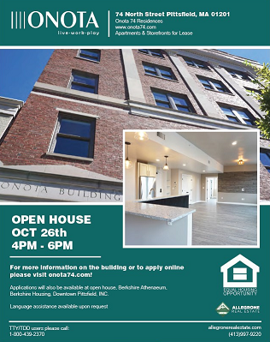
Housing Development
Incentive Program (HDIP)
Promotes market-rate housing in Gateway Cities
Encourages development consistent with a locally adopted Plan & Zone
Flexible local tax increment exemption on improvements
Up to 25% state tax credit on qualified improvements
Predominantly market rate – affordability is capped

Slide 4
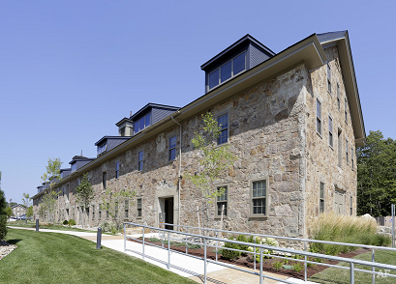
Tax Increment Financing (UCH-TIF)
Urban Center Housing
Promotes housing/mixed-use in commercial centers consistent with adopted plan & zone
New tax revenue for municipalities
Amended to allow more flexibility
Tax exemptions on improved value
Allows for special assessments
Flexible affordability requirements
Not limited to Gateway Cities
Linda Balzotti
617.573.1446
linda.balzotti@state.ma.us

