Slide 1
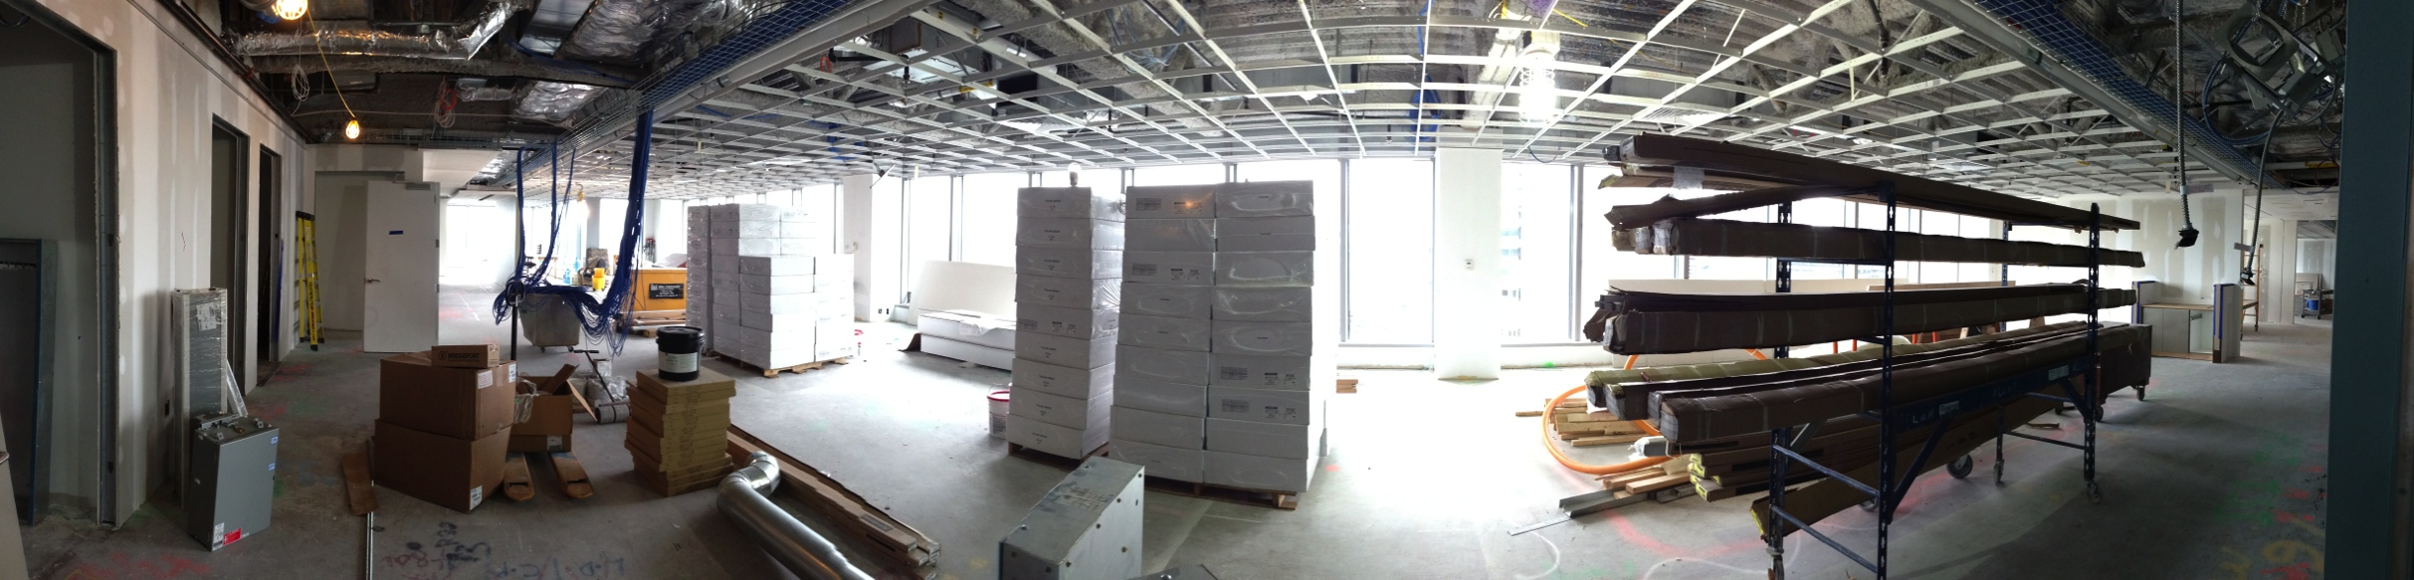
Getting to YES In My Backyard!
Entegra Development & Investment, LLC
Sustainable | Development | Consulting

Slide 2
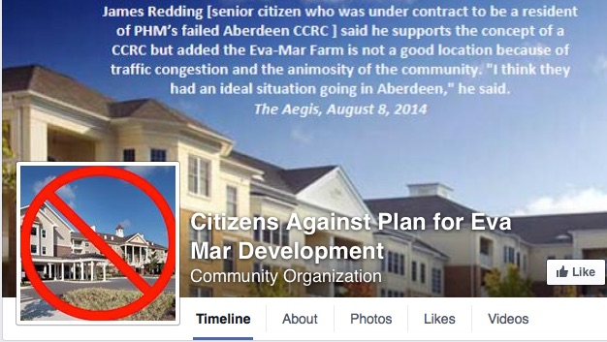
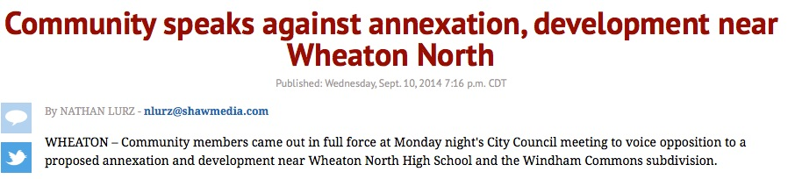
Reinventing the Development Process
Thing 1: Development is often conducted with “doors closed.”
Thing 2: Communities distrust developers.
Thing 3: The process is inefficient.
Notes:
Developers hold charrettes and community forums for their projects only when they are asked or required to. There’s a sense of entitlement with development that leads to unhealthy and counterproductive tactics in order to push a project through an already existing and archaic approval process. Further, when developers conduct these community meetings, many of the critical business decisions have been made, namely, : what’s being built, how big, how nice, and who is it for?
Because of these issues, communities hate development. Consequently, they push legislators to tighten up zoning to reduce the effects of change that can be imparted by the developer on their surroundings. It’s a vicious circle.
Developers need to open up the process to community members, open up the secret tool box of development, and hopefully work with communities to reduce unnecessary restrictions that don’t matter (like parapet wall height), and focus on things that do matter, like visibility corridors and pedestrian friendly access.

Slide 3
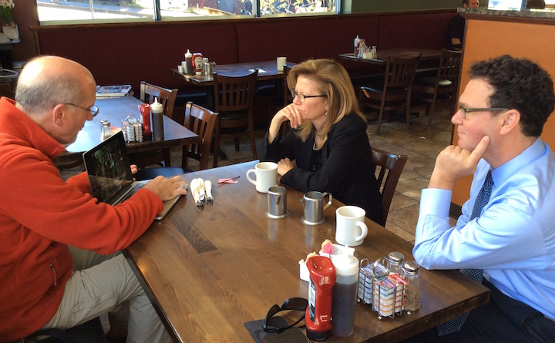
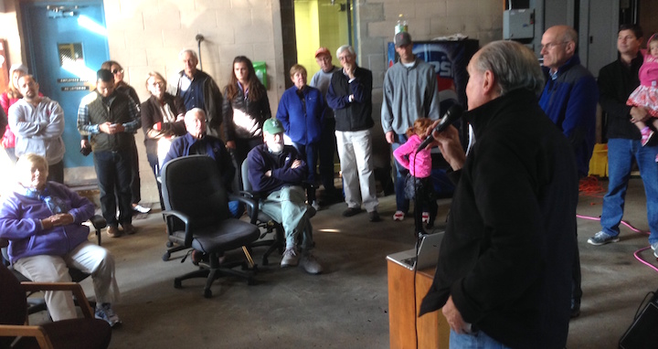
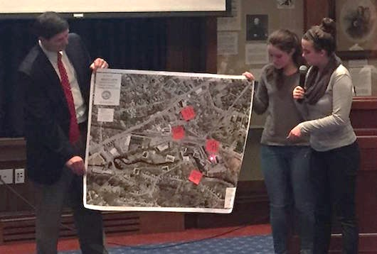
How Entegra Works
Identify the Opportunity
Consult with the Community
Get the Kids Involved
WALK the Neighborhood!
Get back to Nature
Address the Approval Process
Design & Develop

Slide 4
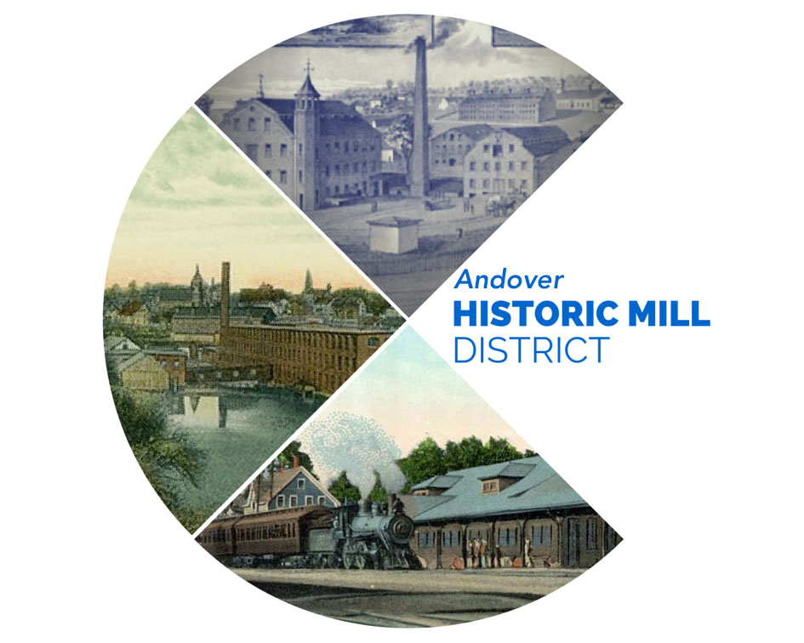
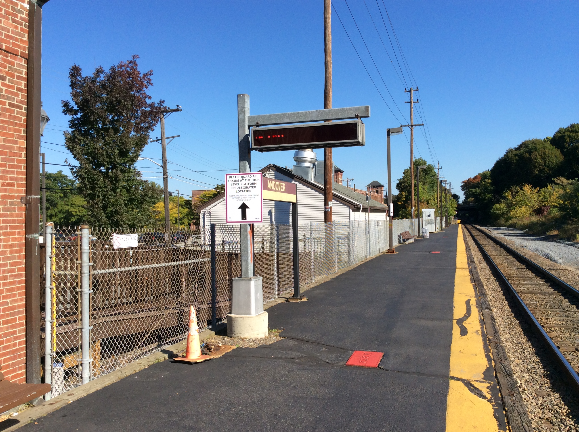
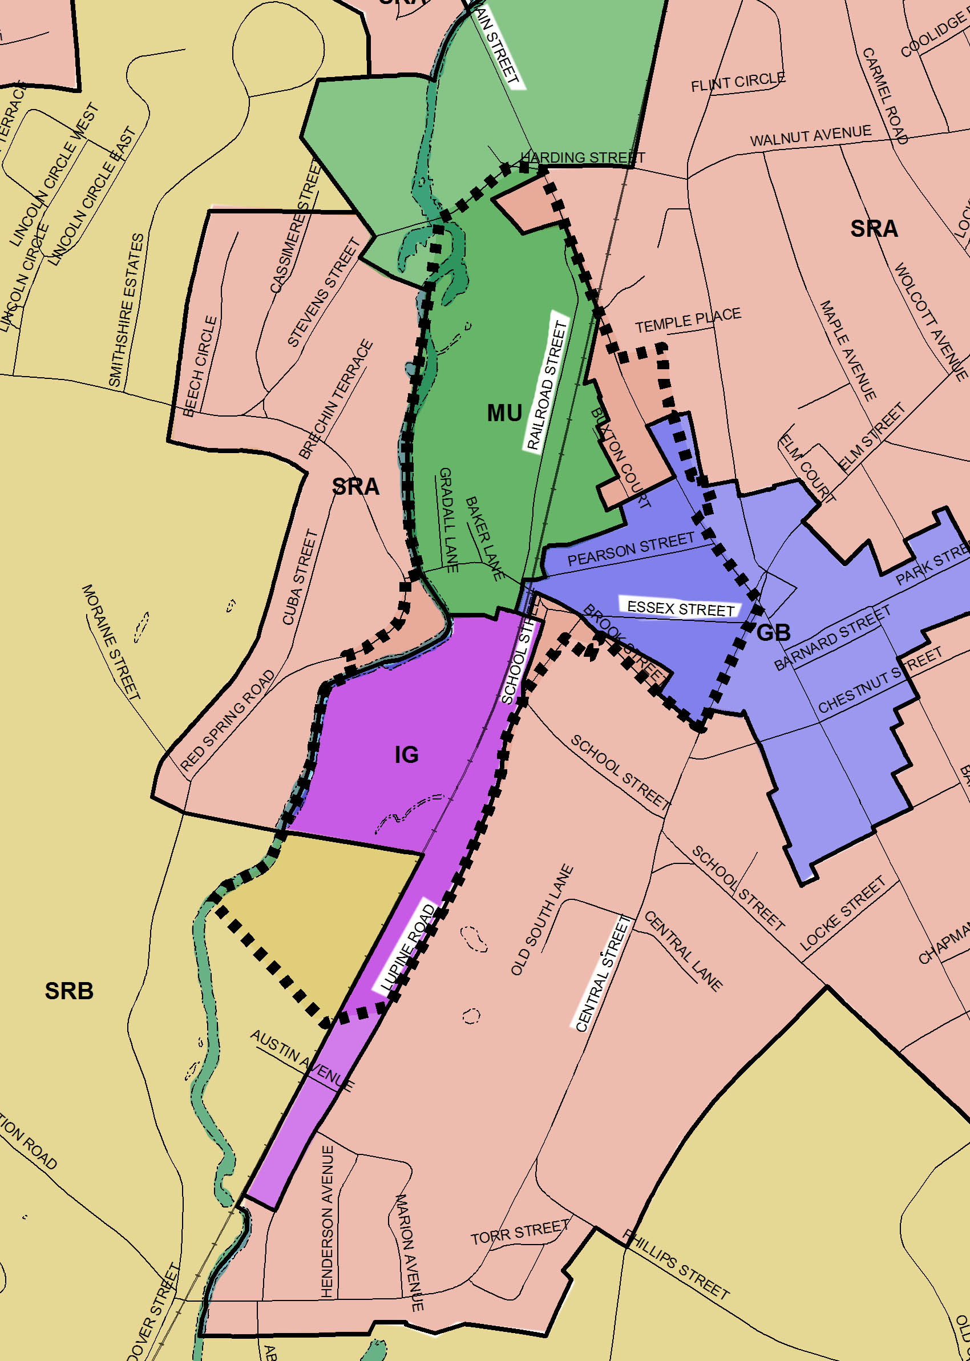
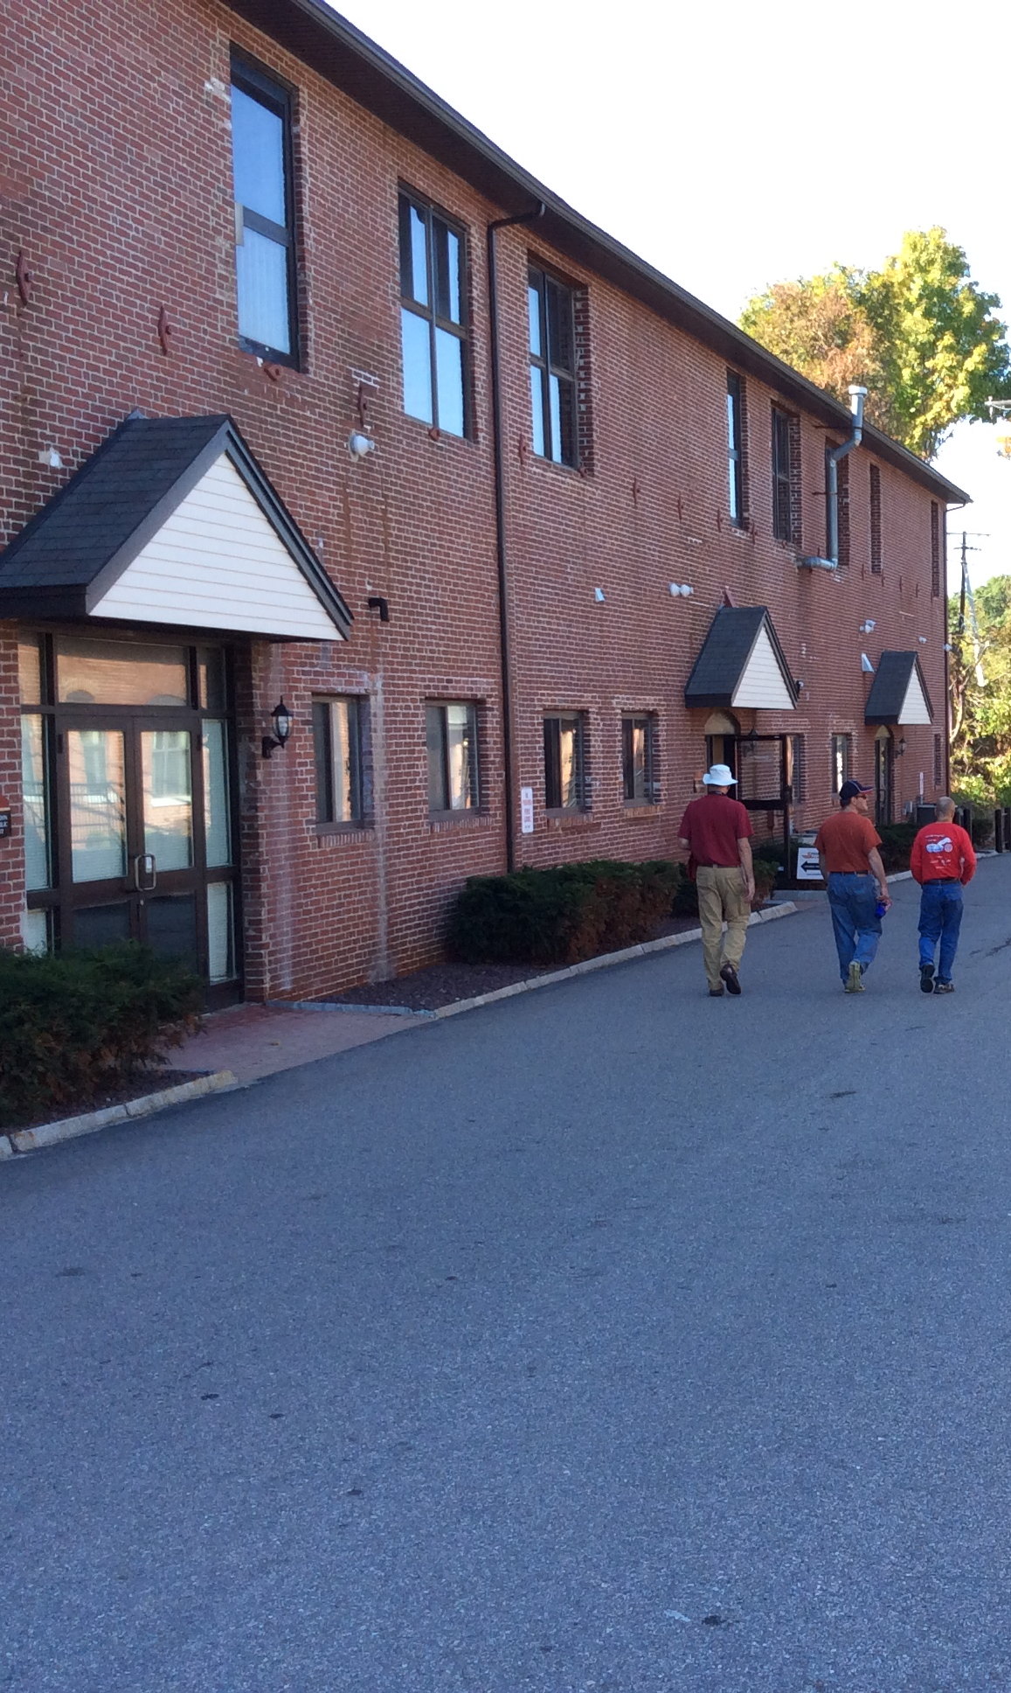
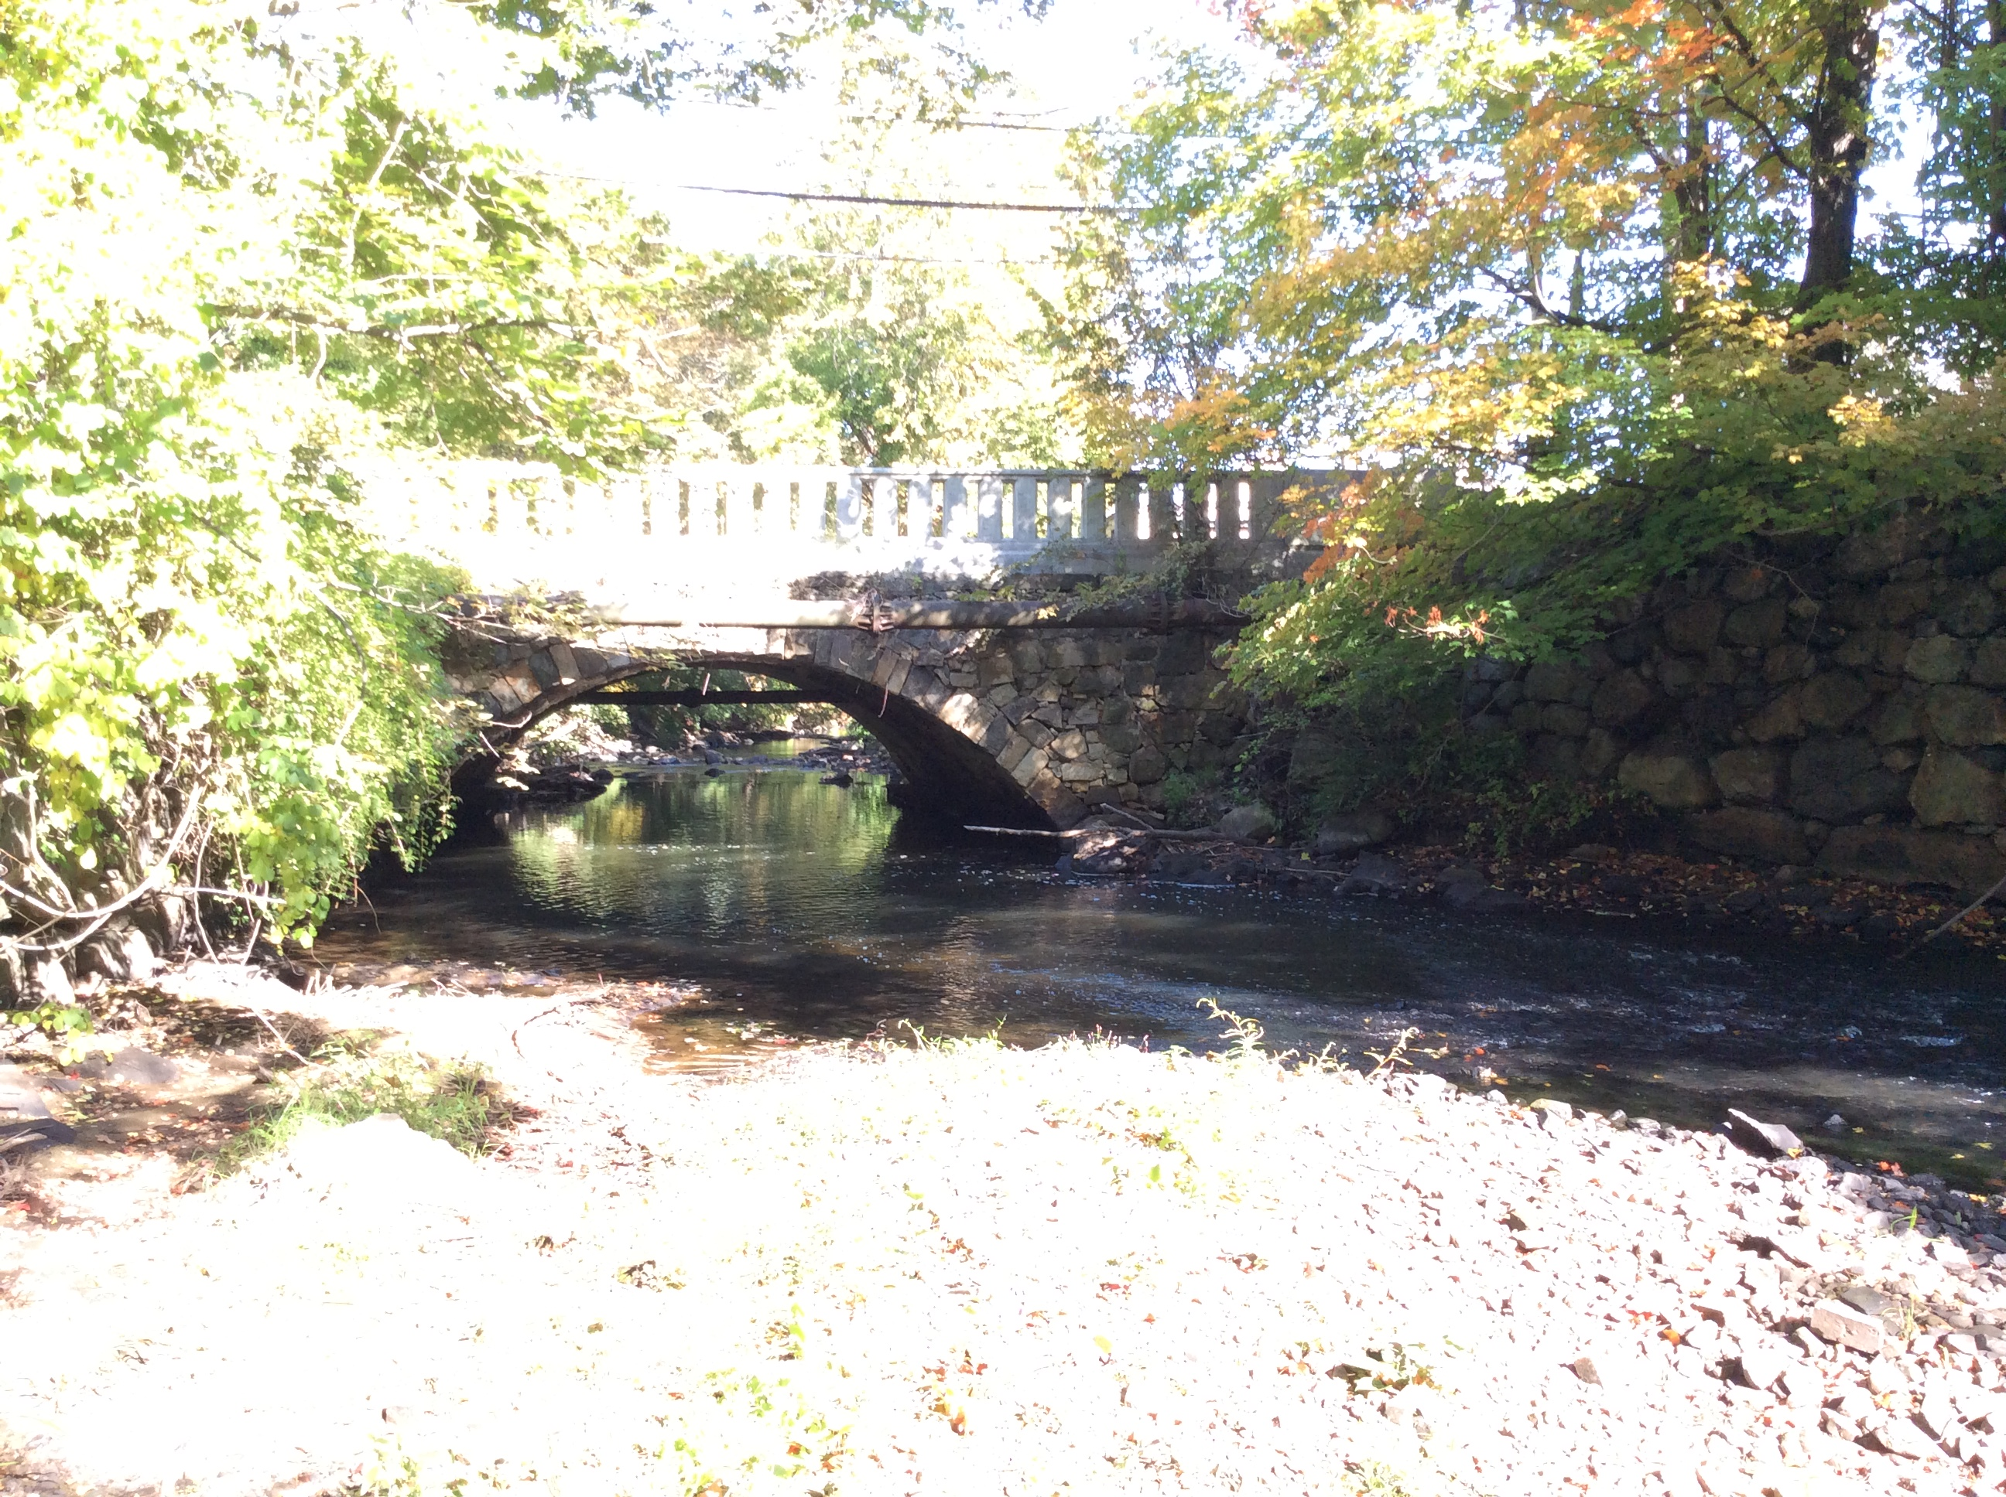
Example: Andover Historic Mill District
THE VIDEO = http://www.bit.ly/andoverhistoricmilldistrict

Slide 5
Summary: Andover Historic Mill District
Mixed Use/TODD Zoning Overlay District
3x Rejected Proposal
7 acres, then 15 acres, then 30 acres
$$$ Spent on engineering/studies
Developers drove the process
Timeline > 14 years
Andover Historic Mill District
Overwhelming Approval
100+ acres
$10k donation to pay for collateral and video
Voters drove the process
Timeline > 11 months

Slide 6
AHMD Progress Continues…
AHMD Design Review Guidelines
Committee formed, consultant hired
Community Forum (TONIGHT!)
Town Yard Relocation Part One
Vote to purchase land to relocate the Municipal Services Facility
Nearly unanimous vote (May 2016)
Town Yard Relocation Part Two
Vote to construct a new Municipal Services Facility ($17.5M)
Nearly unanimous vote (May 2017)

