Slide 1


Climate Adaption and Resiliency
Wayne Feiden, FAICP
Director of Planning and Sustainability
City of Northampton

Slide 2
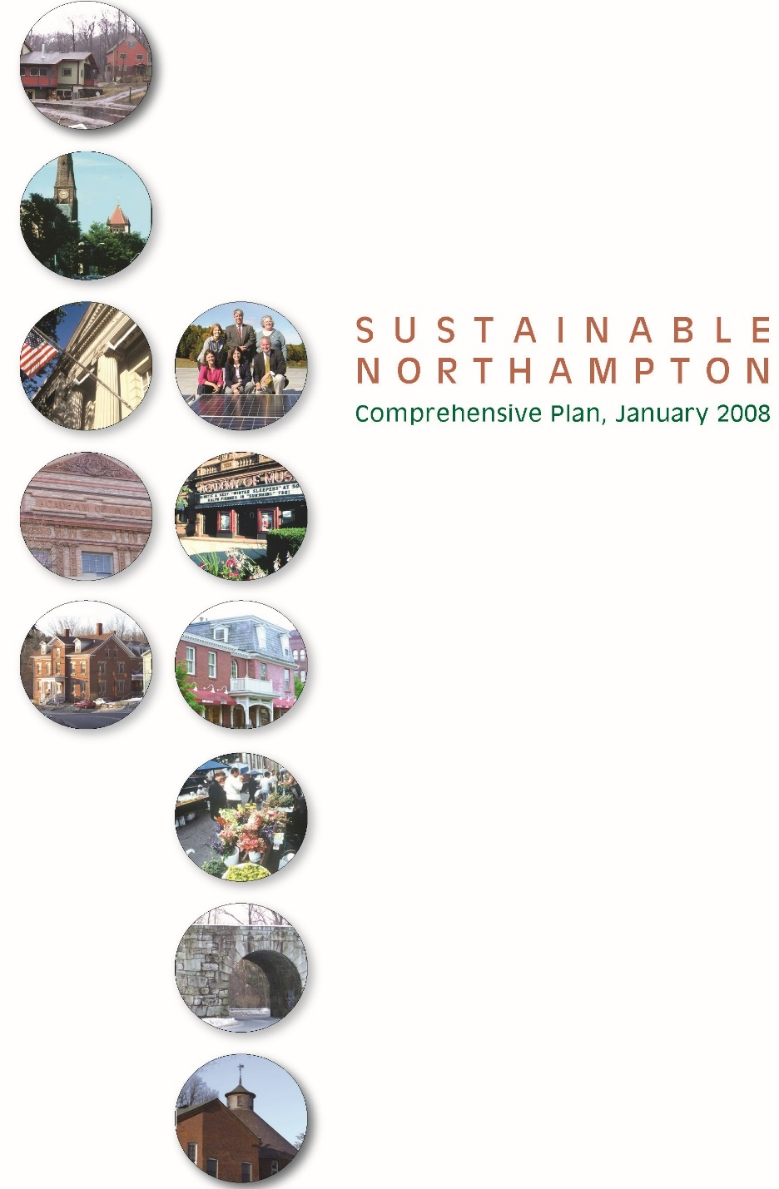



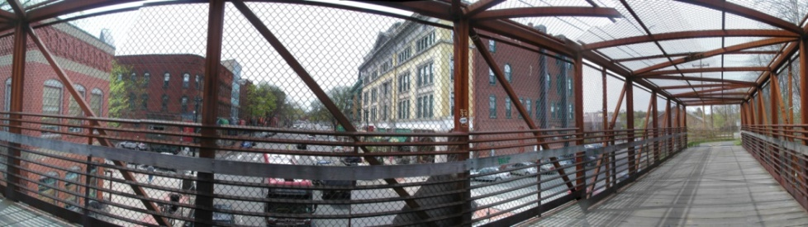
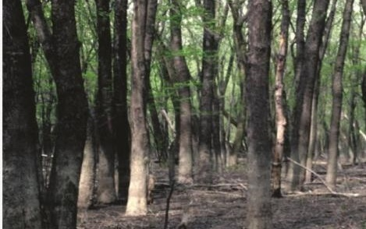
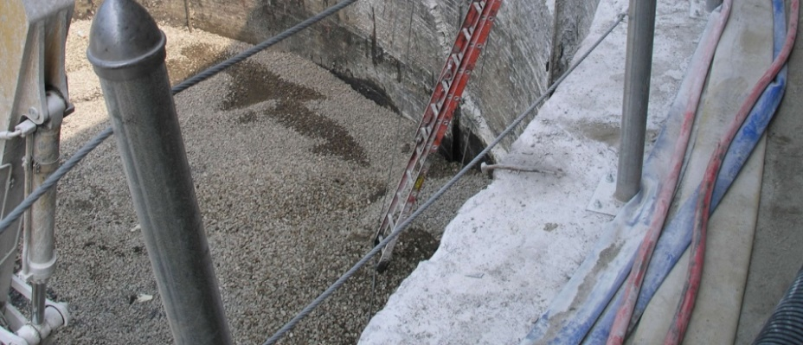
Built Environment
Health & Safety
Transportation
Natural Systems
Equity/Empowerment

Slide 3
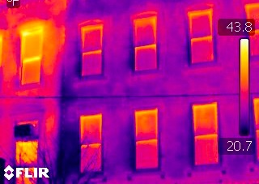
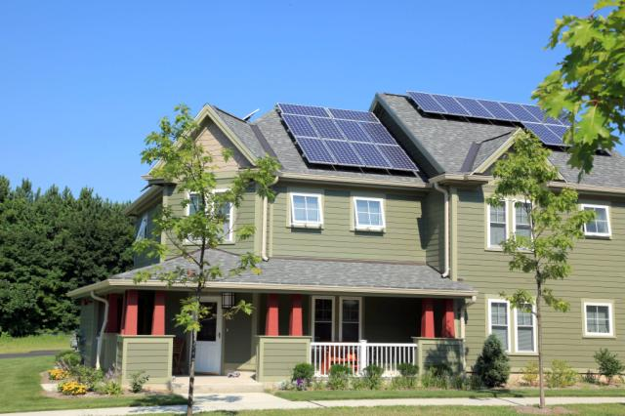
Climate Mitigation: part of adaptation
20% reduction city government energy
Energy concierge
Energy & Sustainability Commission
Zoning incentives & requirements
Average new home <40 HERs rating
SREC: revolving clean energy $$$

Slide 4
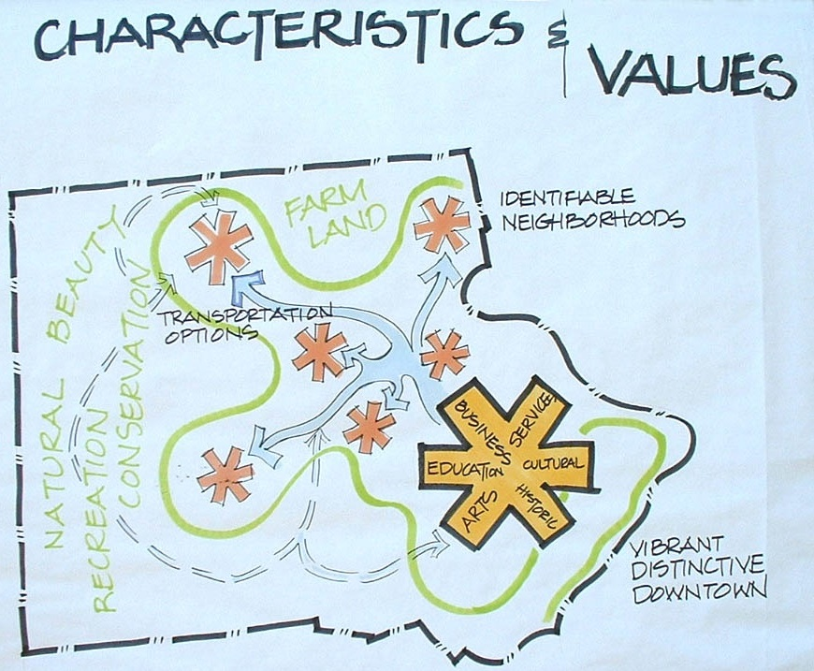

Community Values and Conversation

Slide 5
Climate Change expectations
Medium term
Event | Before | After
Avg. Summer temp | 68˚ | 74˚-82˚
Days over 90˚ | 5-20 | 30-60
Annual precipitation | 41” | 44-47”
Peak storms |  | INCREASE
Data uncertainties and sensitivity
Possible regional predictive model

Slide 6
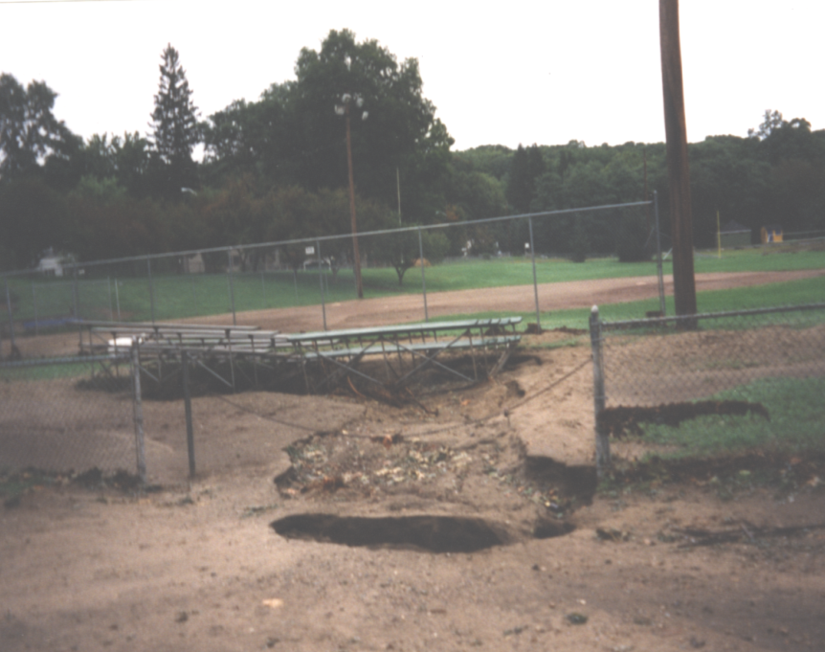
Multi-Hazard Mitigation Planning
Evolving natural hazards
FEMA: “…sustained action to reduce or eliminate long-term risk…from natural hazards…”
Northampton=$2.5 million FEMA mitigation
Less expensive than disaster: 100 year storm=$25 million

Slide 7
Northampton Hazard Assessment
Type | Location | Probability | Impact | Hazard Risk
Flooding | Medium | High | Limited | 2
Severe Ice and Snowstorms | Large | High | Minor | 3
Severe Thunderstorms / winds / tornadoes | Small / Small / Medium | Low / Low / Very Low | Critical | 2 / 4
Hurricanes | Large | Low | Critical | 2
Wildfire/Brushfire | Small | Low | Minor | 4
Earthquakes | Large | Very low | Critical | 4
Dike/Dam Failure | Large | Very low | Catastrophic | 2

Slide 8
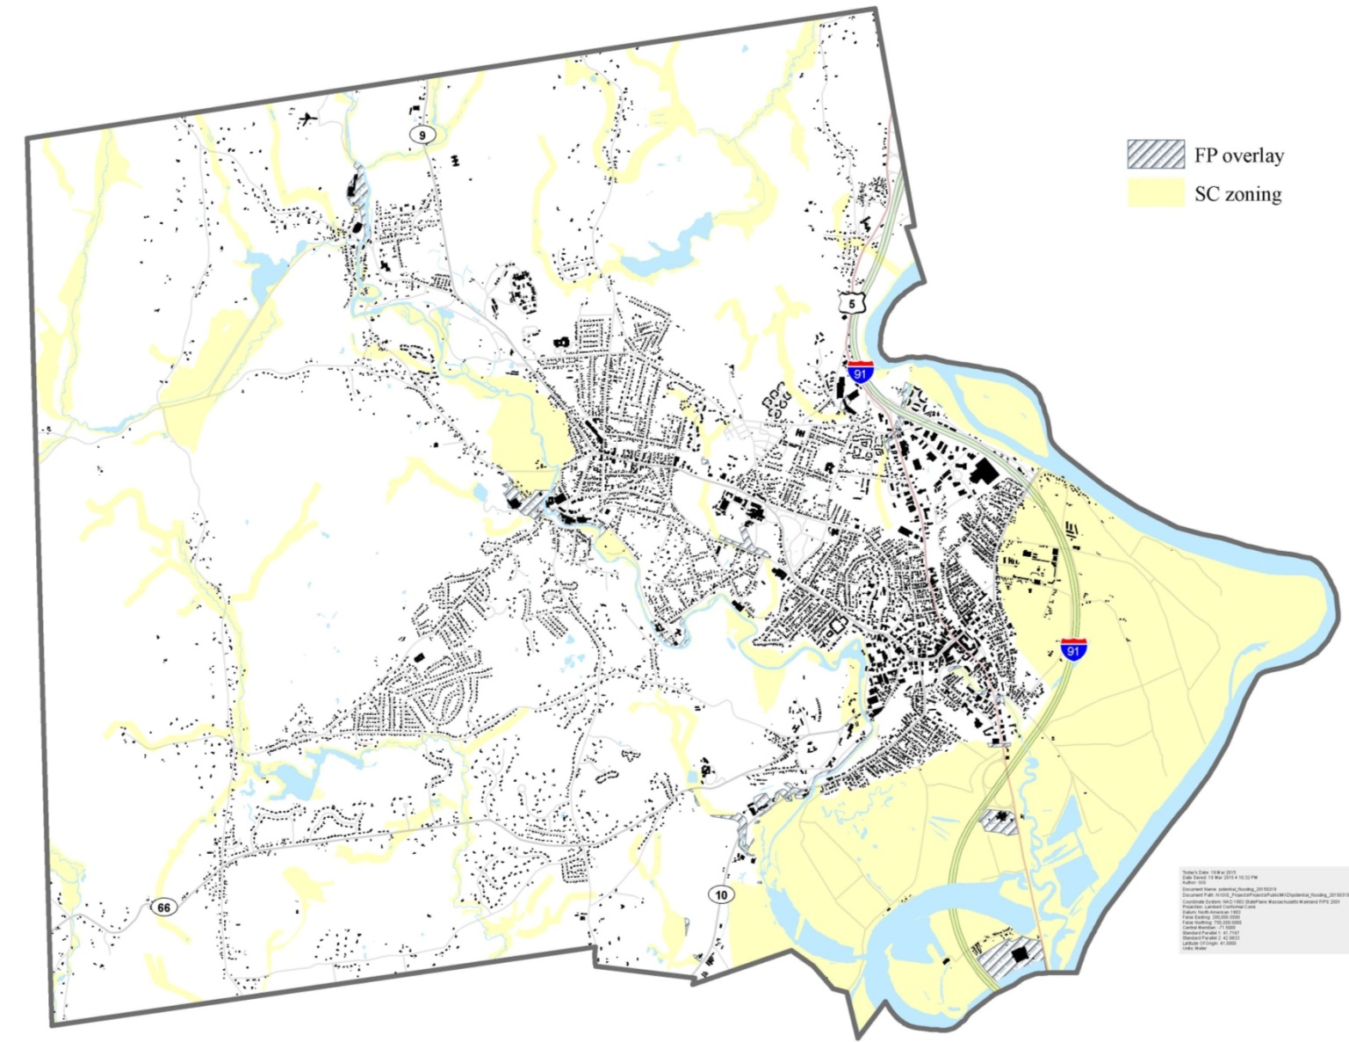
Zoning for Climate Change
Flood Hazard Areas: 100 & 500 year

Slide 9
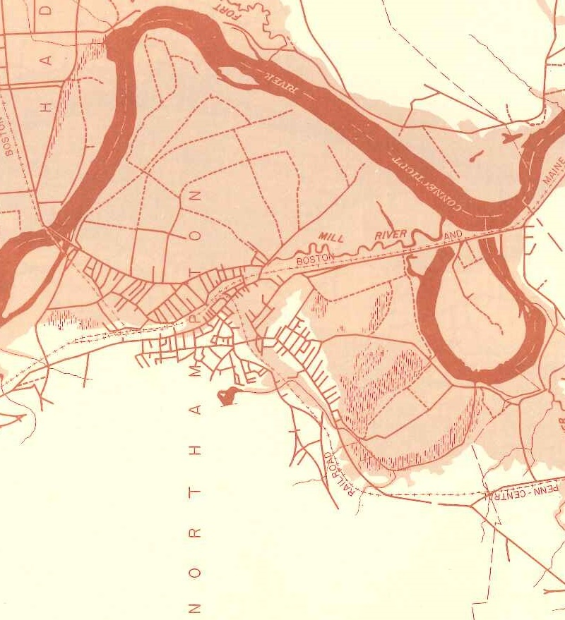
Added Flood Hazard: Dike Breach

Slide 10
Critical Infrastructure Affected
Hazard | Area | Critical Facilities
Flooding | Mill & Connecticut Rivers | IF dikes fail, all downtown
Severe Snowstorms / Ice Storms | Entire City | Hospital power outage Nursing Homes
Severe Thunderstorms / wind / tornadoes | Entire City: Pine Brook (2000), Burts Pit (2002) | Site Specific
Hurricanes | Mill & Connecticut Rivers | IF dike fail, all downtown
Wild/Brushfire | Western Northampton | Watershed Lands
Earthquakes | Entire City | Emergency operations; all structures; shelters; waste treatment
Dam Failure | Mill River | Downstream structures
Drought | Entire City | Fire fighting operations

Slide 11
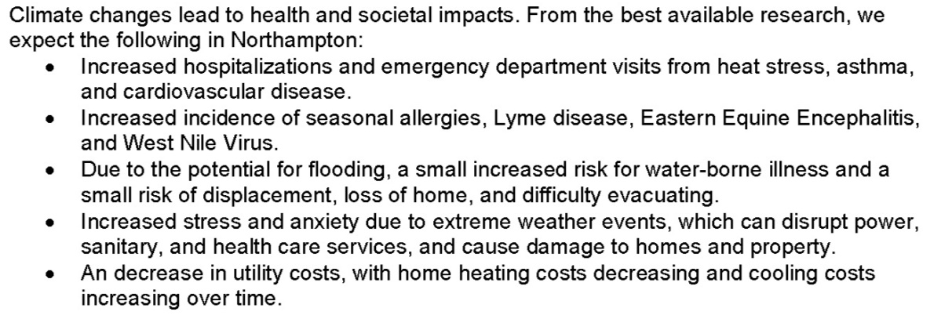
Health Assessment Climate Change
Public health at the table
Address social equity
Community conversation
More informed vulnerability assessment

Slide 12
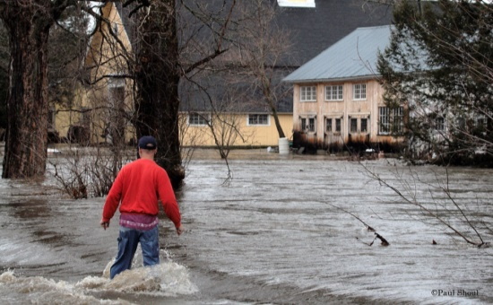
Climate Adaptation
Street trees from warmer climates
No-build in 500 year floodplain
Storm-water standards
Land-use for walkable communities
Micro-grid underway (shelter, DPW, hospital)
Green infrastructure for stormwater
Emergency cooling shelter

Slide 13
Climate Adaptation: Staff
 | Plan & Sustain | DPW | Central | Other
Adaption Plan | Lead | Support | Support | Support
Land Use | Lead
Sustainable Transport | Lead | Support (does traditional)
Energy & Climate mitigation | Support | Support | Lead
Stormwater | Support | Lead
Hazard Mitigation | Lead Planning | Lead bricks & mortar |  | Emergency supports
Health | Lead active living |  |  | Health- lead
Downtown | Lead planning |  | parking | Econ. Director private sector
Natural systems | Lead | Lead- water

Slide 14
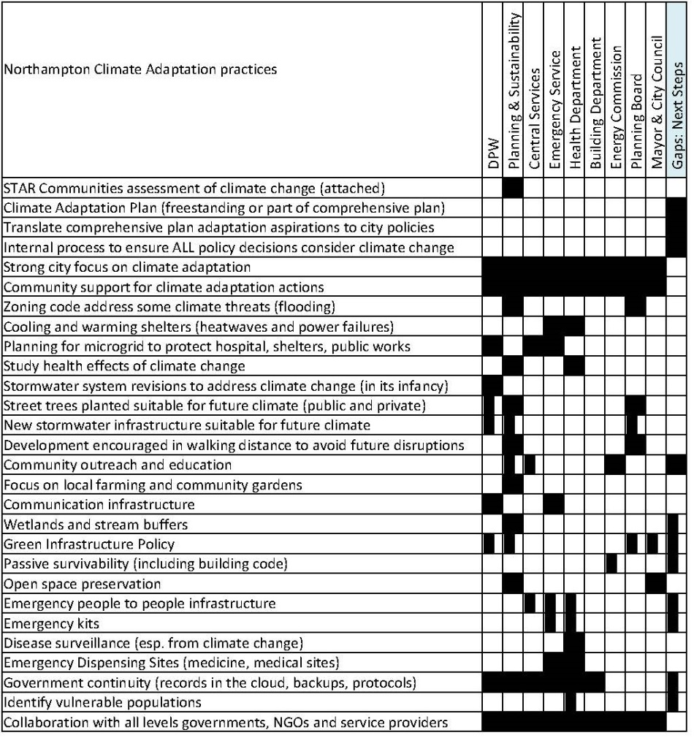
Climate Adaptation Plan Framework
Hazard & flooding mitigation
Storm-water
Acute (e.g., storm)
Chronic (health & disease)
Food
Land Use

Slide 15
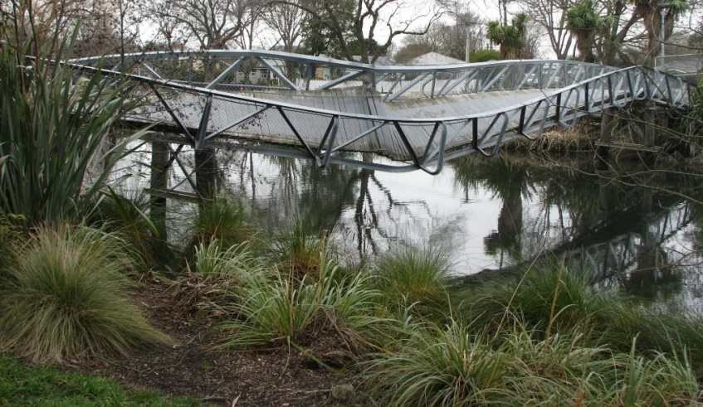
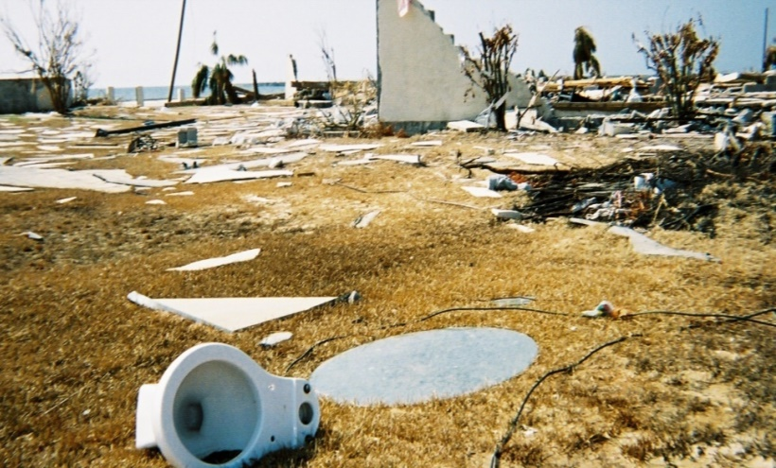
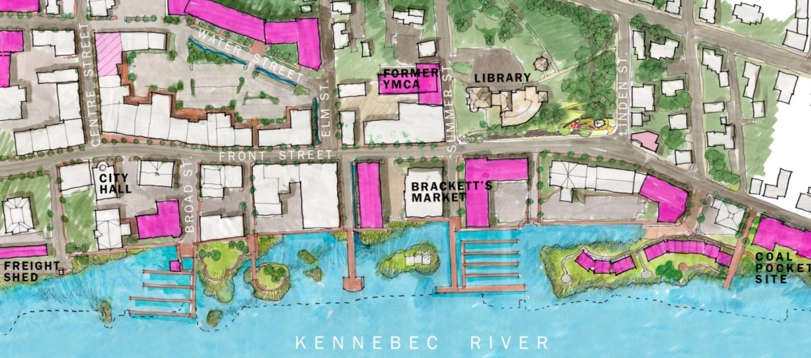
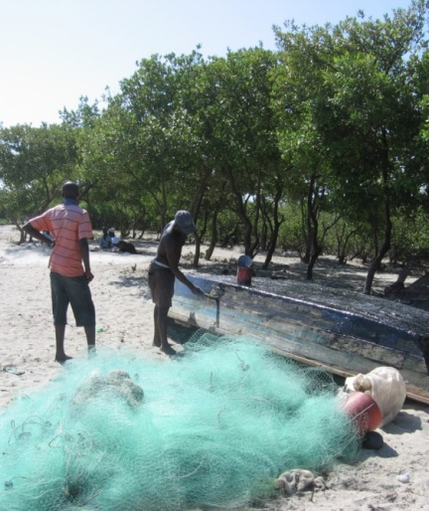
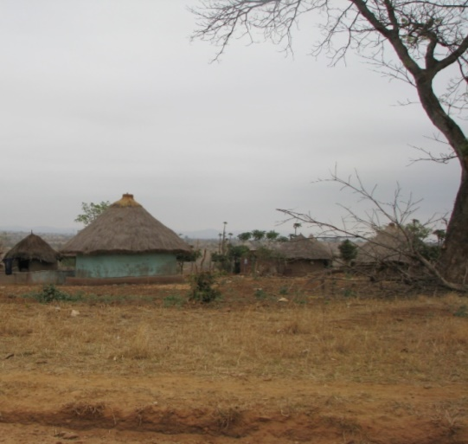
community
The right time for ˄change
Providence
2010
Christchurch-2010
Katrina-2005
Bath, Maine
Haiti-2010
South Africa

