Slide 1
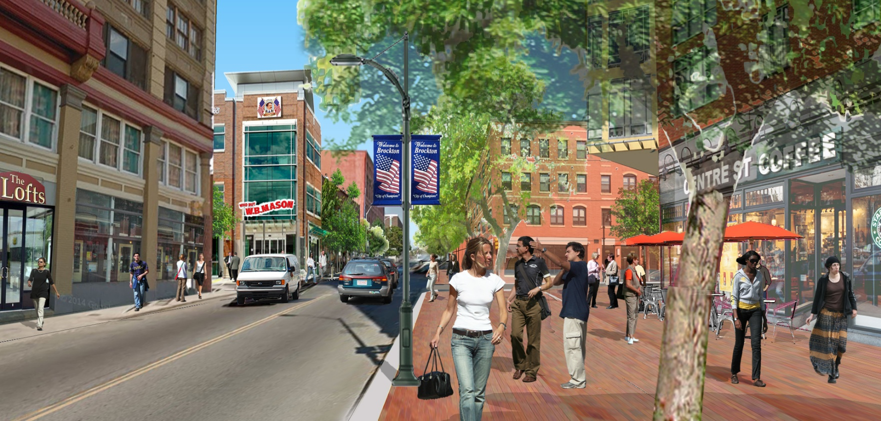
The Layered Approach
Rob May
Director of Planning & Economic Development
City of Brockton

Slide 2
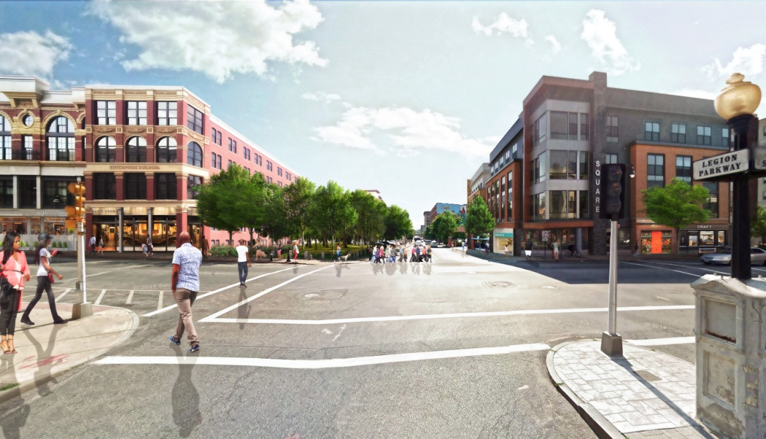
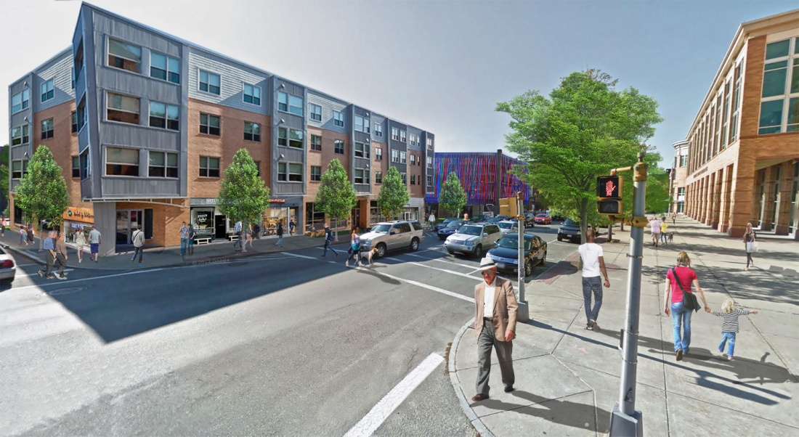
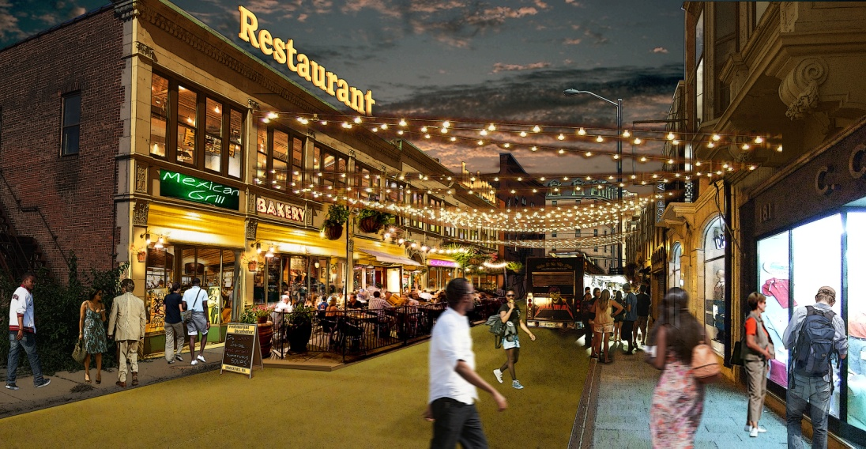

Slide 3
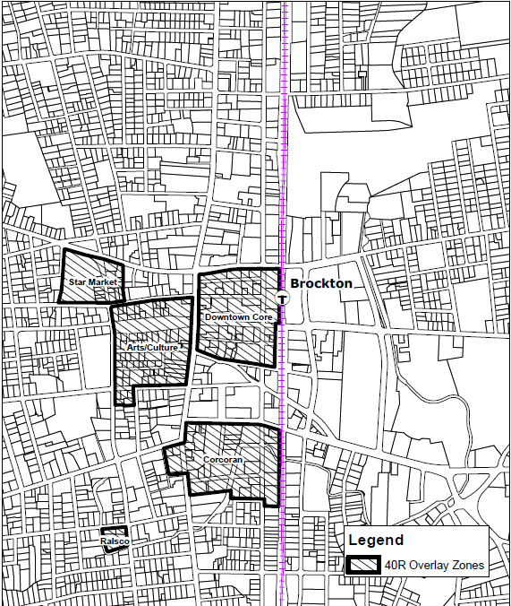
40-R
Smart Growth

Slide 4
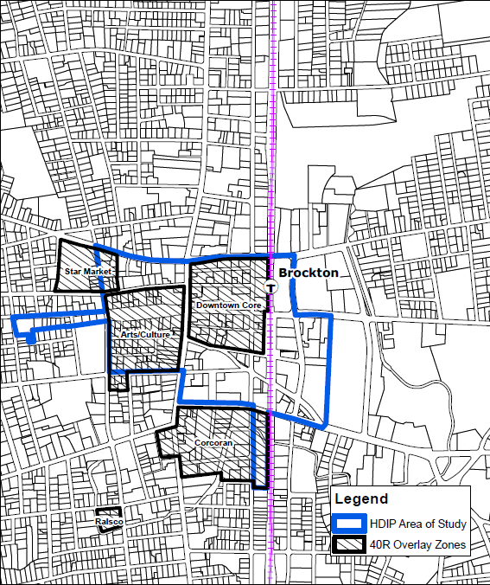
40-V
HDIP

Slide 5
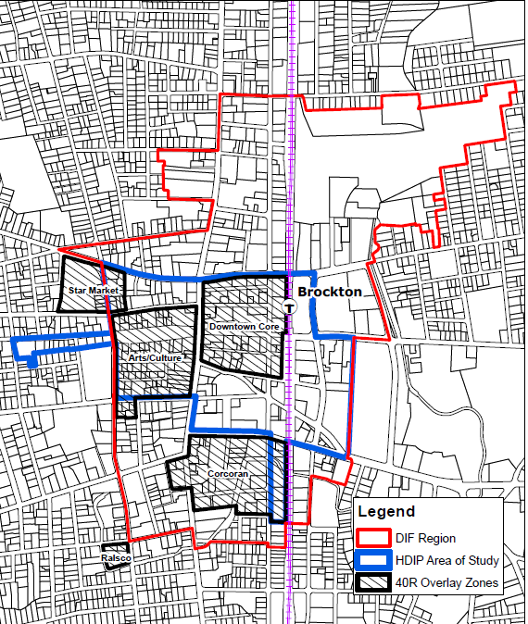
40-Q
DIF

Slide 6
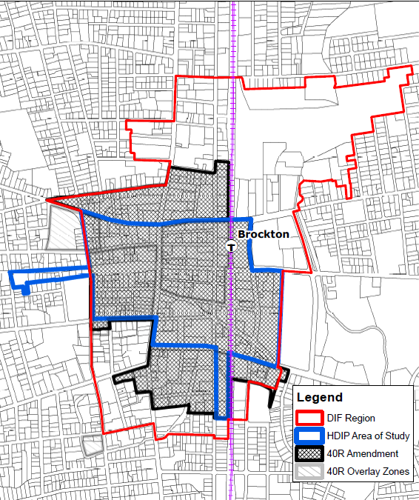
40-R
Smart Growth
Proposed Amendment

Slide 7
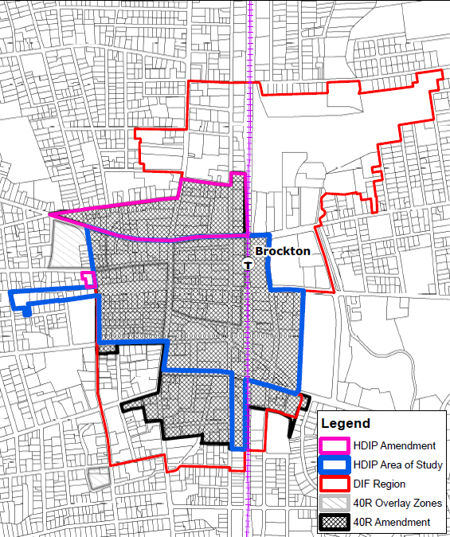
40-V
HDIP
Amendment

Slide 8
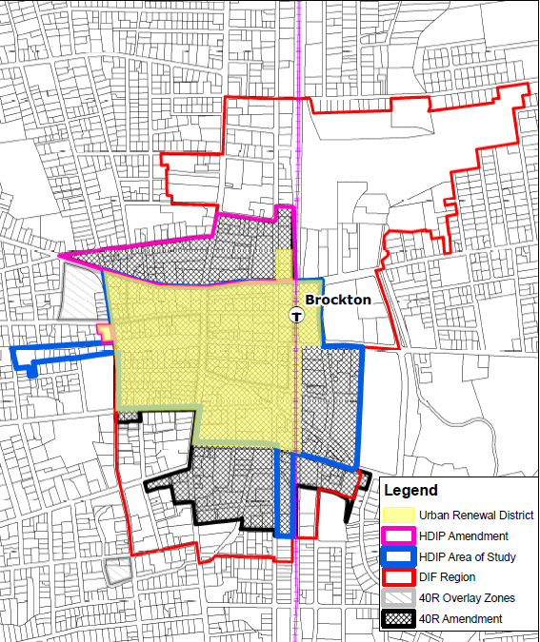
121-B
Urban Renewal

Slide 9
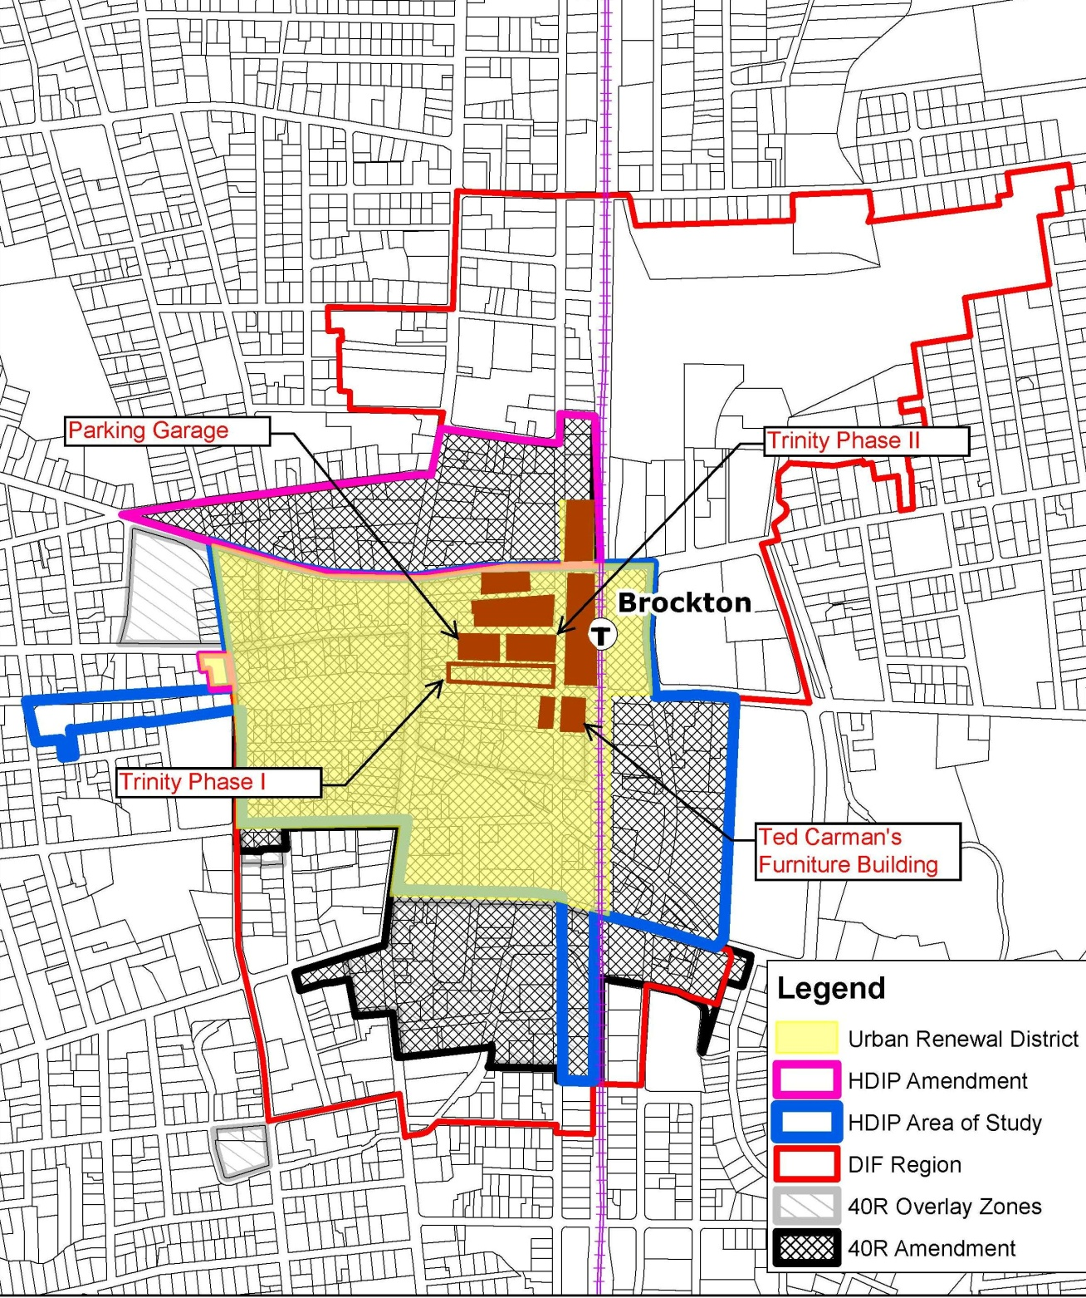
Action Strategy
Catalytic Projects

Slide 10
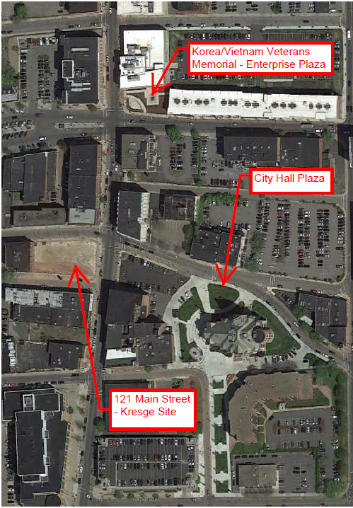
Activating Public Space

Slide 11
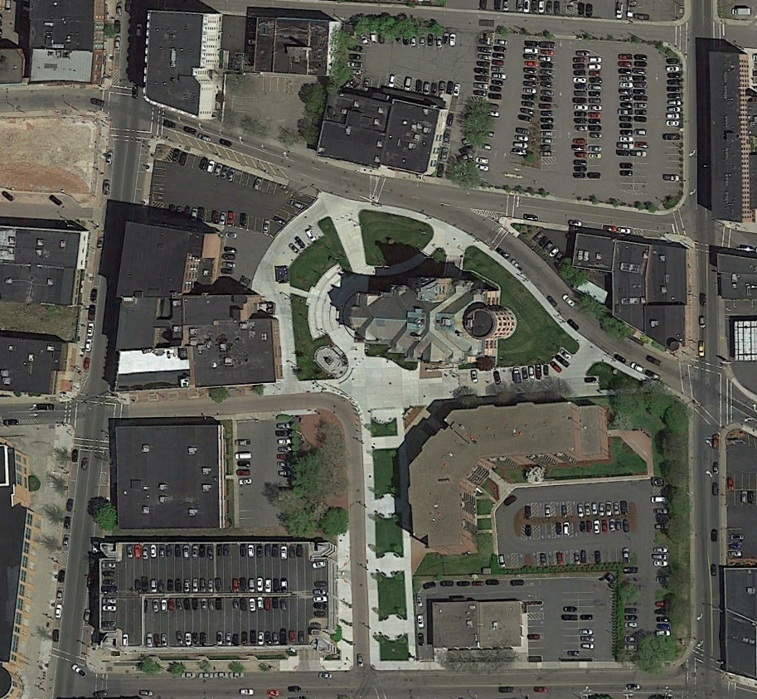
City Hall Plaza

Slide 12
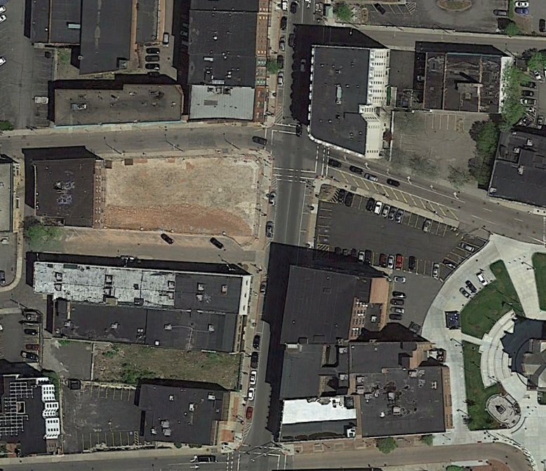
Kresge Site

Slide 13
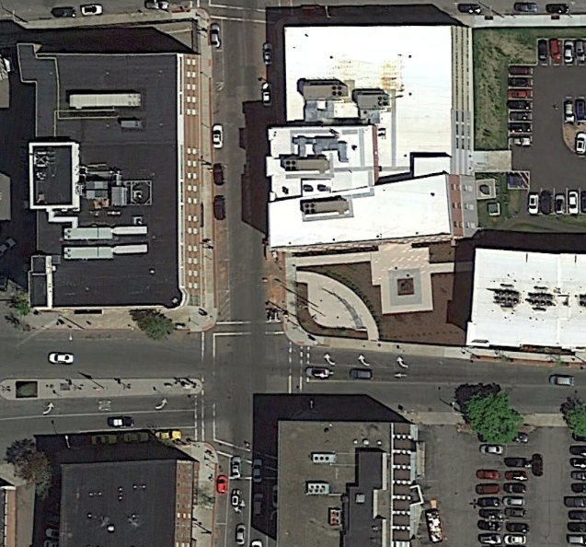
EnterprisePlaza

Slide 14
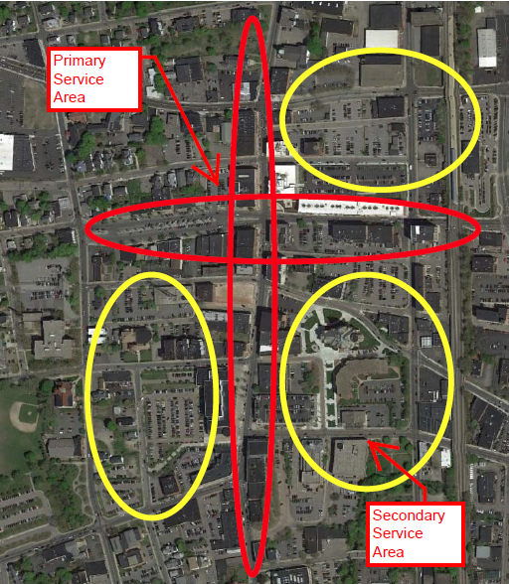
Downtown Clean, Green and Safe Program

Slide 15
