Slide 1
Advanced Placemaking
District Approaches to Place Management
Smart Growth Massachusetts
May 18, 2017
Presented by Marco Li Mandri, President
New City America, Inc.
New City Public Spaces

Slide 2
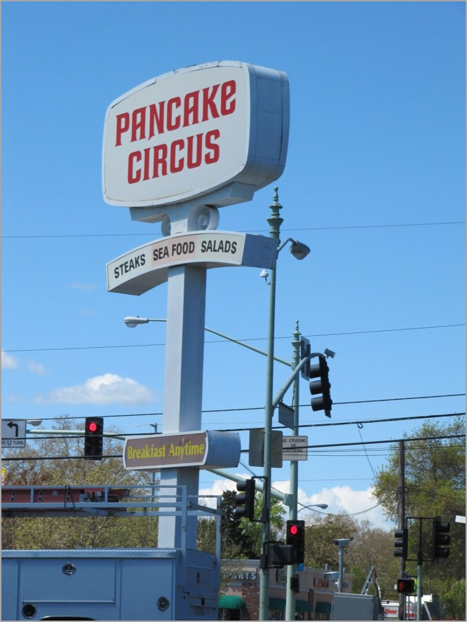

Slide 3
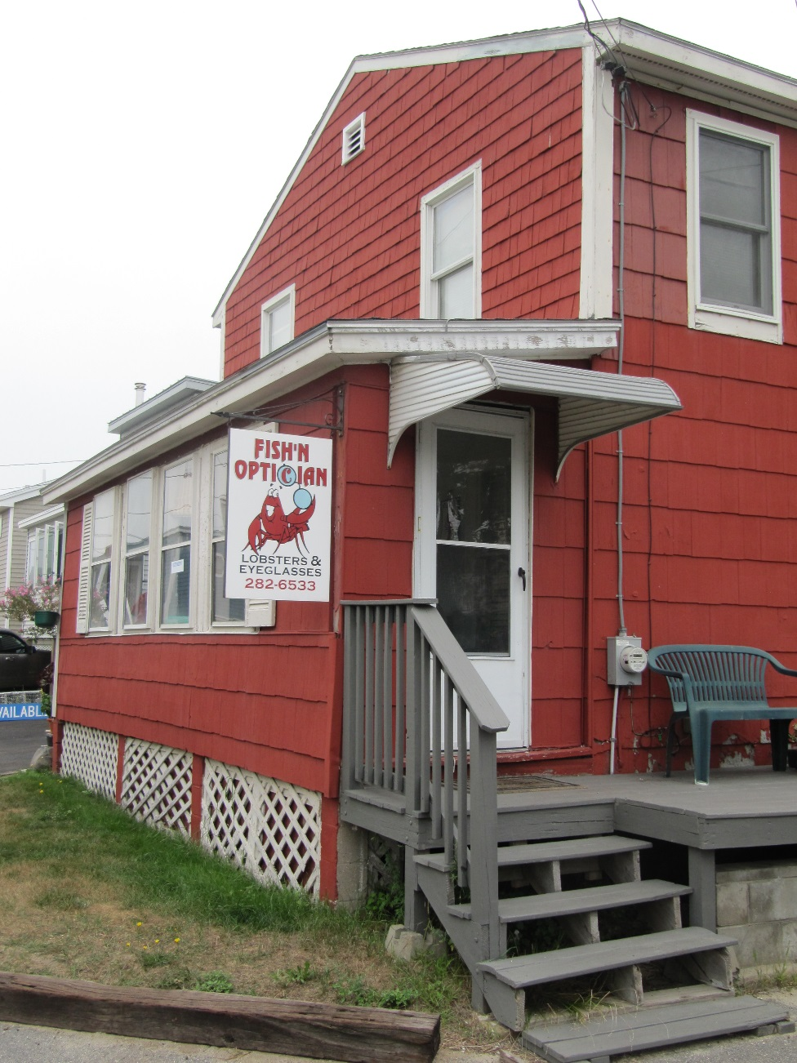

Slide 5
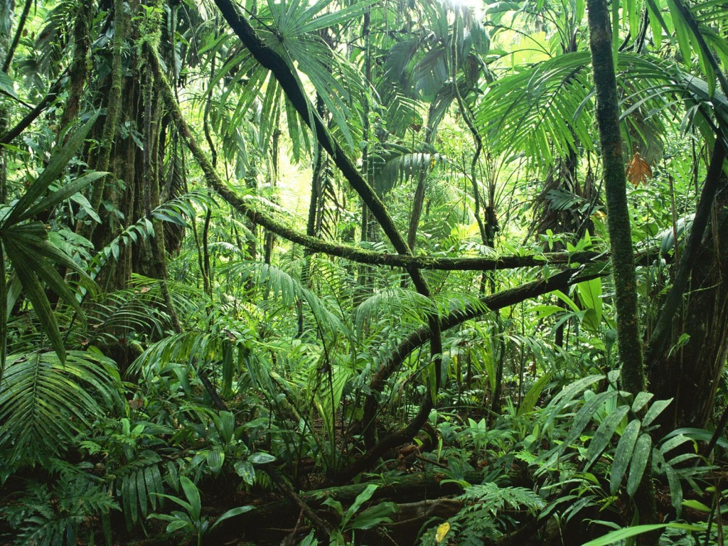

Slide 8
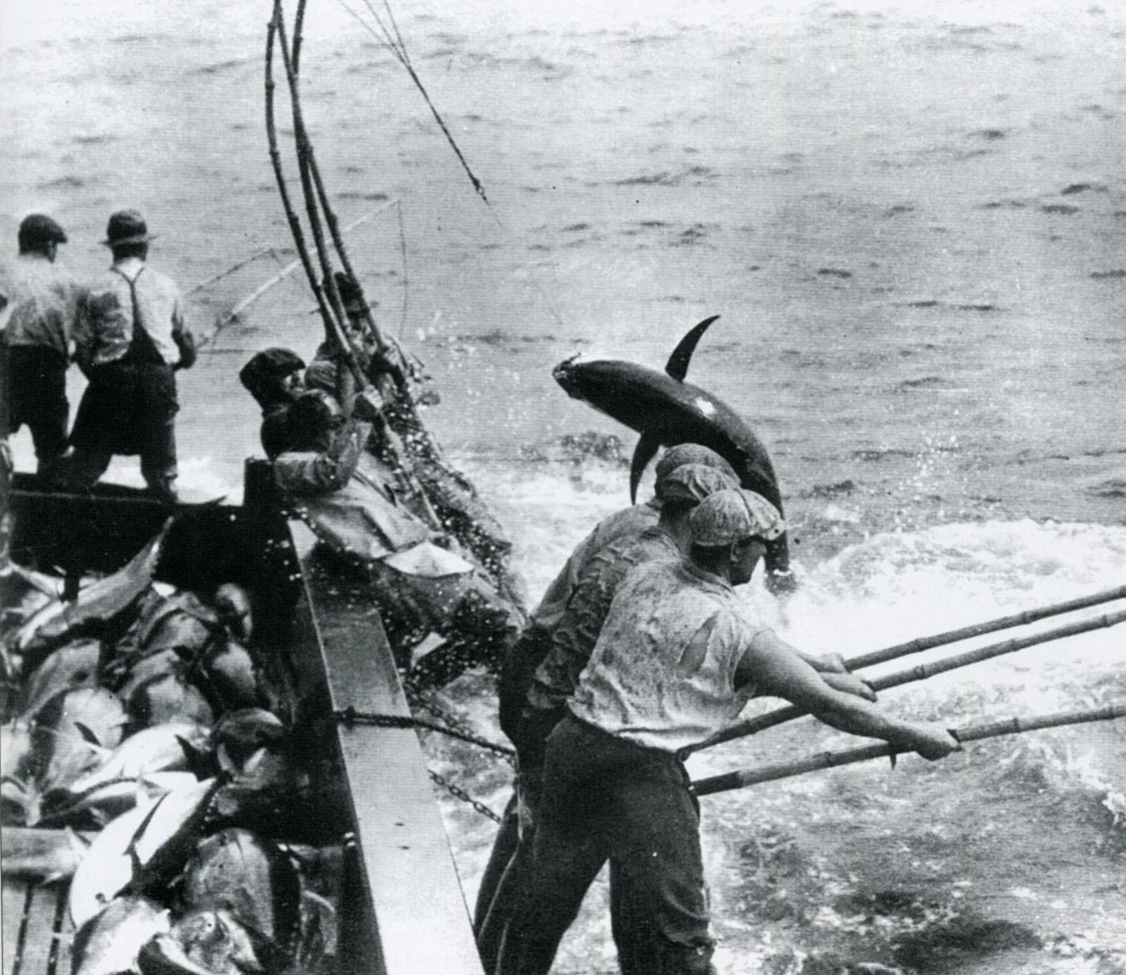
Little Italy Tuna Capital of the World – 1970’s

Slide 9
Laurel St.
Kalmia St.
Juniper St.
Ivy St.
State St.
Columbia St.
India St.
Kettner Blvd.
Pacific Hwy.
Hawthorn St.
N
Grape St.
State St.
Little Italy CBD Today
W
E
Fir St.
S
Elm St.
Date St.
Front St.
Cedar St.
Kettner Blvd.
Beech St.
Pacific Hwy.
India St.
Columbia St.
State St.
Union St.
Map created by New City America Inc.
Ash St.

Slide 10
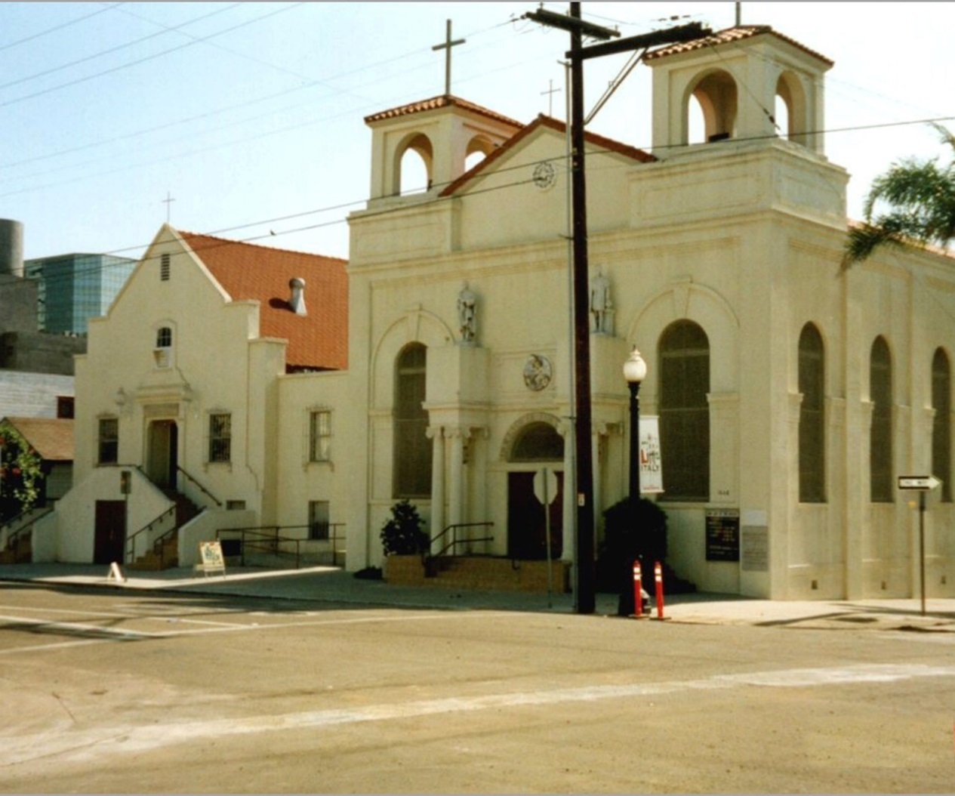
Little Italy - Our Lady of the Rosary Church

Slide 11
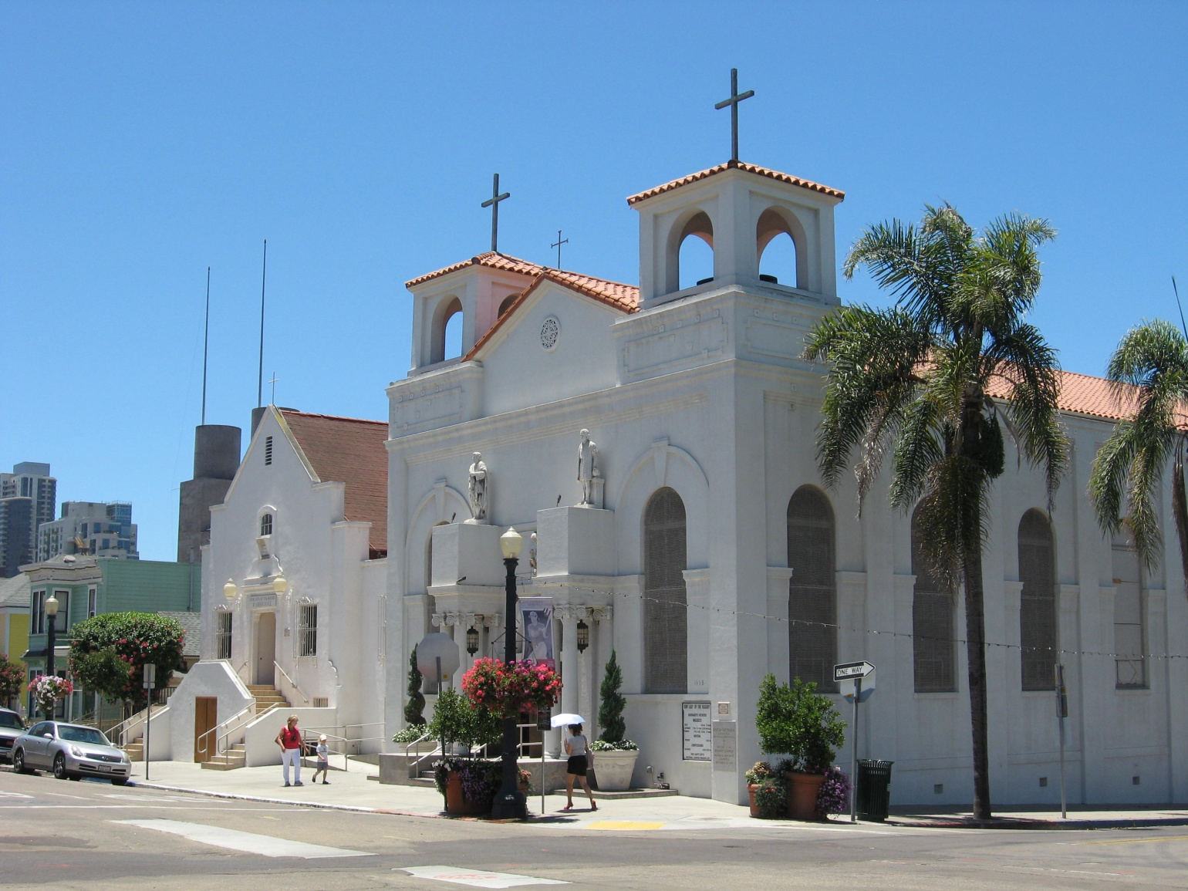
Little Italy - Our Lady of the Rosary Church

Slide 12
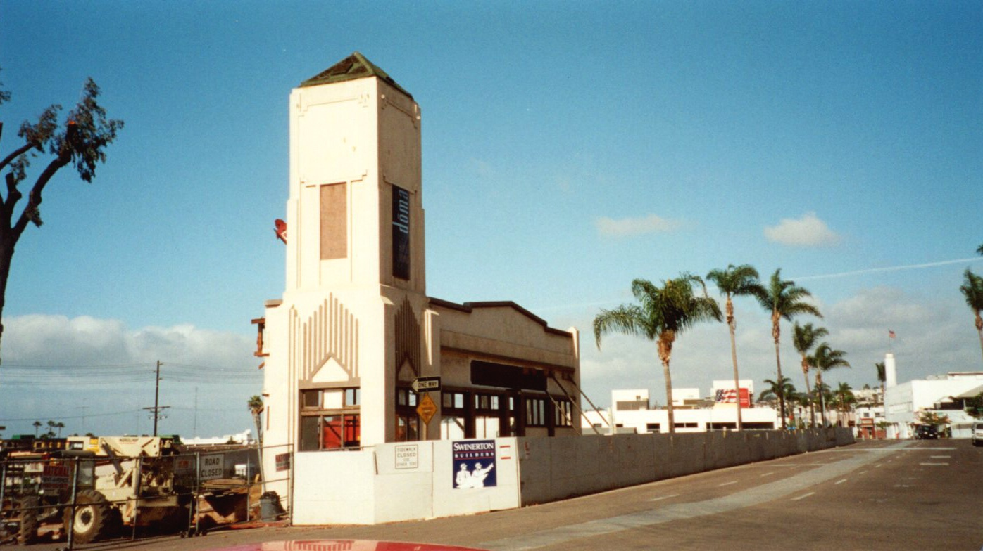
Little Italy - Before

Slide 13
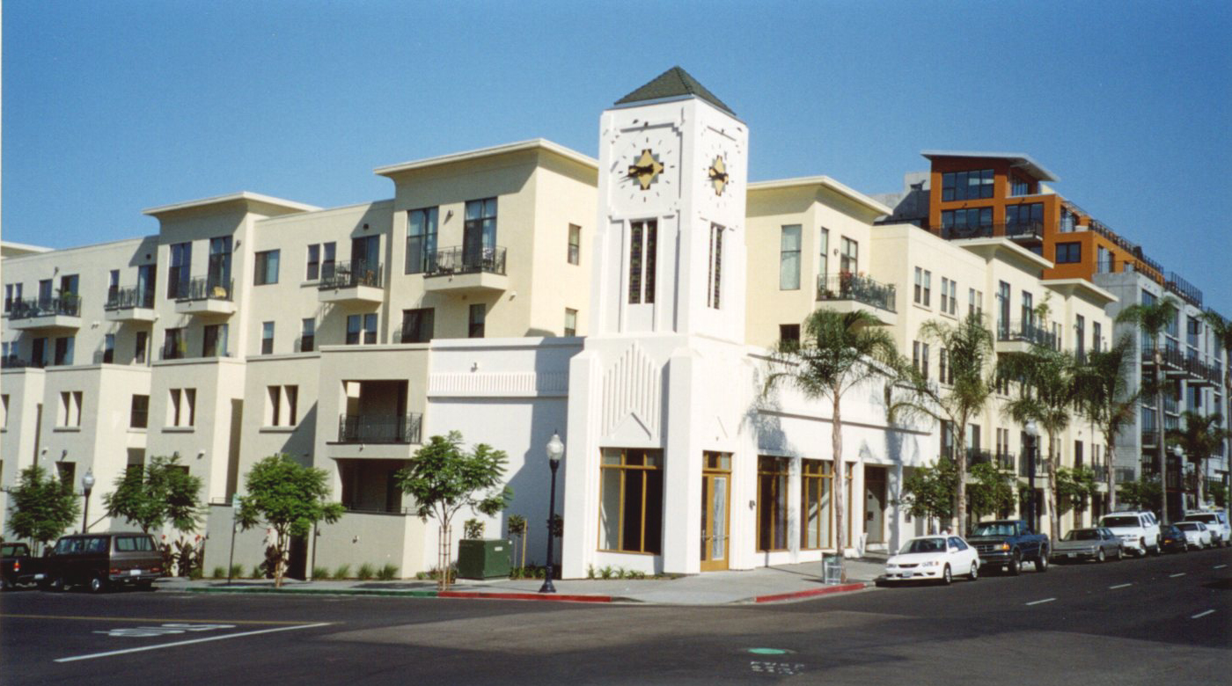
Little Italy - After

Slide 14
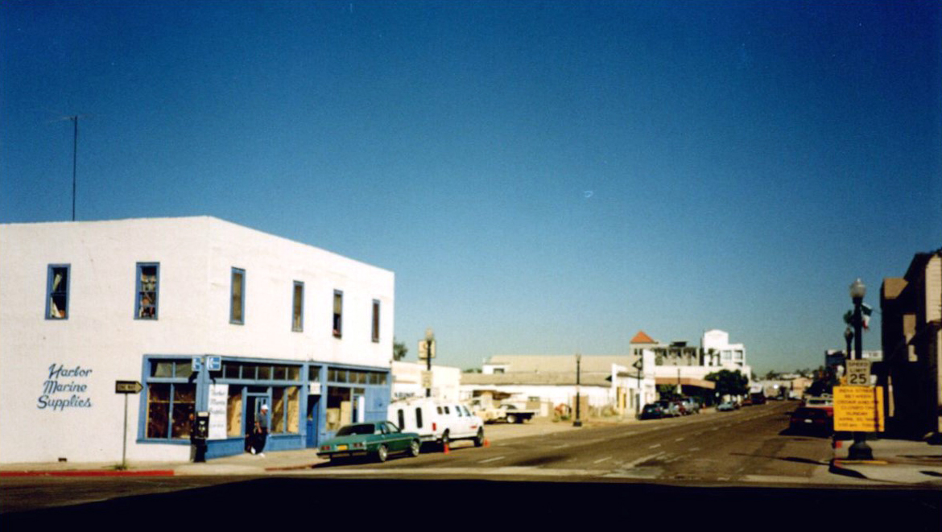
Little Italy - Before

Slide 15
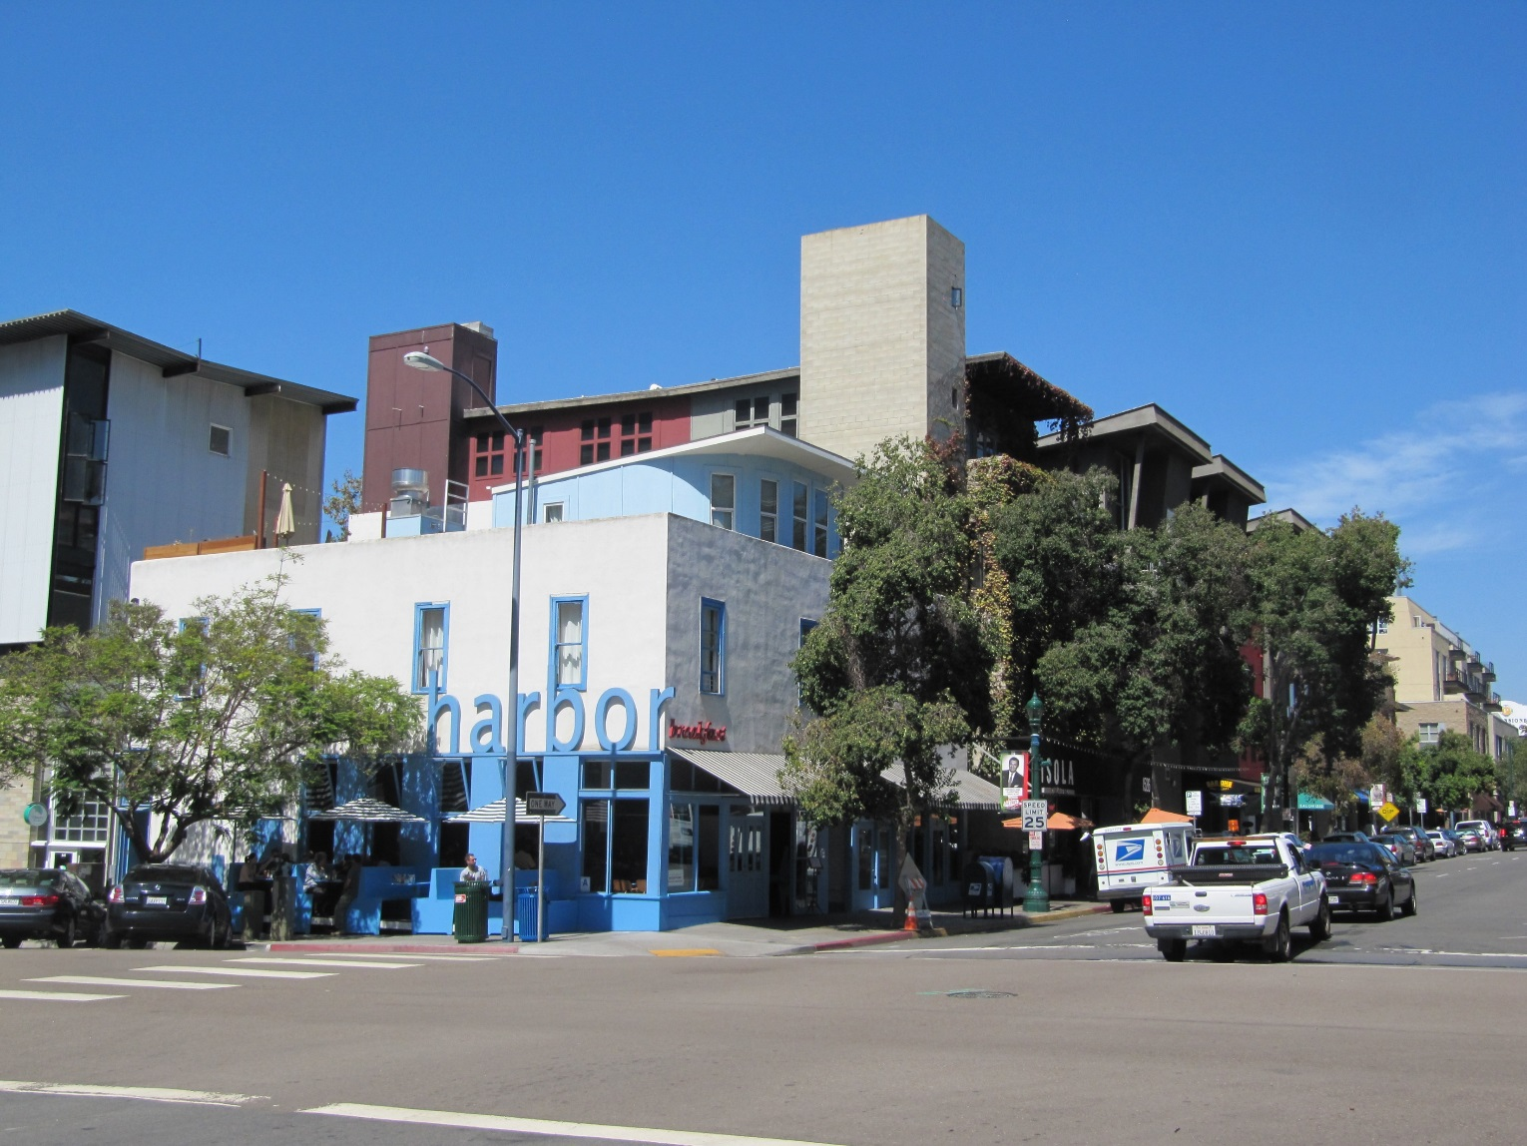
Little Italy - After

Slide 16
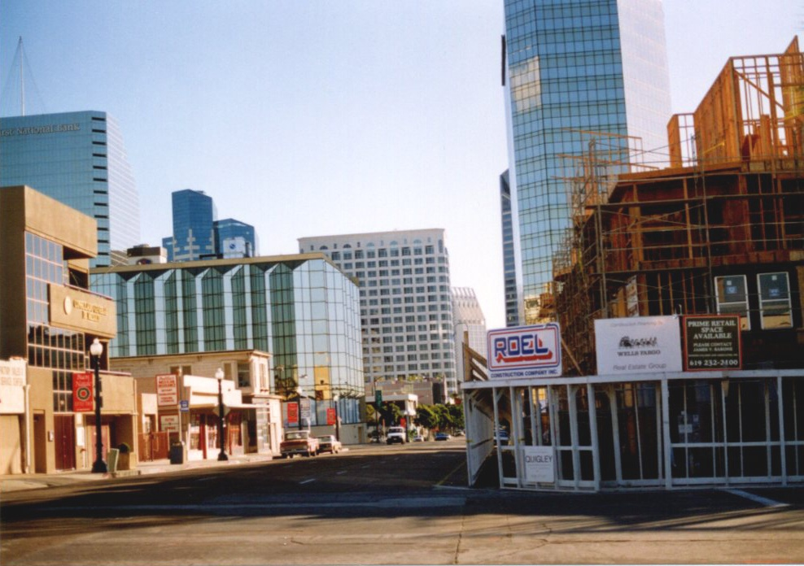
Little Italy - Before

Slide 17
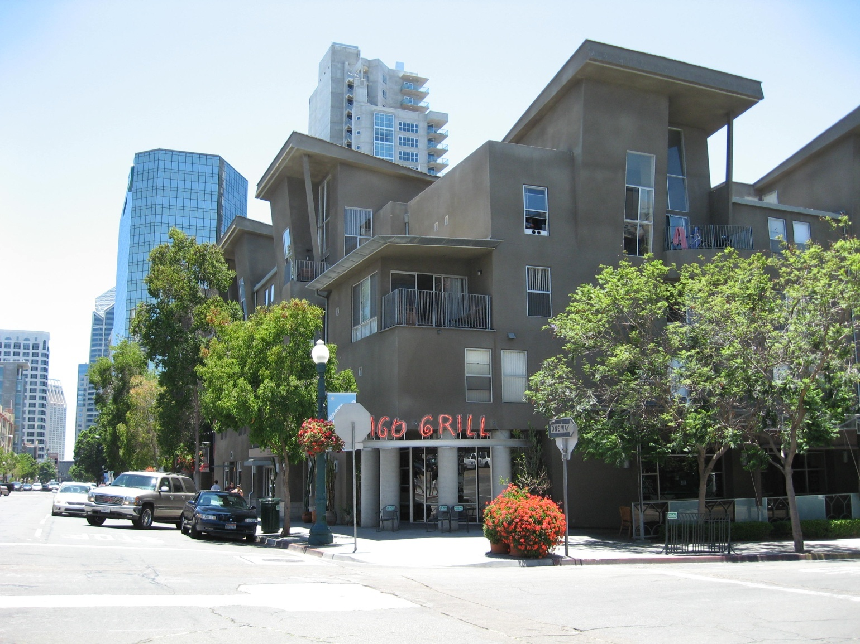
Little Italy - After

Slide 18
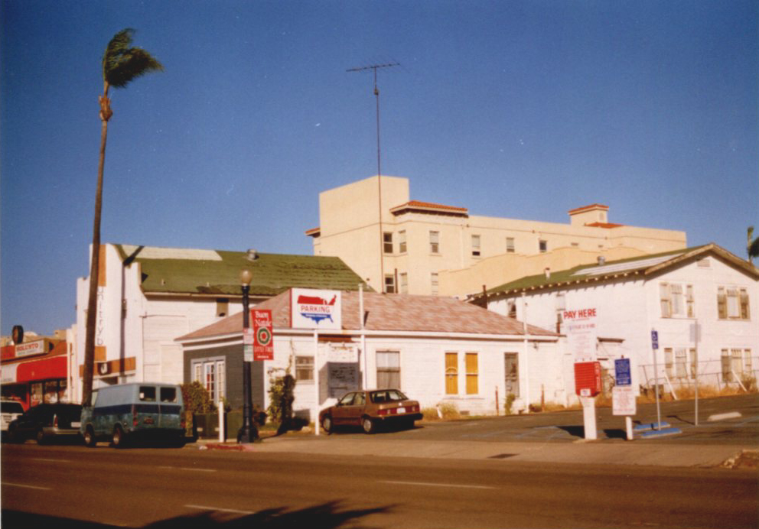
Little Italy - Before

Slide 19
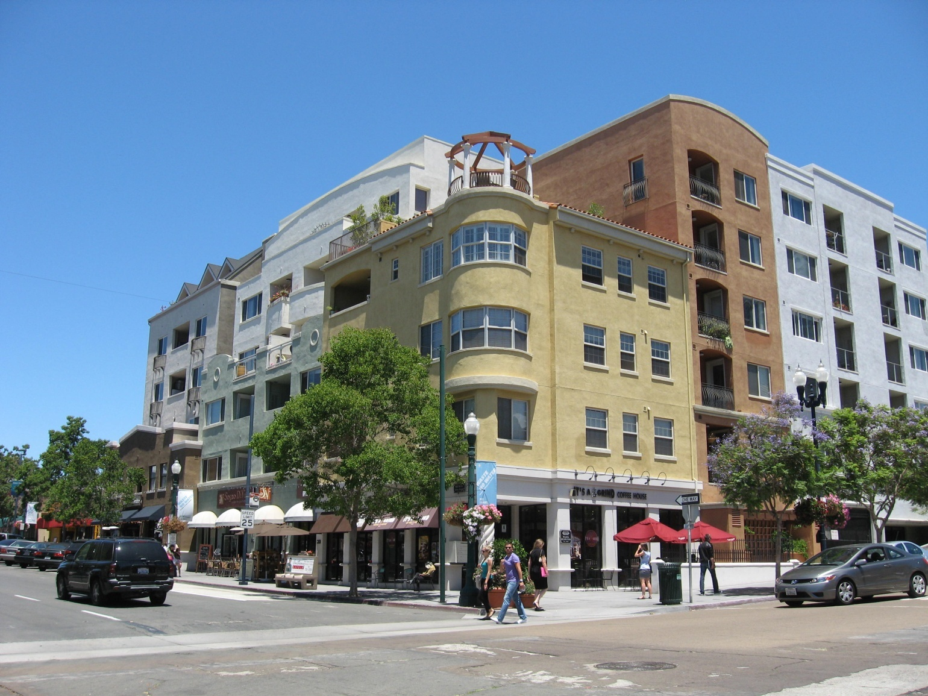
Little Italy - After

Slide 20
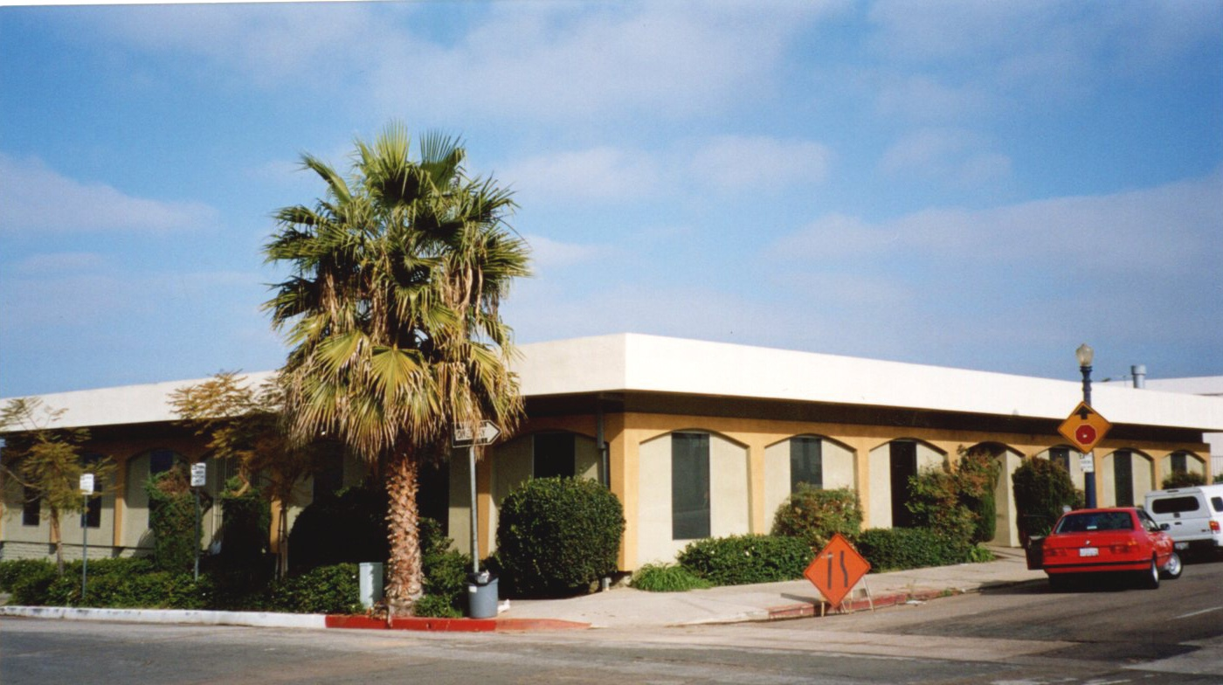
Little Italy - Before

Slide 21
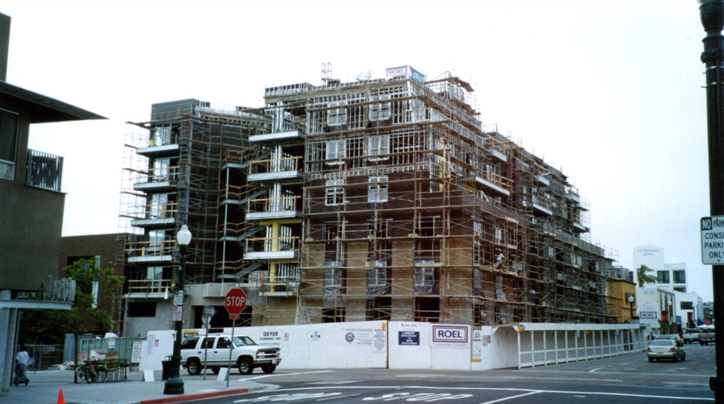
Little Italy - Before

Slide 22
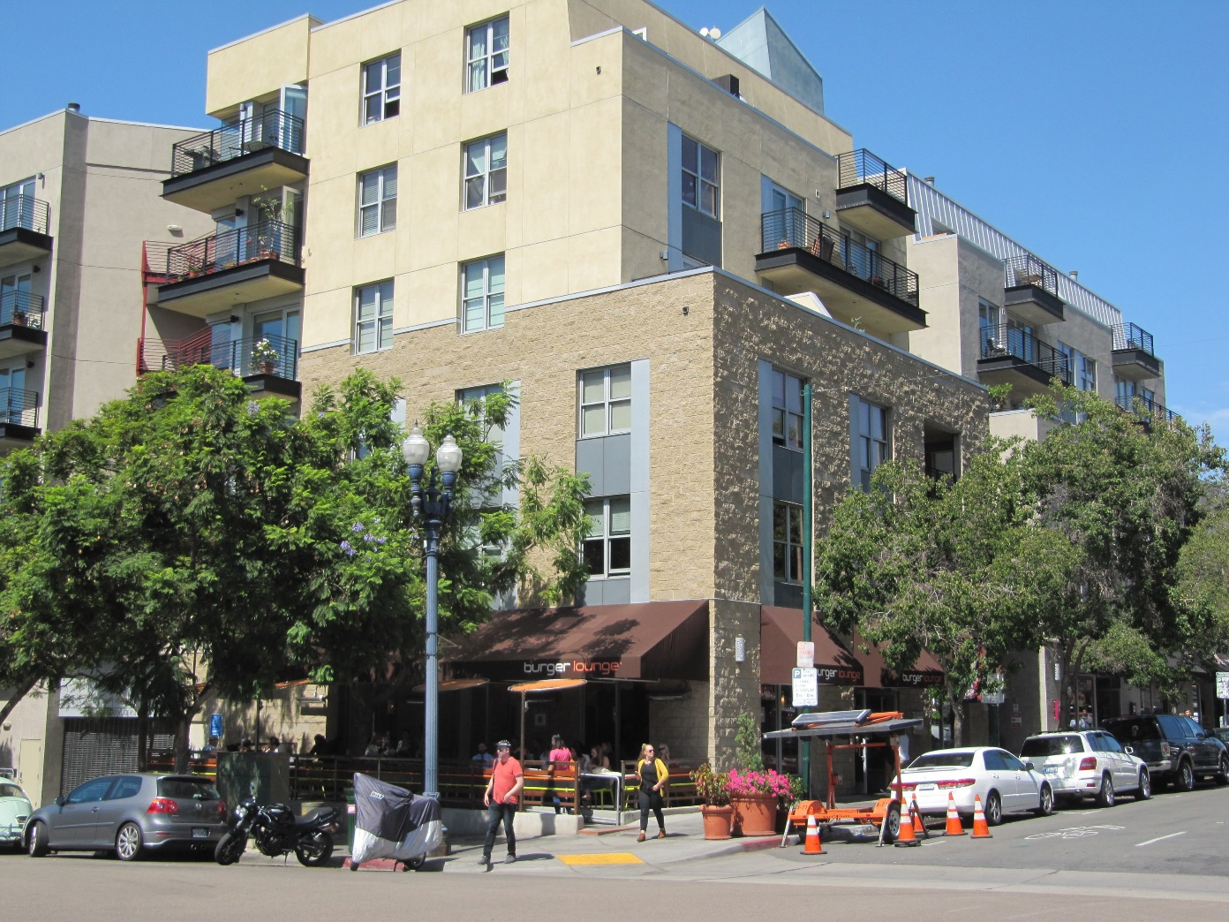
Little Italy - After

Slide 23
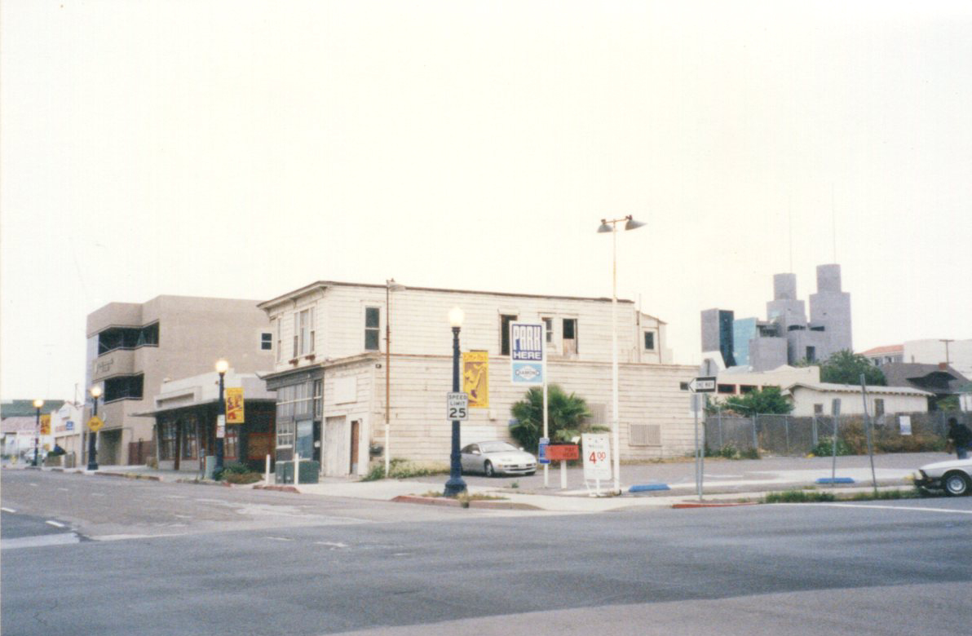
Little Italy - Before

Slide 24
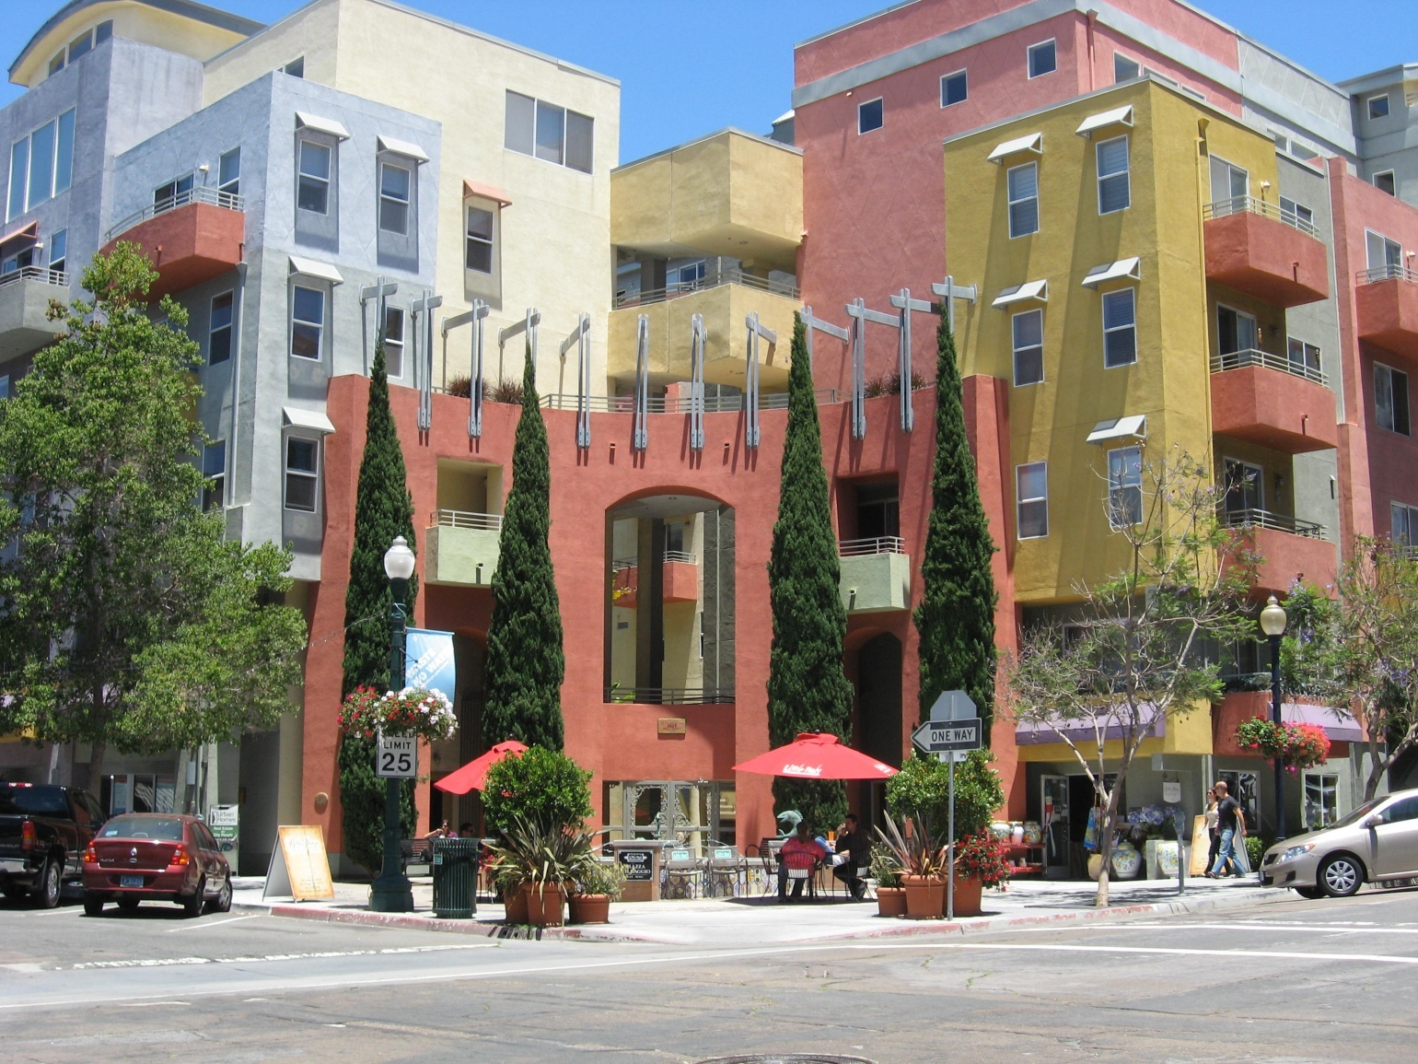
Little Italy - After

Slide 25
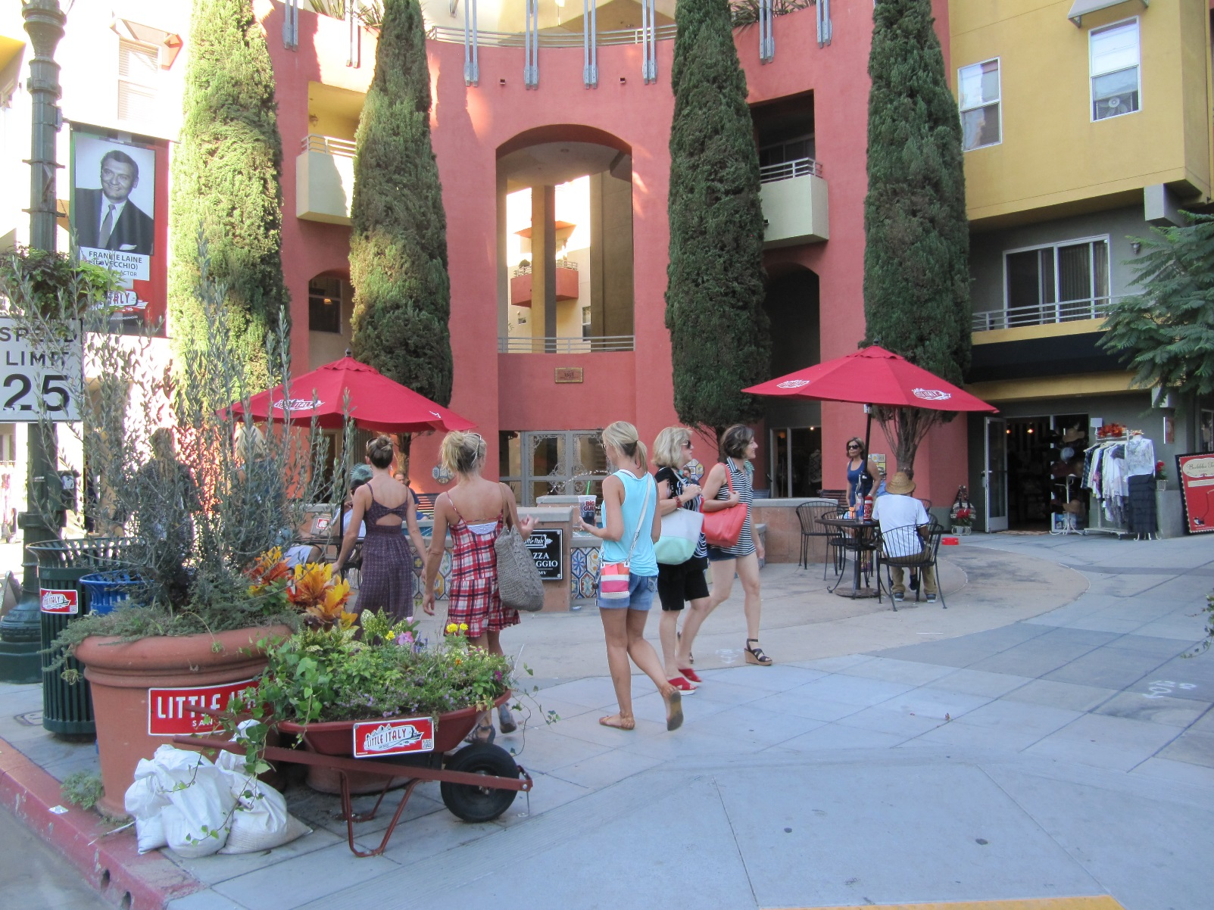
Little Italy - After

Slide 26
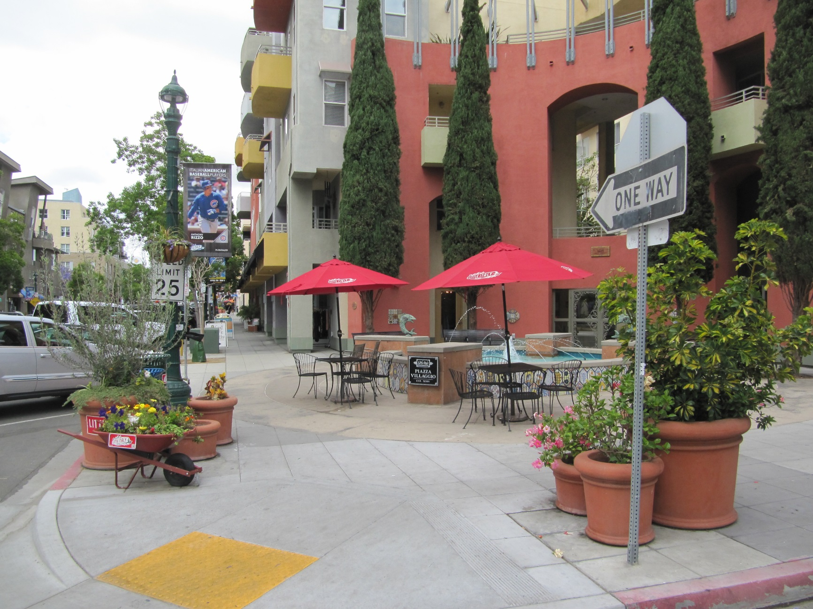

Slide 27
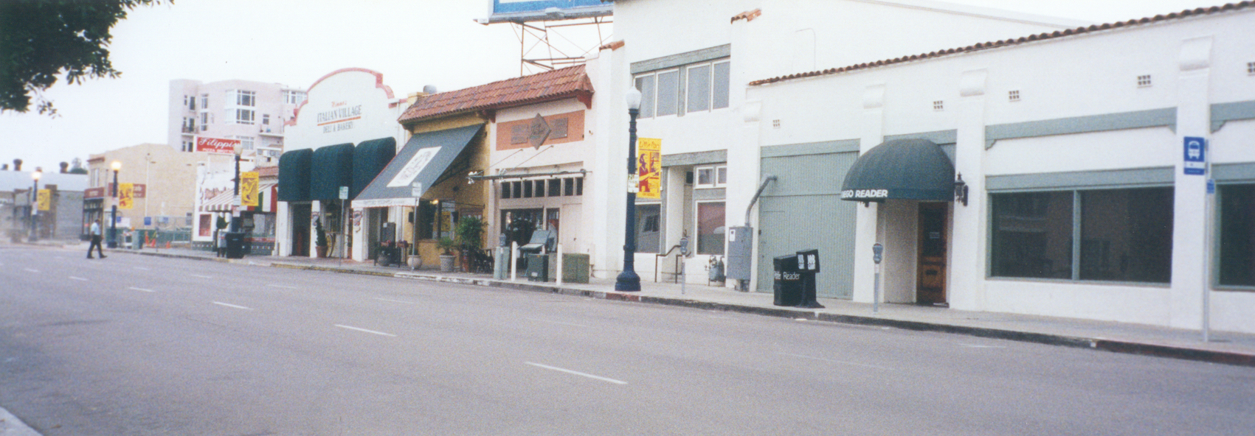
Little Italy - Before

Slide 28
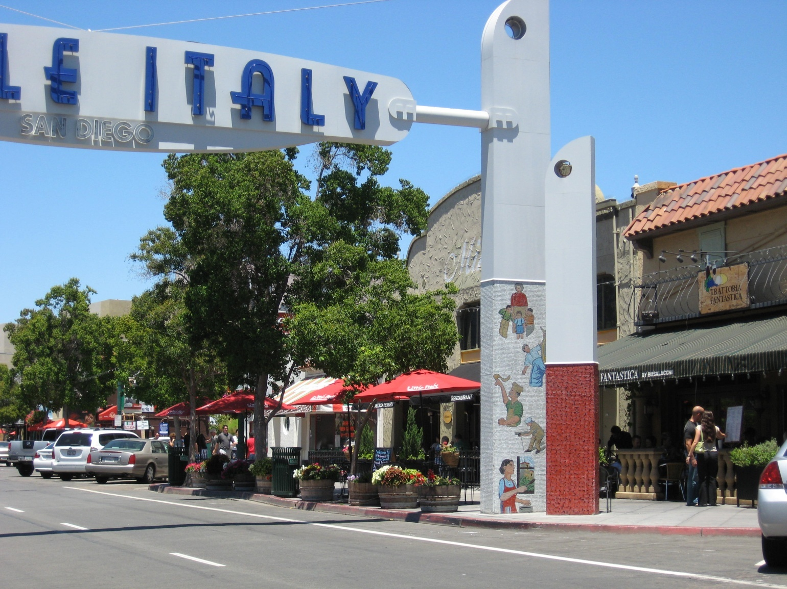
Little Italy - After

Slide 29
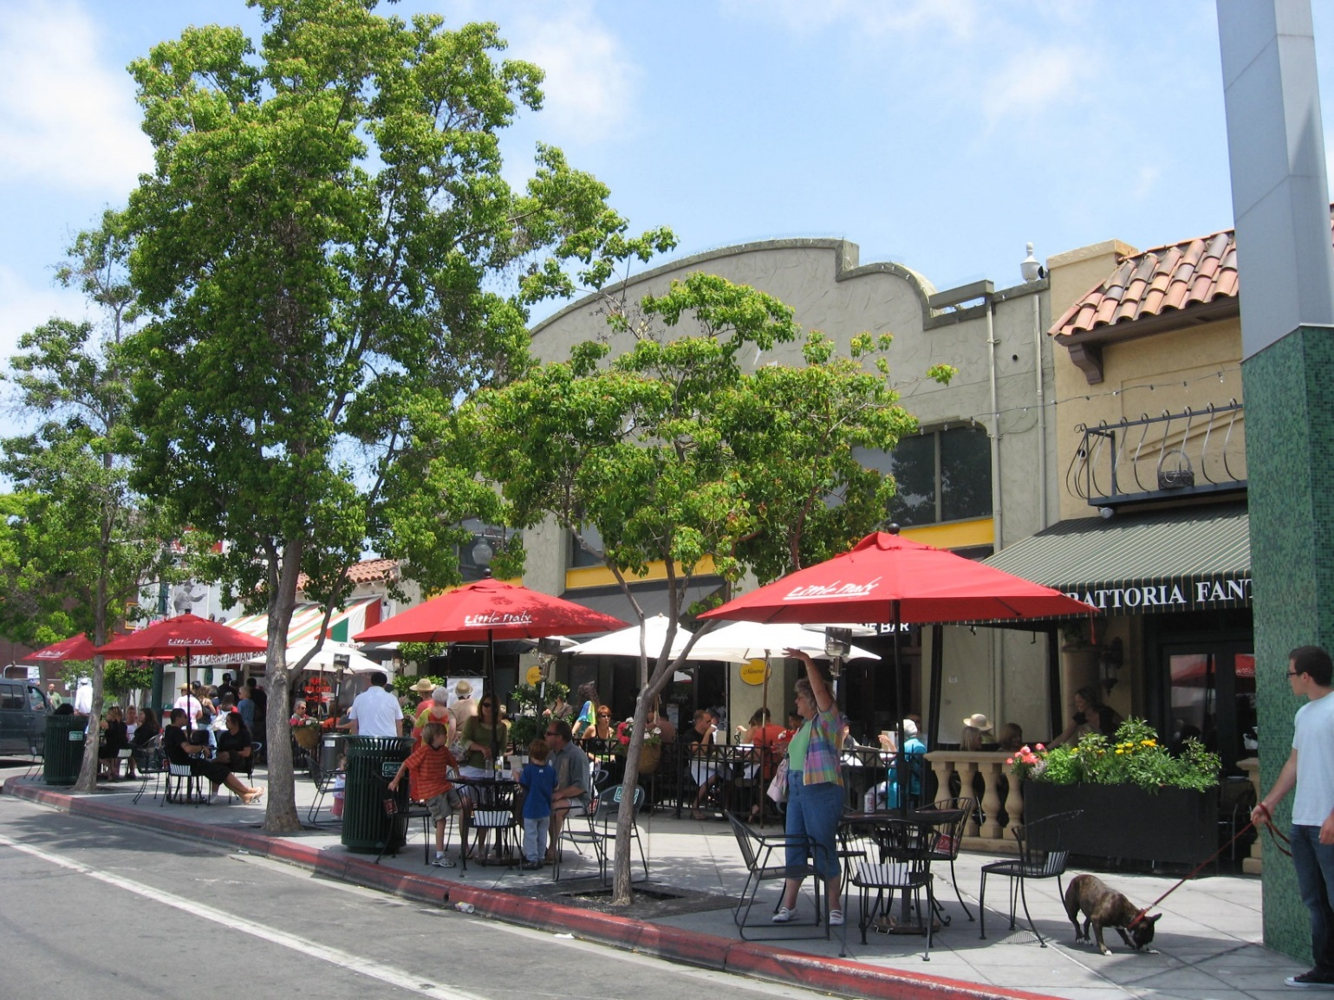
Little Italy - After

Slide 30
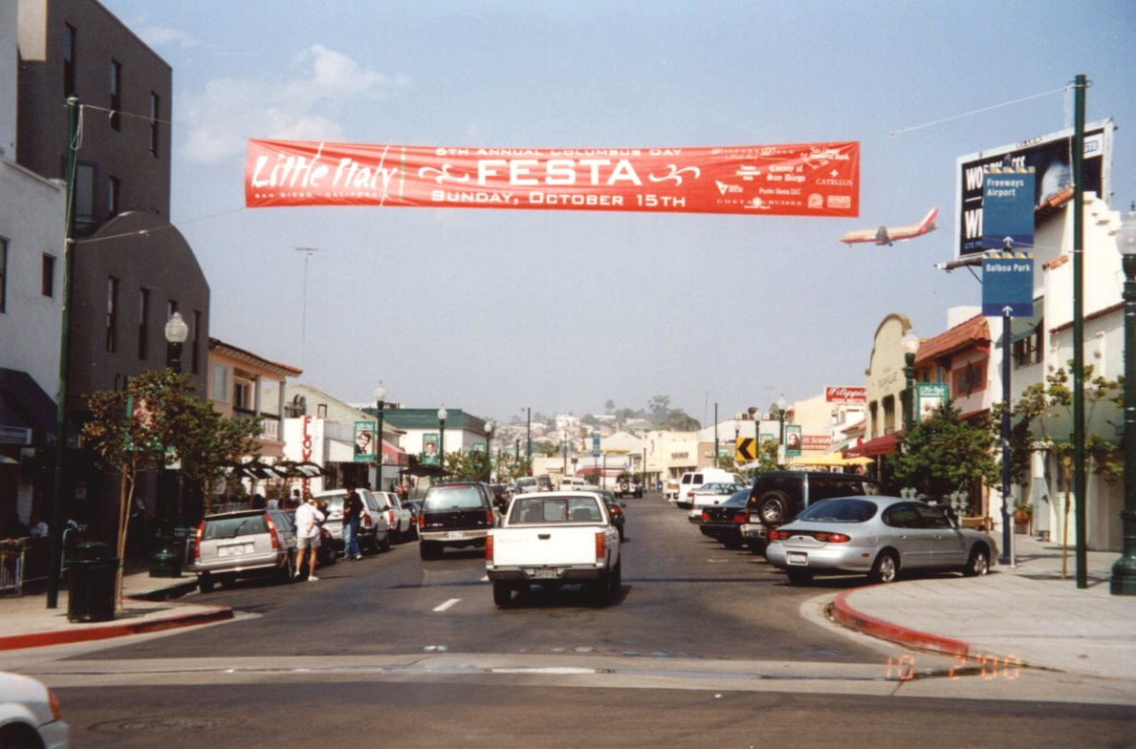
Little Italy - Before

Slide 31
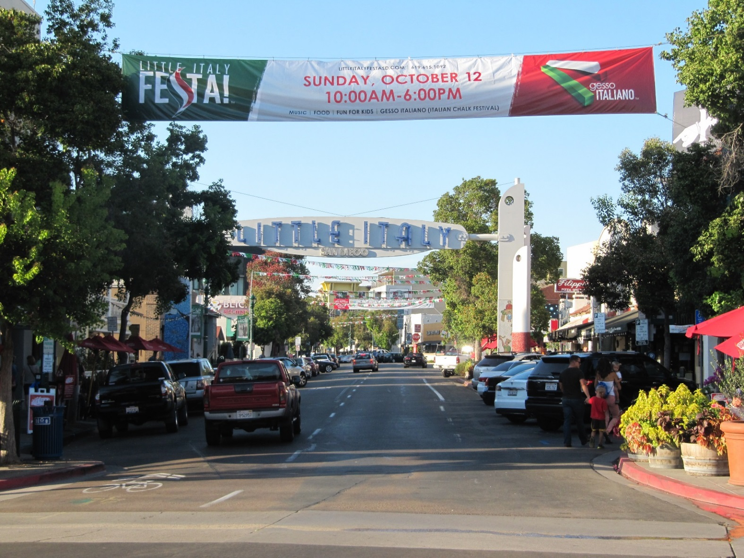
Little Italy - After

Slide 32
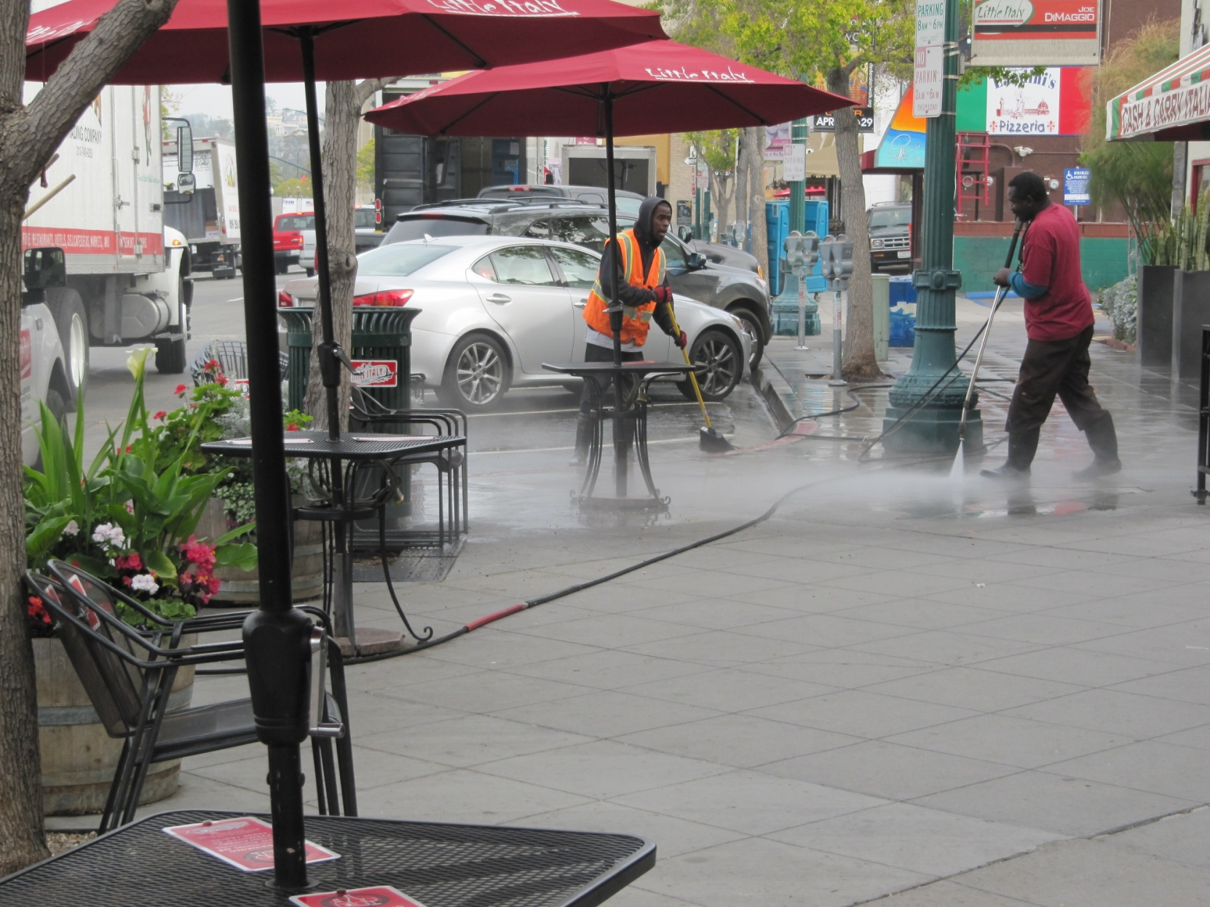
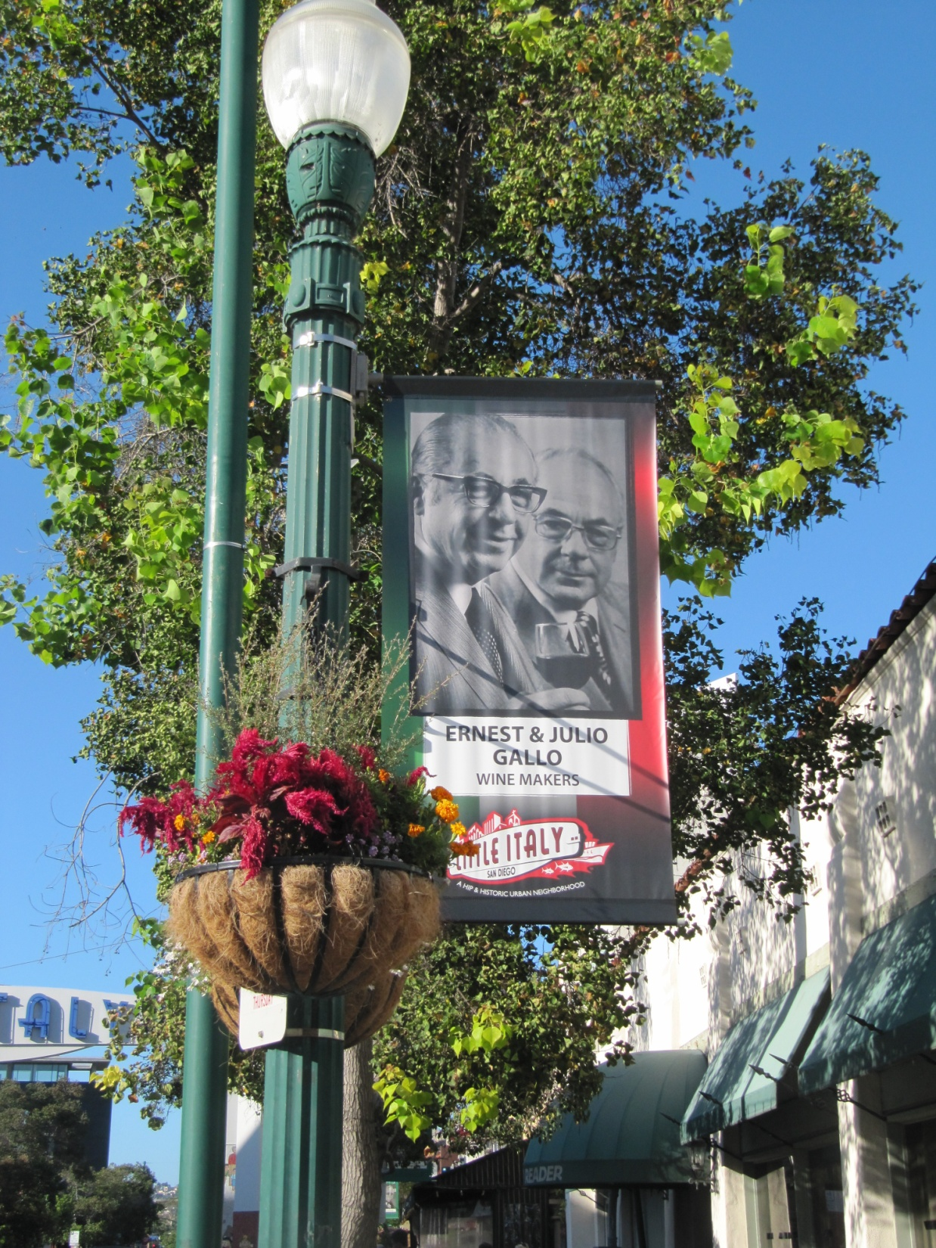
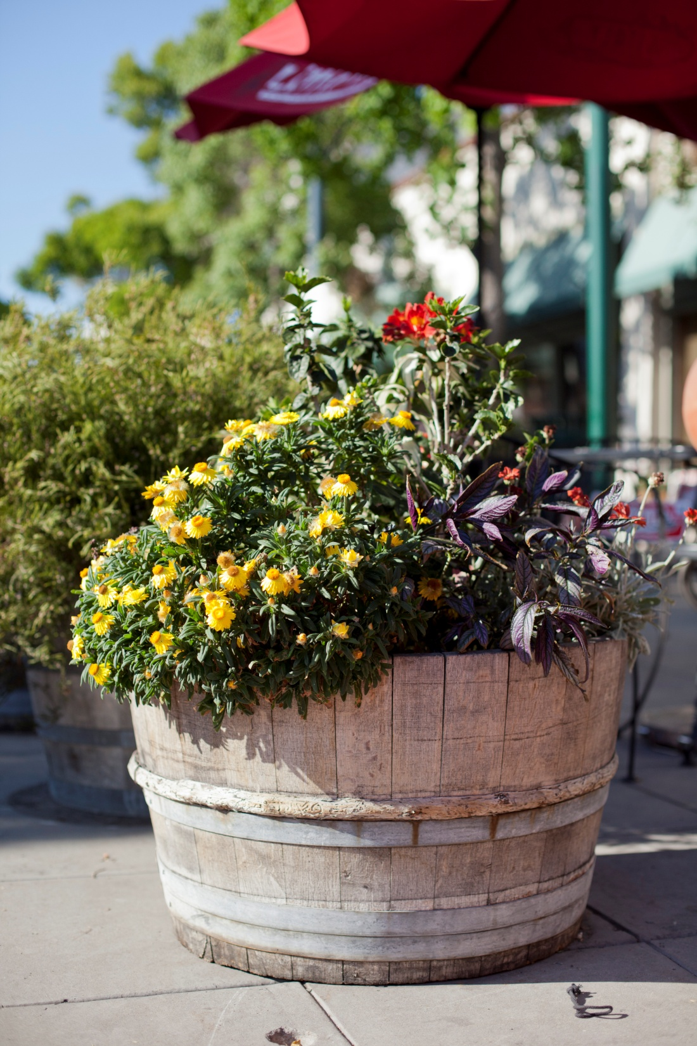
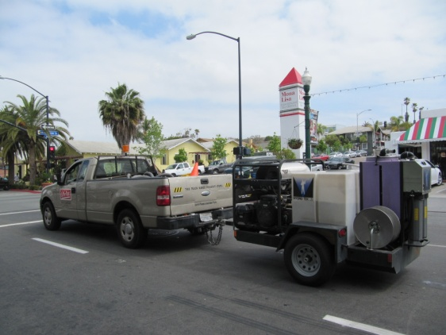
Sidewalk Operations
Sidewalk Steam Cleaning
Beautification in the Public Rights of Way

Slide 33
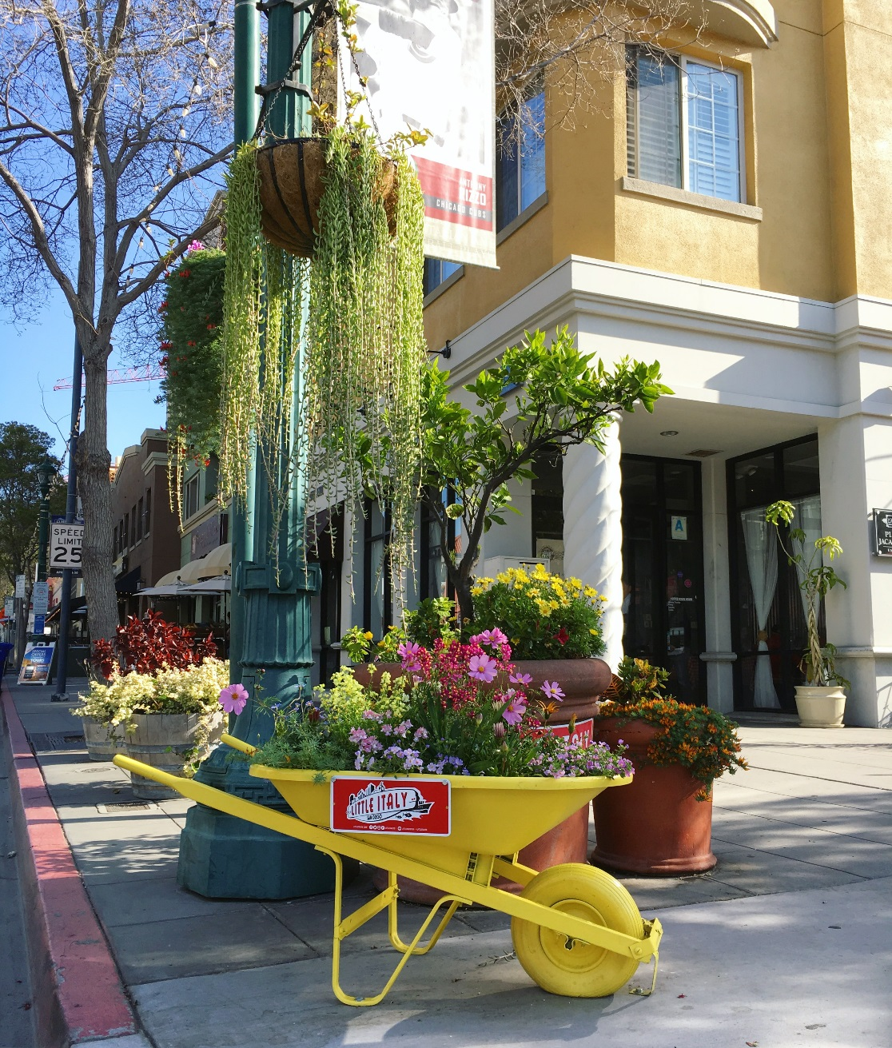

Slide 34
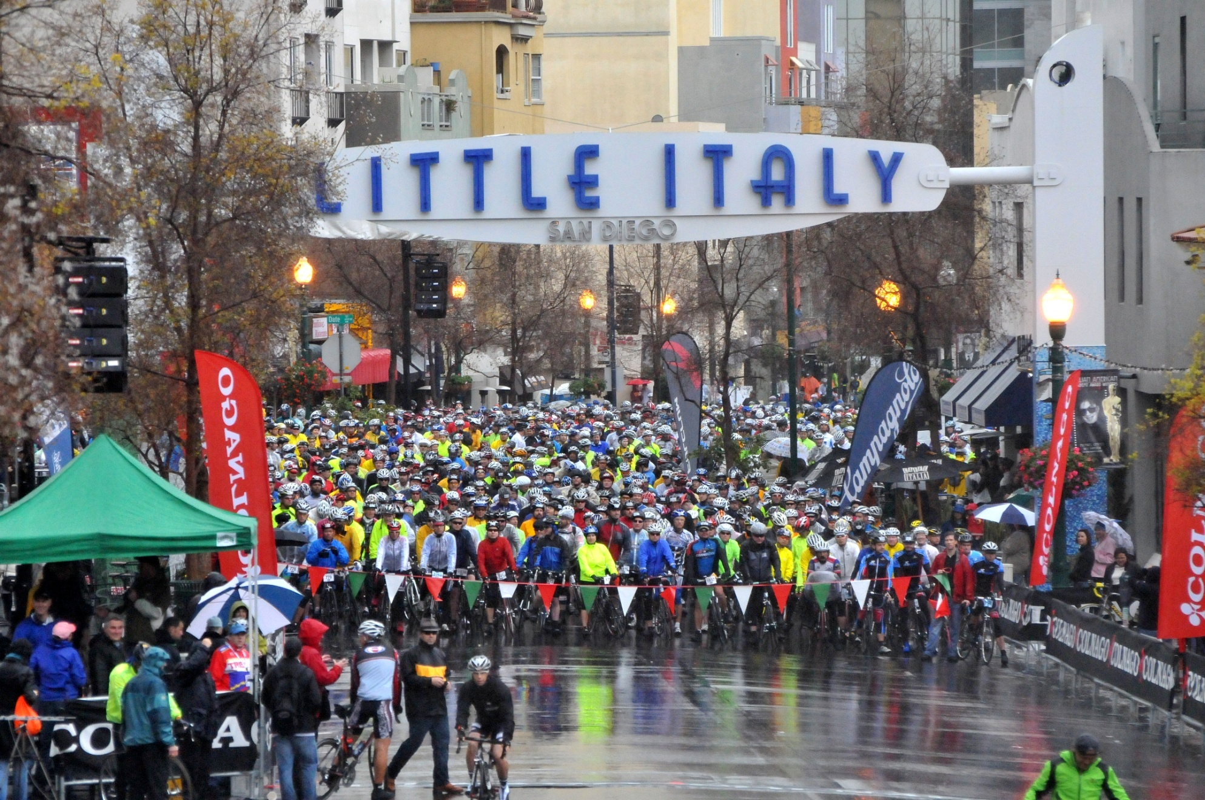
Gran Fondo

Slide 35
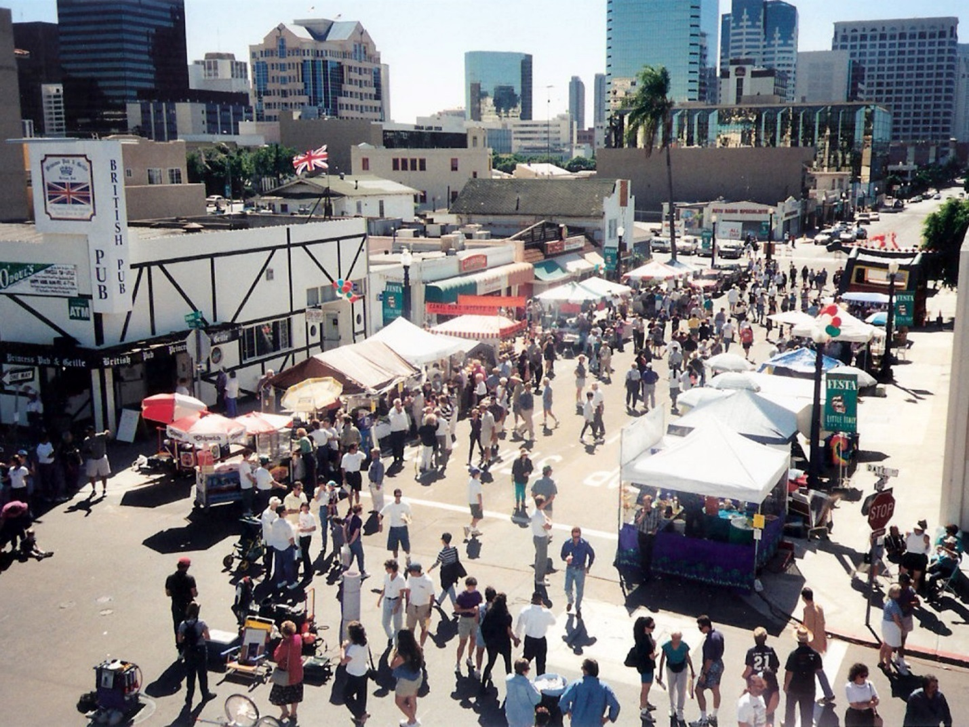
FESTA Little Italy - Annual Event in October

Slide 36
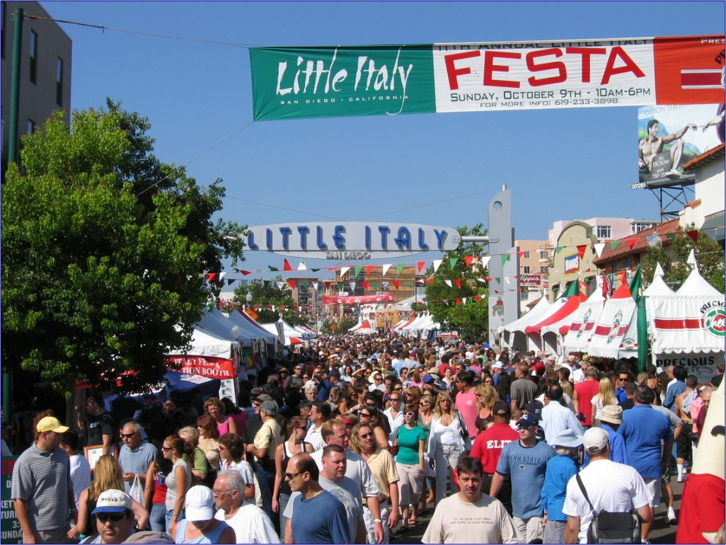
FESTA Little Italy - Annual Event in October

Slide 37
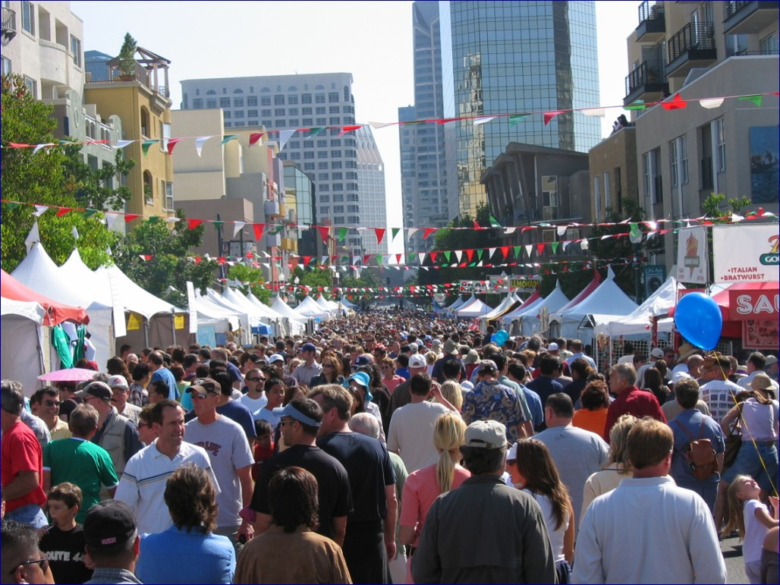
FESTA Little Italy - Annual Event in October

Slide 38
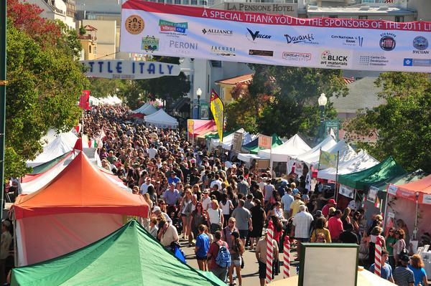
FESTA Little Italy - Annual Event in October

Slide 39
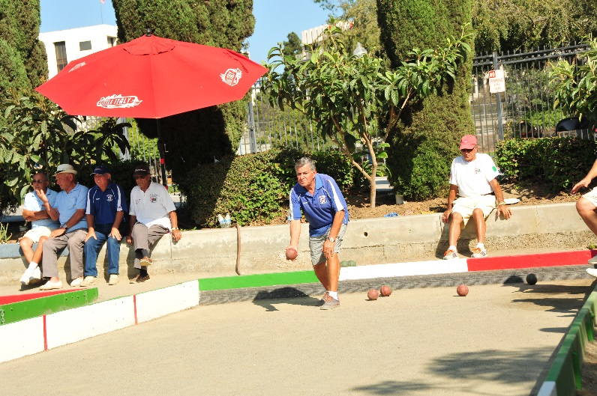
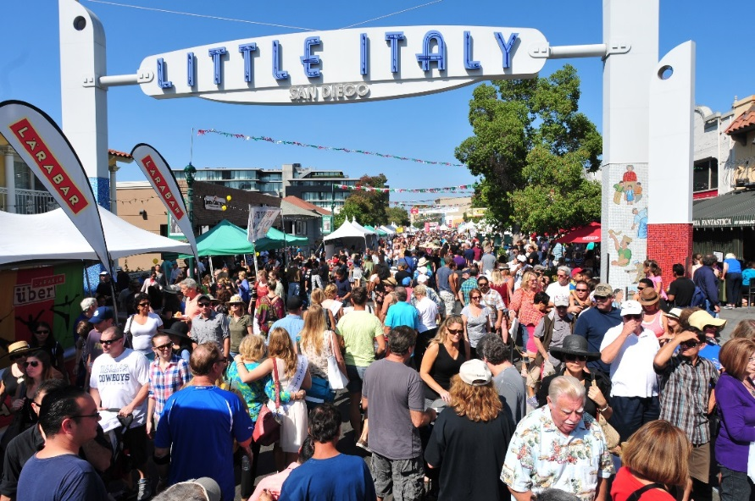
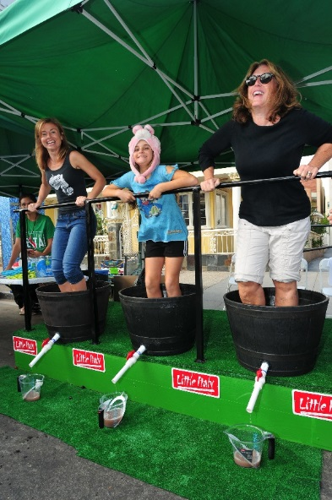
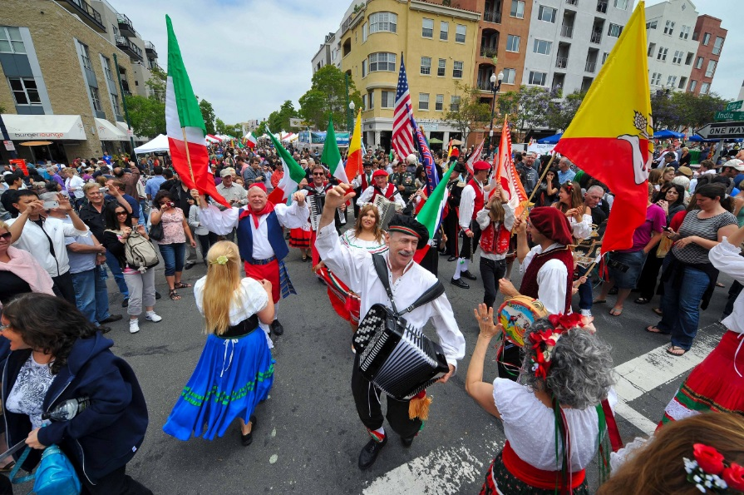
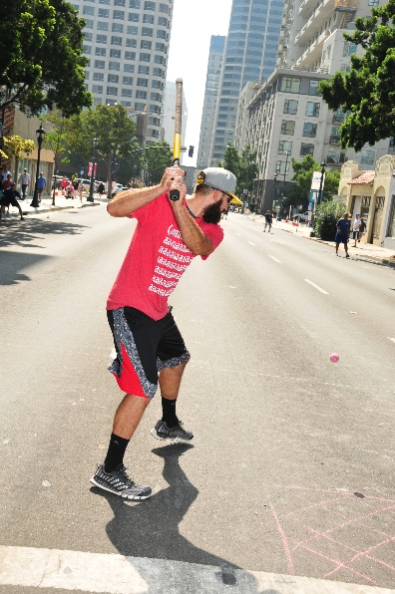
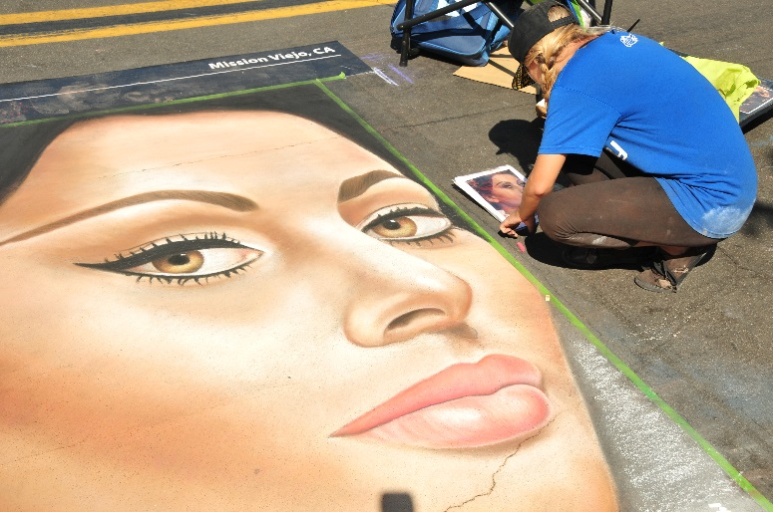

Slide 40
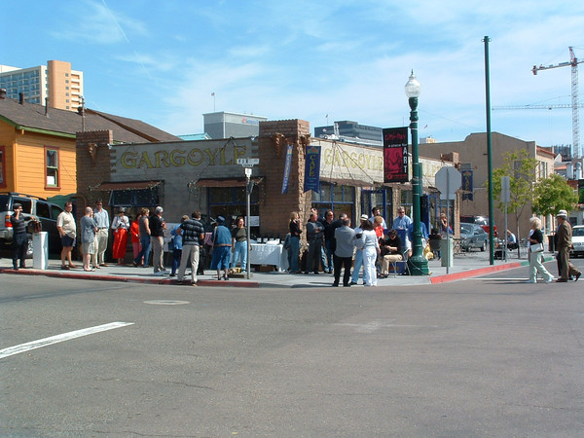
Piazza Basilone

Slide 41
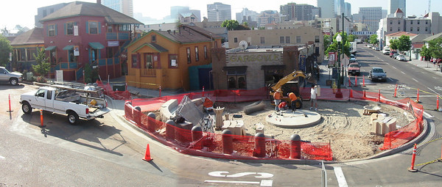
Piazza Basilone

Slide 42
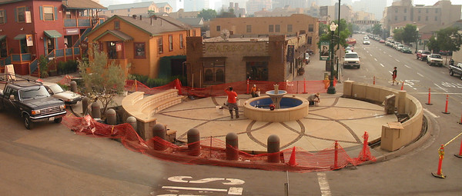
Piazza Basilone

Slide 43
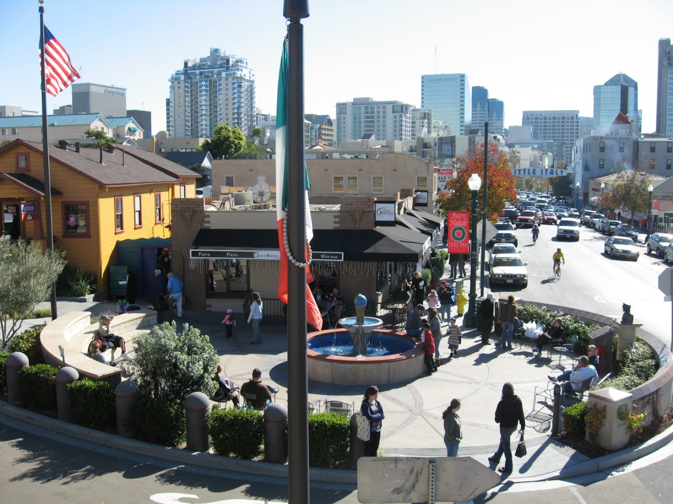
Piazza Basilone

Slide 44
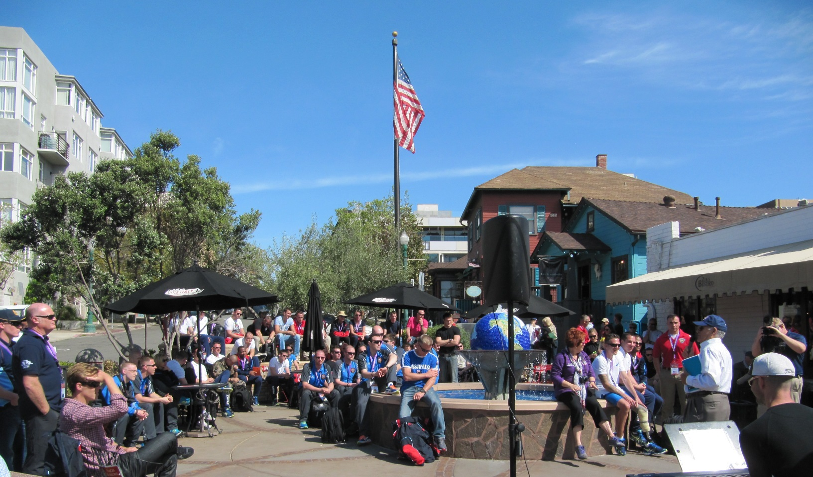

Slide 45
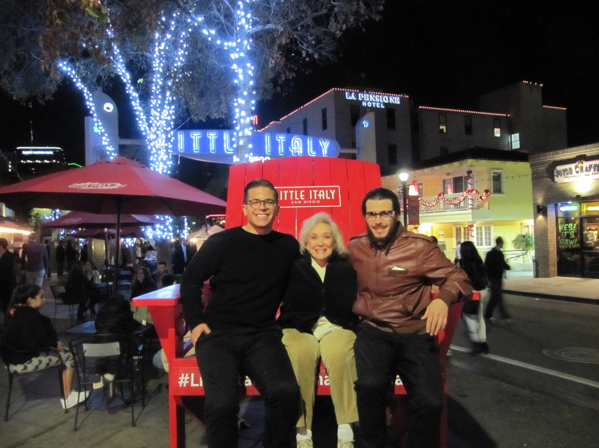

Slide 46
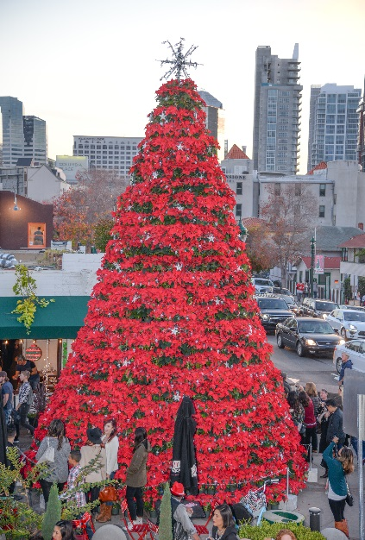
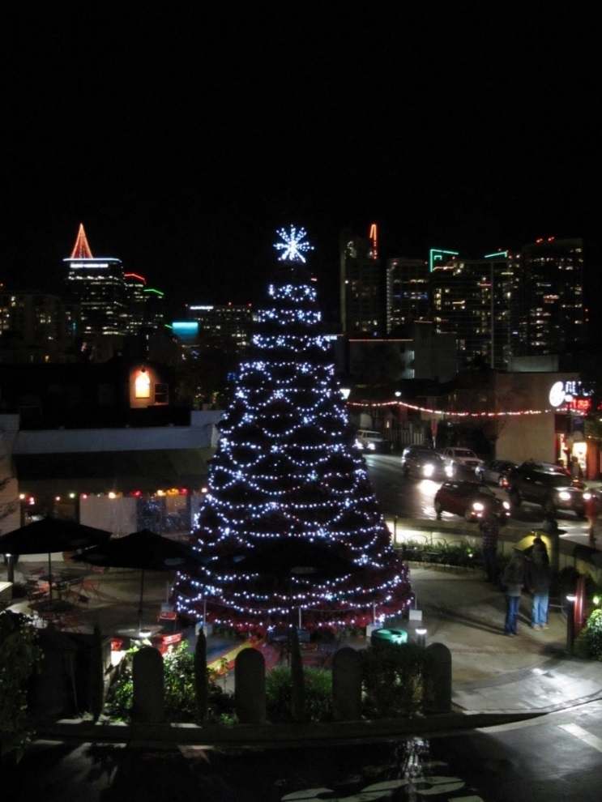
Christmas - Little Italy

Slide 47
Christmas - Little Italy

Slide 48
Little Italy - Before

Slide 49
Little Italy - After

Slide 50
Public Spaces
Piazza Famiglia

Slide 51
Public Spaces
Piazza Famiglia

Slide 52
Public Spaces
Piazza Famiglia

Slide 53
Public Spaces
Piazza Famiglia

Slide 54
Public Spaces
Piazza Famiglia – Amici Park – Dog Park

Slide 55
Photo by
Dogs of Little Italy

Slide 60
Little Italy Mercato – Farmers’ Market

Slide 63
Key Issues:
Place
Financial stability of the place
District Management Corporation for the place

Slide 64
Key issue is Sustainability:
Three key elements to ensure the best chance of achieving sustainability in city center areas include:
1. Identification of “place” and emphasis on placemaking
2. Creating a system of financial stability and independence
3. Creation of a new District management corporation whose whole focus is building the place and using revenue to fund programs and activities

Slide 65
Retail Space Per Capita, May 2016
Wall St. Journal April 21, 2016
30
25
20
Square feet of Retail Space Per Person
15
10
5
USA (24)
Canada (15)
Australia (10)
U.K (5)
E-Commerce is now estimated to be close to 20% of total mall sales

Slide 69
Sales Tax Growth

Slide 70
Residential Growth 2000-2015

Slide 73
48 Square Blocks
67 Acres
71/2 Miles of Frontage
2,123 Parcels
1,858 Property Owners
1,753 Condos
1,113 Apartment Units
Approx. 5,000 Residents
476 Business Licenses
944,969 Sq ft. of Commercial Space
1,092 Hotel Rooms
166 Motel Rooms
27 B&B Rooms
Approx. 6,900 Employees
Maintenance Employees
4 Landscape Employees
2 Pressure Washing Employees
14 Parking Employees
1,300 Trees
250 Trashcans
100 Recycling Receptacles

Slide 75
If you would like to read more information and
client satisfaction letters about New City America, Inc., please visit www.NewCityAmerica.com
Thank you for your time.

