Slide 1
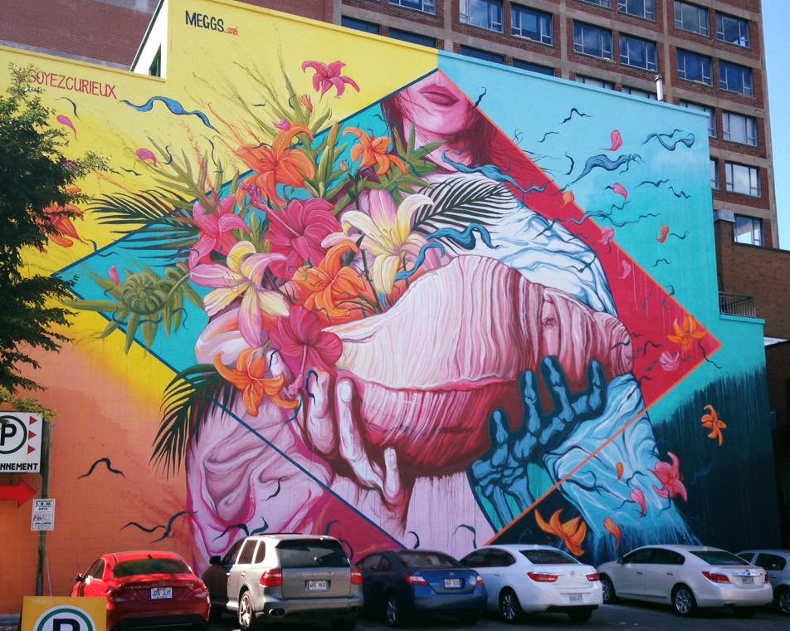
Advanced Placemaking: District Approaches to Place Management Massachusetts Smart Growth Conference Thursday, May 18, 2017 1:00 – 2:15 pm
Pictured: Mural by David “MEGGS” Hooke for the Montreal MURAL Street Art Festival, 2016. Photo by Jenn Erickson
Notes:
My name is Jenn Erickson and I’m a regional urban planner and head up the new Arts and Culture Division at the MAPC in Boston MA. I will be moderating this session with these three talented panelists.
We are very excited to spend the next 75 minutes with you to dive into district approaches to operationalizing placemaking.
District management strategies (Creative Placemaking, Business Improvement Districts, Eco-Districts, Cultural Districts, Innovation Districts, Parking Benefits Districts, Community Benefit Districts)
Learn about various approaches to place-based revitalization, development and management tools that emphasize existing assets of place including the arts, cultural diversity, economic development, and environmental sustainability.
Show of hands:
How many of you are familiar with cultural districts?
40R smart growth districts?
parking benefits districts?
community benefits districts?
Eco districts?

Slide 2
Session Objectives
Learn about different approaches to planning, managing, and financing district-level placemaking and the roles that public and private sector entities can play.
Learn about the benefits of district-level management and walk away with case examples of how existing districts share responsibilities including management, programming, promotion, and resource generation.
Notes:
Orienting to the subject matter – We’re going to do a little mental visioning exercise. Close your eyes for 30 seconds to think about this question (open your eyes when you have answers to the question)
Think back at the last week. Do you recall witnessing, experiencing, or personally engaging in an arts or cultural experience? This might include: taking in views of a cultural landscape – whether natural or man-made; admiring architectural design details in the built environment; experiencing art in public spaces – art sited on public grounds, on buildings, or on indoor walls; witnessing or participating in a parade, festival, market or other outdoor cultural event; listening to live or recorded music; watching a film or television show; enjoying a meal made from recipes; dancing; visiting an art show in a gallery or museum.
Arts and culture reveals itself and is expressed in many ways in civic life. It is a core element of what makes our communities healthy, dynamic, livable, vibrant.

Slide 3
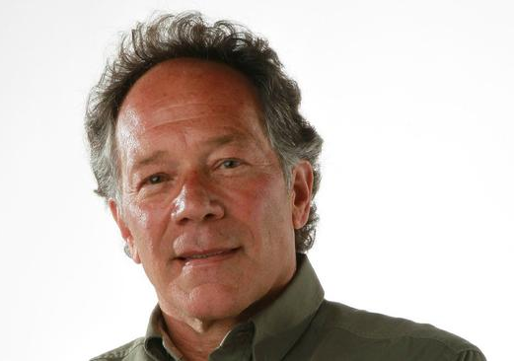
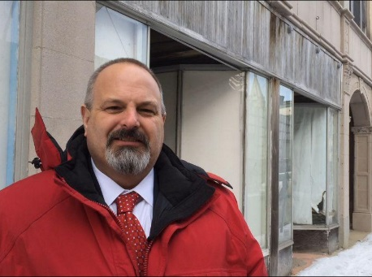
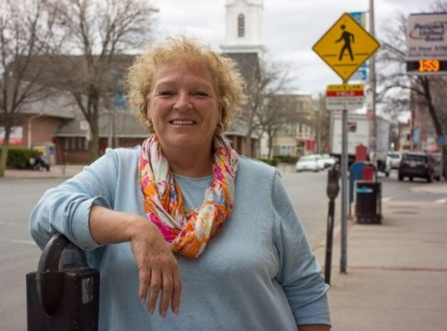
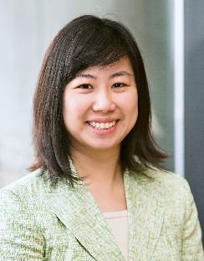
About Us
Marco Li Mandri
President, New City America, Inc.
Rob May
Director, Planning & Economic Development
City of Brockton
Gin Wallace
Executive Director, Beverly Main Streets
Jennifer Sien Erickson
Manager of Arts & Culture, Metropolitan Area Planning Council

Slide 4
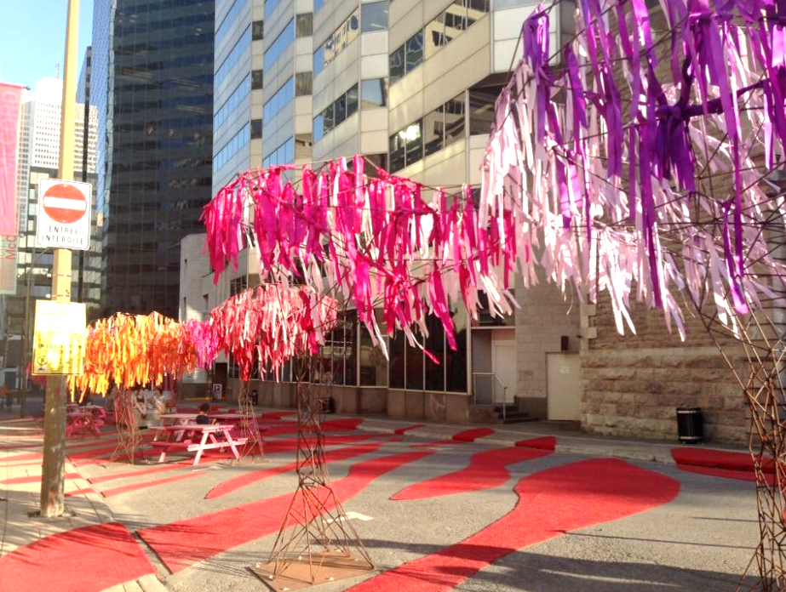
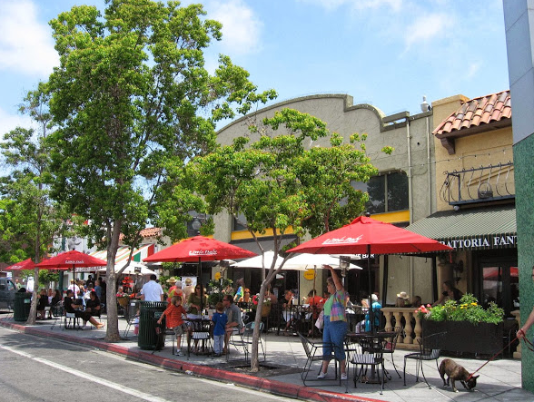
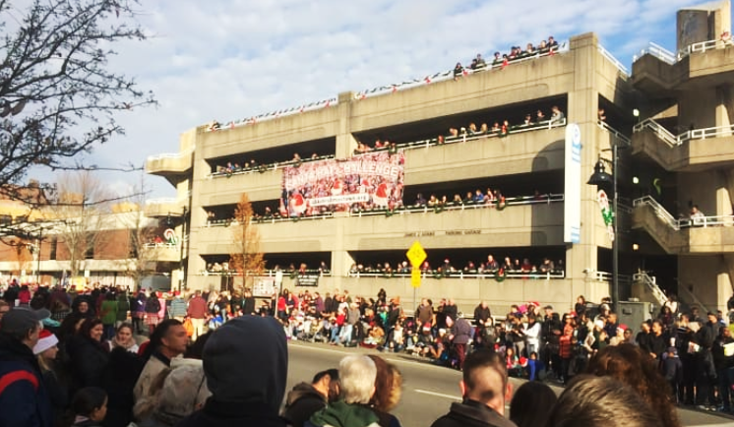
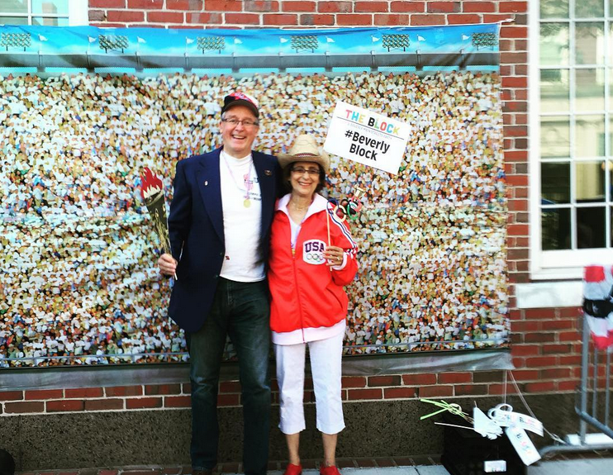
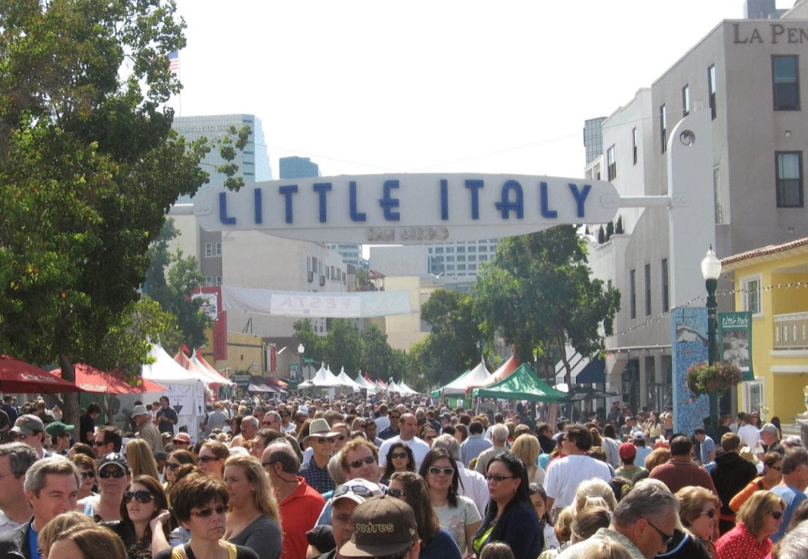
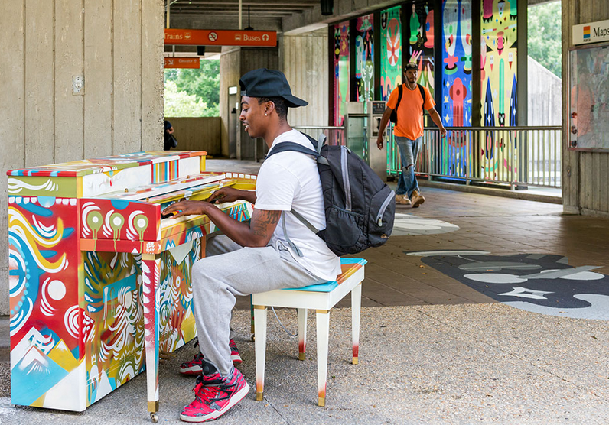
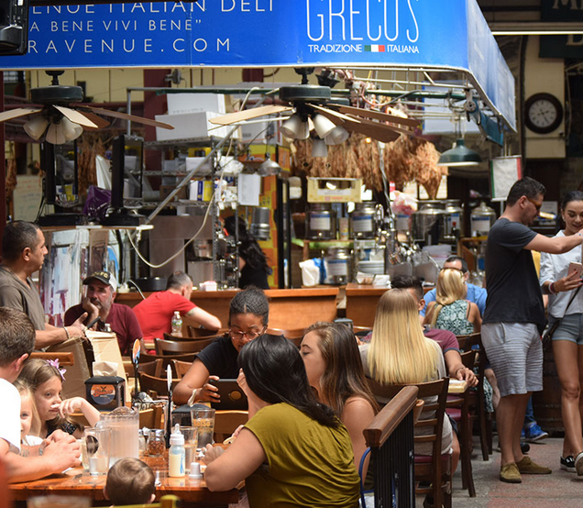
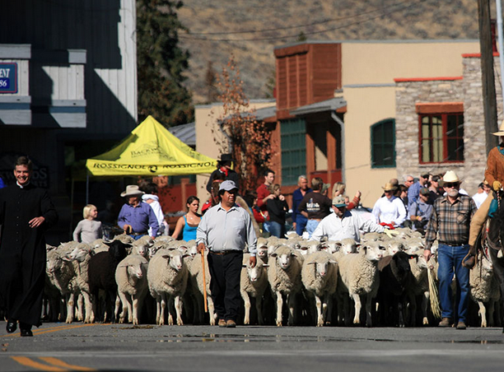
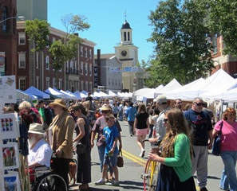
Credits: New City America, Inc.; Beverly Main Streets; Office of Bronx Borough President; Midtown Alliance of Atlanta, GA; Alpinfoto; MAPC
Notes:
Definition
Values: elevate assets of place – history, heritage, culture

Slide 5
Placemaking is a revitalization and reclaiming of public spaces and public commons in a way that engages the human and physical assets of place
Image Credits: New City America, Inc.; Beverly Main Streets; Office of Bronx Borough President; Midtown Alliance of Atlanta, GA; Alpinfoto; MAPC
Notes:
Definition
Values: elevate assets of place – history, heritage, culture

Slide 6
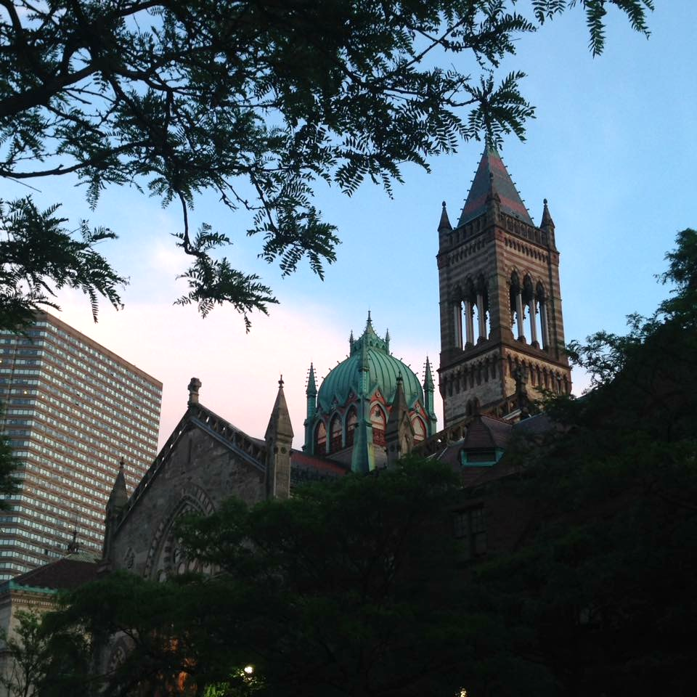
District-level planning and management is one way of operationalizing placemaking
staffing and management
resource generation
engagement and partnerships
community and economic development
arts and cultural programming
branding and marketing
Notes:
Operationalizing placemaking – various tools but the best scenarios line up four things: management, staffing, fundraising, and programming
Types of districts grounded in elevating assets of place:
Creative Placemaking, Business Improvement Districts, Eco-Districts, Cultural Districts, Innovation Districts, Parking Benefits Districts, Community Benefit Districts)

Slide 7
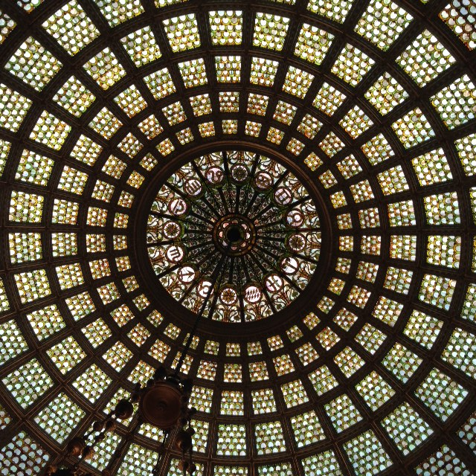
Various district tools to choose from: each option elevates different assets of place and advances different values
40R Smart Growth overlay districts
community benefit districts
Business improvement districts
cultural districts
parking benefit districts
eco-innovation districts
Notes:
Operationalizing placemaking – various tools but the best scenarios line up four things: management, staffing, fundraising, and programming
Types of districts grounded in elevating assets of place:
Creative Placemaking, Business Improvement Districts, Eco-Districts, Cultural Districts, Innovation Districts, Parking Benefits Districts, Community Benefit Districts)

Slide 8
Advanced Placemaking: District Approaches to Place Management Massachusetts Smart Growth Conference Thursday, May 18, 2017 1:00 – 2:15 pm
Pictured: Mural by David “MEGGS” Hooke for the Montreal MURAL Street Art Festival, 2016. Photo by Jenn Erickson
Notes:
My name is Jenn Erickson and I’m a regional urban planner and head up the new Arts and Culture Division at the MAPC in Boston MA. I will be moderating this session with these three talented panelists.
We are very excited to spend the next 75 minutes with you to dive into district approaches to operationalizing placemaking.
District management strategies (Creative Placemaking, Business Improvement Districts, Eco-Districts, Cultural Districts, Innovation Districts, Parking Benefits Districts, Community Benefit Districts)
Learn about various approaches to place-based revitalization, development and management tools that emphasize existing assets of place including the arts, cultural diversity, economic development, and environmental sustainability.
Show of hands:
How many of you are familiar with cultural districts?
40R smart growth districts?
parking benefits districts?
community benefits districts?
Eco districts?

Slide 9
Q&A Starter Questions
The concept of placemaking is constantly being redefined. What are your placemaking values? How do you define it and what does it mean to you in practice?
An earlier session discussed the tension between a concentrated focus on downtown areas and districts and its potential impact on other neighborhoods and the risk of sucking investment and attention away from those places. What advice do you give for people doing placemaking work and district work to address this equity issue?
Notes:
Definition
Values: elevate assets of place – history, heritage, culture

Slide 10
Q&A Starter Questions
Like any revolution, we also have guerilla placemaking tactics and activities that engage public art, design, etc. What advice can you give for taking the best ideas emerging from these tactics and activities and bring them into government-sanctioned process? How do you promote it and how do you pay for it?
Notes:
Definition
Values: elevate assets of place – history, heritage, culture

