Slide 2
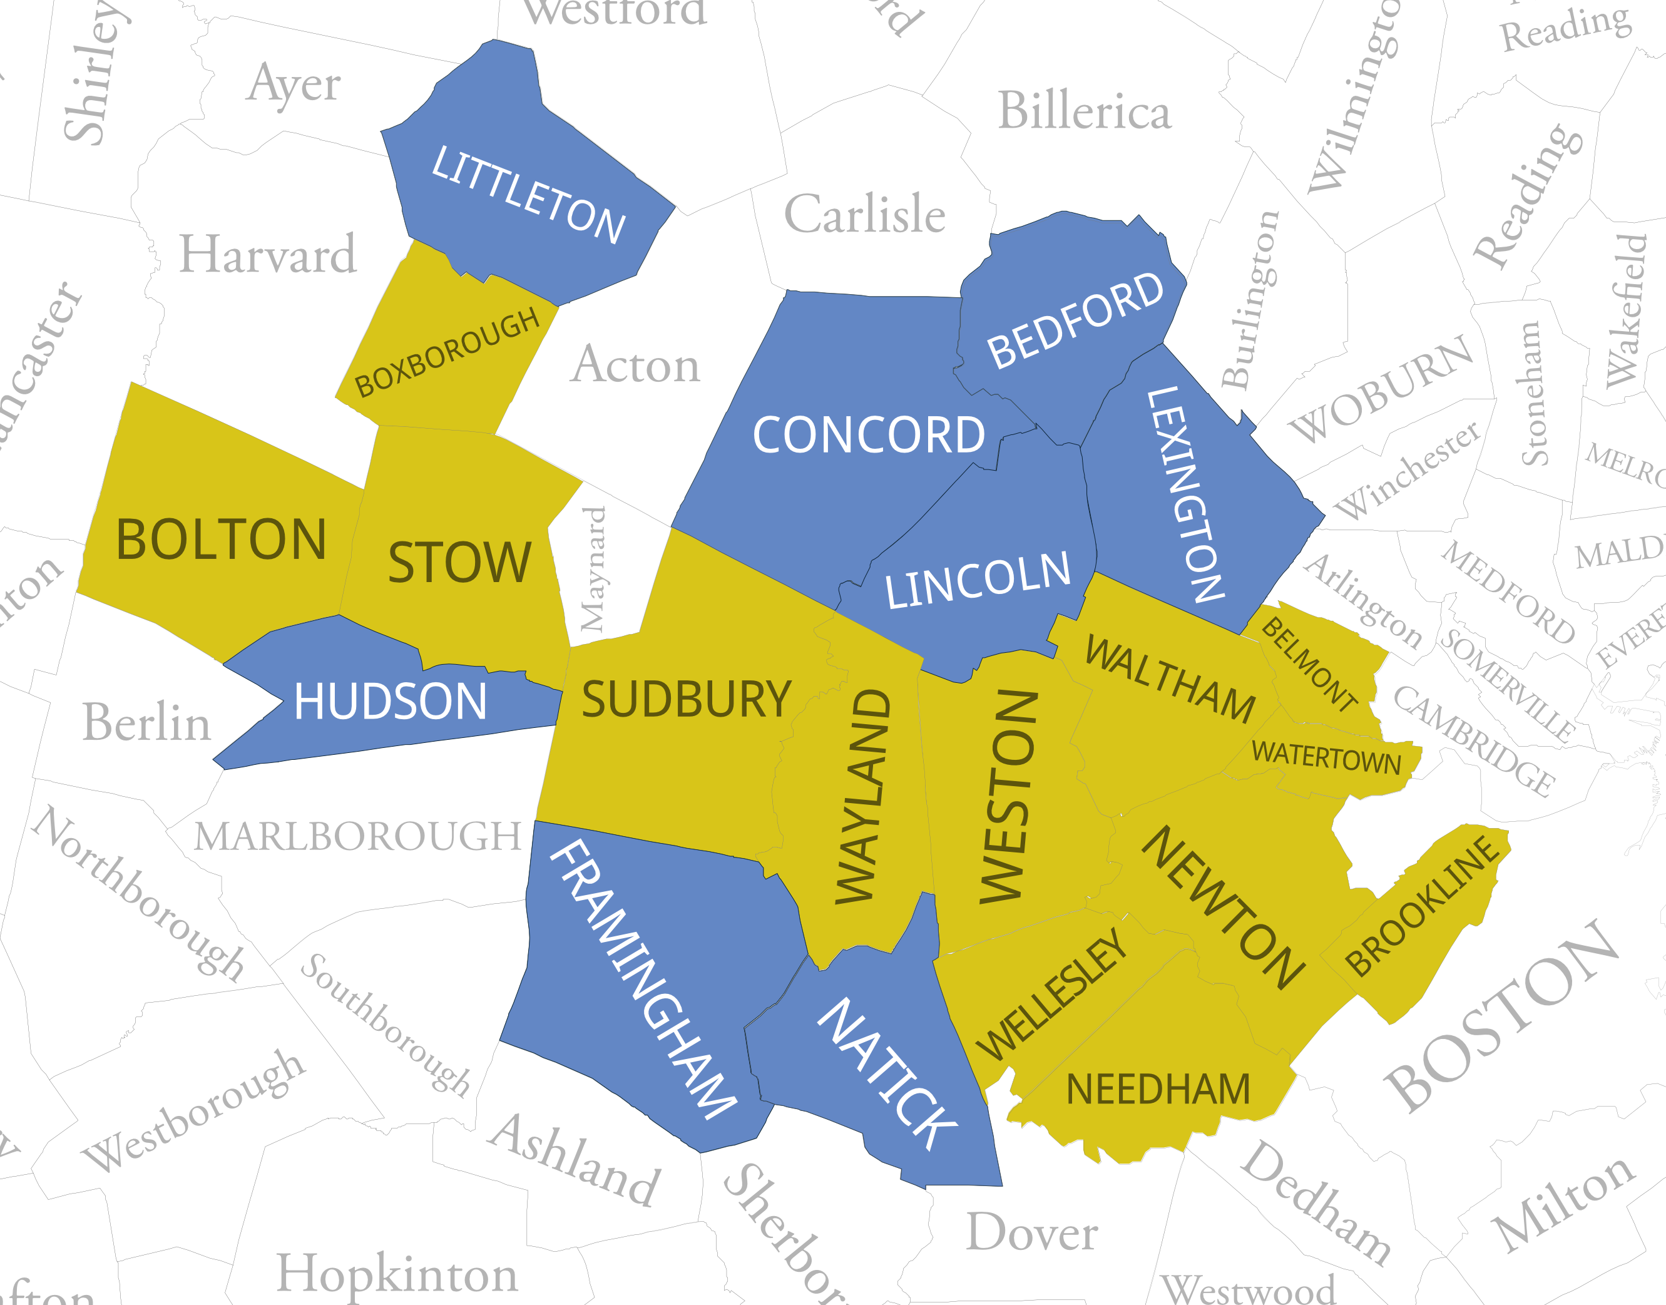

Slide 3
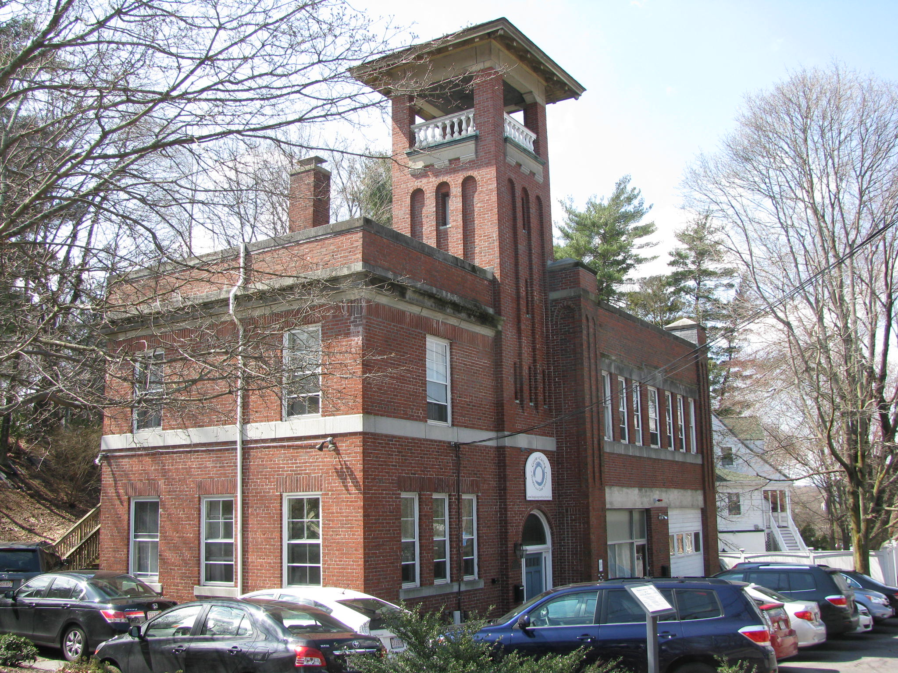
Engine 6, Newton

Slide 4
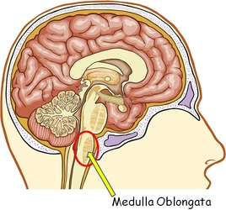

Slide 5
The purpose of the Fair Housing Act (Title VIII of the Civil Rights Act of 1968) is to end segregation

Slide 6
How to DESEGREGATE?
Move white people in (presumes economic “opportunity” follows them)
Move people of color out (presumably to economic opportunity areas)

Slide 7
Poor People are People of Color
Mass. is 74.3% White/Non-Hispanic
Poverty is 91% Non-White

Slide 8
Suburban Affordable Housing Units
Subsidized Housing Inventory in 21 Metro West towns
 | Total | 10% | Current | current | Units |  |  | Total | 10% | Current | current | Units
 | units | goal | SHI | % | Needed |  |  | units | goal | SHI | % | Needed
Bedford | 5,322 | 532 | 900 | 16.9% | - |  | Natick | 14,052 | 1,405 | 1,417 | 10.1% | -
Belmont | 10,117 | 1,012 | 388 | 3.8% | 624 |  | Needham | 11,047 | 1,105 | 839 | 7.6% | 266
Bolton | 1,729 | 173 | 64 | 3.7% | 109 |  | Newton | 32,346 | 3,235 | 2,436 | 7.5% | 799
Boxborough | 2,062 | 206 | 24 | 1.2% | 182 |  | Sudbury | 5,921 | 592 | 343 | 5.8% | 249
Brookline | 26,201 | 2,620 | 2,122 | 8.1% | 498 |  | Stow | 2,500 | 250 | 179 | 7.2% | 71
Concord | 6,852 | 685 | 719 | 10.5% | - |  | Waltham | 24,805 | 2,481 | 1,780 | 7.2% | 701
Framingham | 27,443 | 2,744 | 2,875 | 10.5% | - |  | Watertown | 15,521 | 1,552 | 1,010 | 6.5% | 542
Hudson | 7,962 | 796 | 918 | 11.5% |  |  | Wayland | 4,957 | 496 | 161 | 3.2% | 335
Lexington | 11,946 | 1,195 | 1,334 | 11.2% | - |  | Wellesley | 9,090 | 909 | 560 | 6.2% | 349
Lincoln | 2,153 | 215 | 236 | 11.0% | - |  | Weston | 3,952 | 395 | 142 | 3.6% | 253
Littleton | 3,443 | 344 | 431 | 12.5% | - |  | Totals | 229,421 | 22,942 | 18,878 |  | 4,977

Slide 9
4,977 units to meet 10% goal
“Need” is closer to 35,000 units

Slide 10
Suburban Segregation

Slide 11
For suburbs to reflect racial composition of the state we need to find room for 42,000 people

Slide 12
Housing is a symptom, but maybe a cure?
Healthy & Happy
INCOME
EDUCATION
HOUSING
HEALTH

Slide 13
Moving To Opportunity Study
Specifically, moving to a less poor neighborhood in childhood (i.e., before the age of 13):
Increased future annual income by the mid-twenties by roughly $3,500 (31%)
Boosted marriage rates
Raised both college attendance rates and quality of college attended

Slide 14
Be Ready!
Talk to you elected officials – vote for the ones who care about these issues
Encourage and support local efforts that support affordable housing, inclusion, diversity, welcoming community strategies
Support state-wide zoning reform
And stake some piece of ground!

