Slide 1
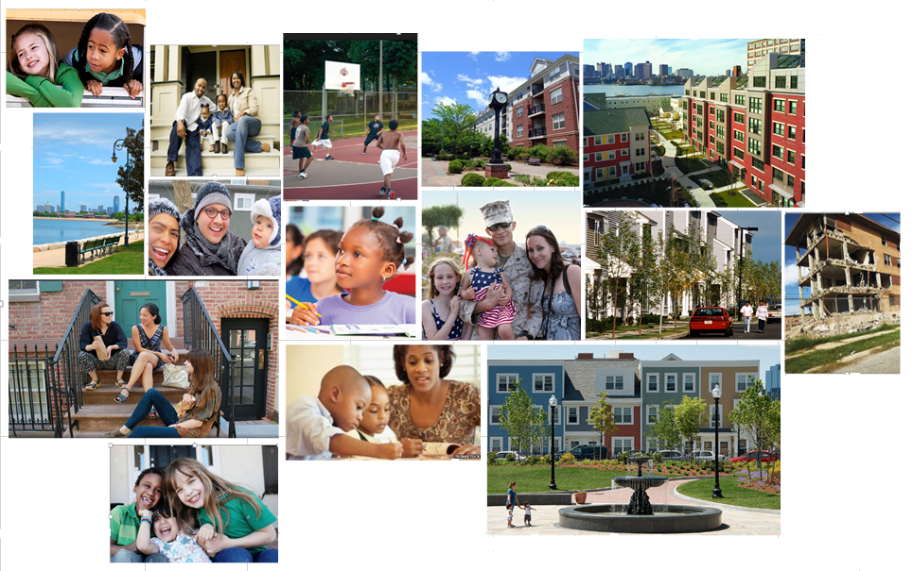
Are Mixed-Income and Mixed-Race Communities Possible?
Massachusetts Smart Growth Conference 2016 June 2, 2016
DCU Center, Worcester, MA Bonnie Heudorfer

Slide 2
Introduction
What do we mean when we talk about mixed race and/or mixed income communities?
Why are we talking about this now, and why in the context of smart growth and sustainability?
Racial Separation, Concentrated Poverty and Access to Opportunity
Inextricably linked
Why does concentrated poverty matter?
What constitutes opportunity? Tensions/tradeoffs
The Massachusetts Context
Who we are and where we live
  The legacy of the past
  Current conditions
Assisted Housing: the safety net
  How the safety net was created
  How we are growing it
Recommendations
For mitigating larger market conditions
For addressing issues in specific mixed income developments

Slide 3
Defining mixed income (mixed race) communities
Naturally occurring neighborhoods where people of different incomes, race and/or ethnicity live together over time? or
Intentional efforts to generate socioeconomic diversity in a targeted geographic area
A multifamily development that has the mixing of income groups as a fundamental part of its financial and operational plan? Or
Communities that encompass both: households who live in homes they bought on private market and households who live in subsidized or mixed income developments (some of whom are market-rate tenants (owners), others of whom are subsidized?

Slide 4
Why all the attention now?
The Supreme Court decision in the case of Texas Department of Housing and Community Affairs v. The Inclusive Communities Project, Inc., in which Court upheld disparate impact as a legal tool for proving housing discrimination under the Fair Housing Act.
HUD’s issuance of its final rule on Affirmatively Furthering Fair Housing (AFFH), intended to clarify and simplify existing fair housing obligations and create a streamlined Assessment of Fair Housing planning process.

Slide 5
Why is this so important to a discussion of Smart Growth?
Sustainability [also] means creating “geographies of opportunity," places that effectively connect people to jobs, quality public schools, and other amenities.
-HUD Secretary Shaun Donovan, in announcing the first round of Sustainable Communities Regional Planning Grants, February 23, 2010
Massachusetts Sustainable Development Principles: Advance Equity, Expand Housing Opportunities
HUD Livability Principles: Support Existing Communities, Value Communities and Neighborhoods
Three Es of sustainability: a prosperous economy, a quality environment and social equity

Slide 6
HUD’s Affirmatively Furthering Fair Housing (AFFH) Rule
“Affirmatively furthering fair housing means taking meaningful actions that, taken together, address significant disparities in housing needs and in access to opportunity, replacing segregated living patterns with truly integrated and balanced living patterns, transforming racially and ethnically concentrated areas of poverty into areas of opportunity, and fostering and maintaining compliance with civil rights and fair housing laws.”

Slide 7
The Preservation v Mobility Debate
The preservation v mobility debate is really is a discussion about allocating resources between three priorities, not two:
  There is enabling people who wish to move from low-opportunity neighborhoods to higher opportunity neighborhoods to do so;
  There is preventing people from having to leave neighborhoods that are experiencing reinvestment; and
  There is investing in neighborhoods that are still suffering from disinvestment for the benefit of the current residents.

Slide 8
The Court and HUD agree…
The final rule supports a balanced approach to AFFH
A balanced approach could include:
  Removal of barriers that prevent people from accessing housing in areas of opportunity;
  Development of affordable housing in such areas;
  Effective housing mobility programs; and/or
  Concerted housing preservation, and community revitalization efforts.

Slide 9
AFFH embodies a balanced approach in which …
Additional affordable housing is developed in areas of opportunity with an insufficient supply of affordable housing;
Racially or ethnically concentrated areas of poverty are transformed into areas of opportunity that continue to contain affordable housing as a result of preservation and revitalization efforts; and
The mobility of low-income residents from low-opportunity areas to high-opportunity areas is encouraged and supported as a realistic, available part of fair housing choice.

Slide 10
Why Does Concentrated Poverty Matter?
Being poor in a very poor neighborhood subjects residents to costs and limitations above and beyond the burdens of individual poverty.
Concentrated poverty can:
Limit educational opportunity.
Lead to increased crime rates and poor health outcomes.
Hinder wealth building.
Reduce private-sector investment and increase prices for goods and services.
Raise costs for local government.

Slide 11
Why Does Concentrated Poverty Matter?
Being poor in a very poor neighborhood subjects residents to costs and limitations above and beyond the burdens of individual poverty.
Concentrated poverty can:
Limit educational opportunity.
Lead to increased crime rates and poor health outcomes.
Hinder wealth building.
Reduce private-sector investment and increase prices for goods and services.
Raise costs for local government.

Slide 12
Racial separation, concentrated poverty and access to opportunity are inextricably linked.
Even though there are more poor White people in MA than there are poor Blacks or Latinos, they do not live in the same communities, for the most part.
Poor people of color predominate in the Commonwealth’s pockets of concentrated poverty.
Regardless of income, people of color are far more likely to live in areas of concentrated poverty.
Springfield, one of the nation’s most segregated metro areas for Latinos, is also one with the highest concentration of poverty (poor people in poor tracts).

Slide 13
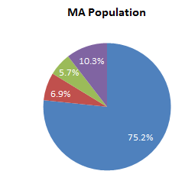
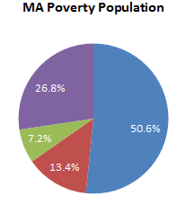
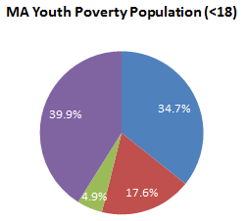
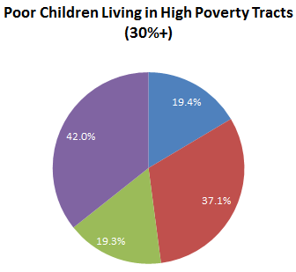
Racial/Ethnic Group’s Share of…

Slide 14
“Naturally occurring” mixed race/mixed income communities
Gentrifying (becoming whiter, more affluent) – usually transitional
Becoming increasingly minority, possibly lower income – usually transitional
Long term stable, mixed race – rare
Intentional decision by residents with resources and options – rare
Expensive privately-owned housing intermingled with assisted housing (e.g. South End)
Is social interaction or cohesion required?

Slide 15
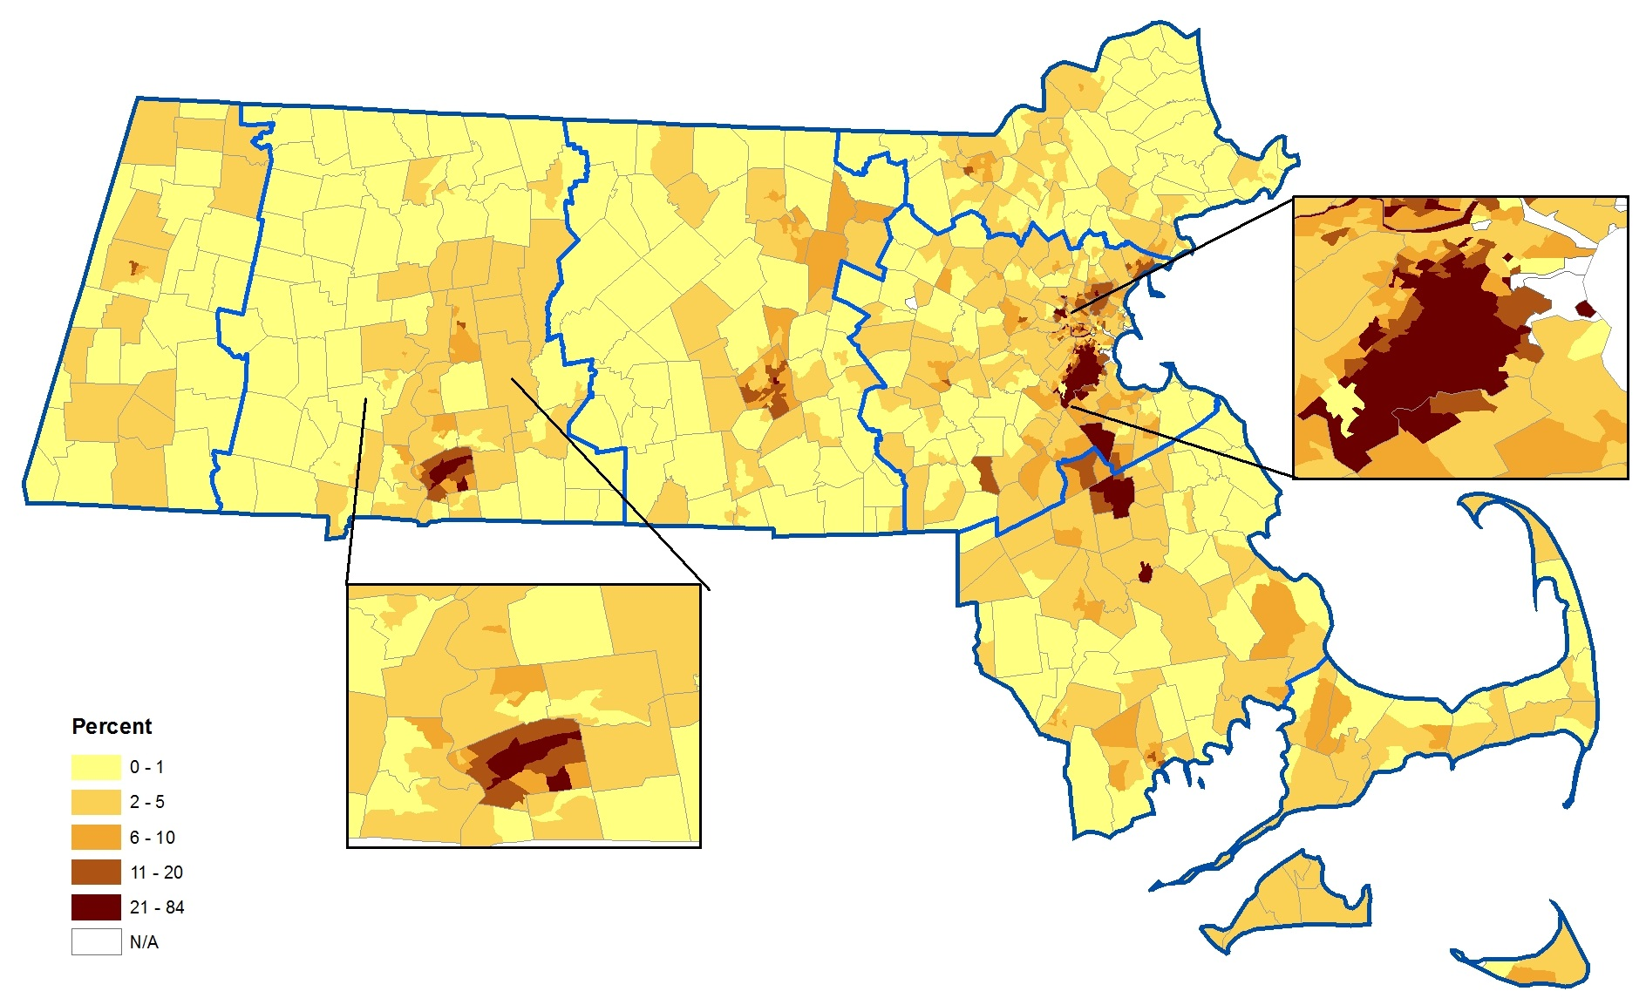
Black Share of the Population
Source: Analysis of Impediments to Fair Housing Choice, DHCD (2013)

Slide 16
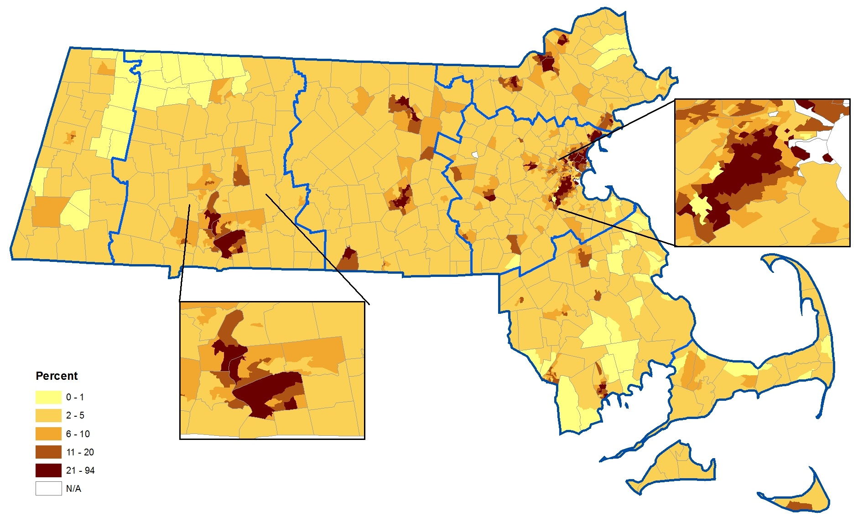
Hispanic/Latino Share of the Population
Source: Analysis of Impediments to Fair Housing Choice, DHCD (2013)

Slide 17
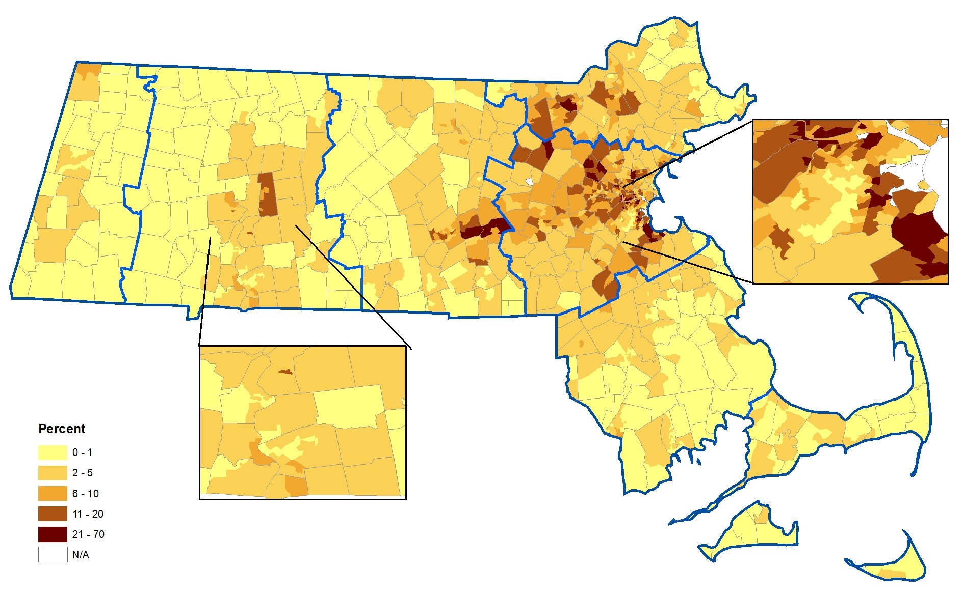
Asian Share of the Population
Source: Analysis of Impediments to Fair Housing Choice, DHCD (2013)

Slide 18
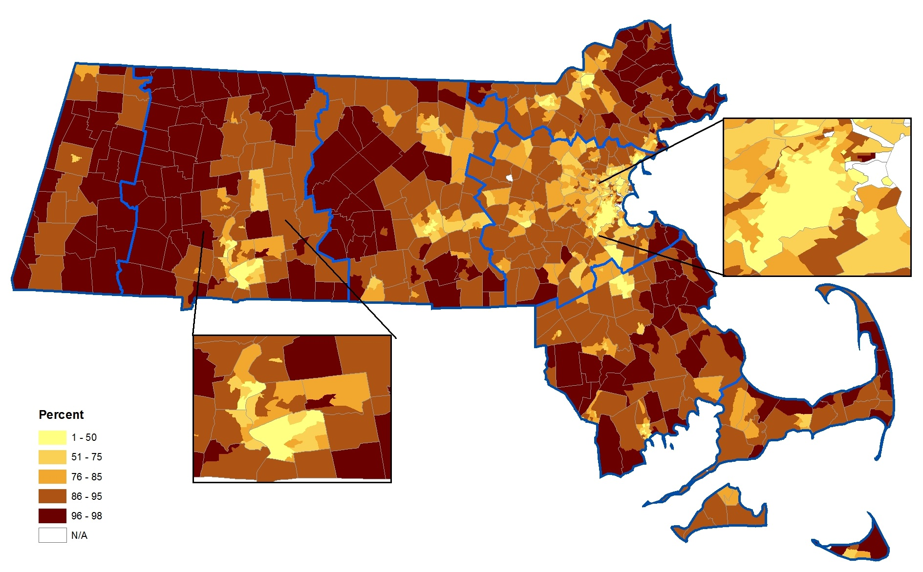
White Share of the Population

Slide 19
Top Ten Massachusetts Communities for Major Racial and Ethnic Groups
Source: 2010 Decennial Census

Slide 20
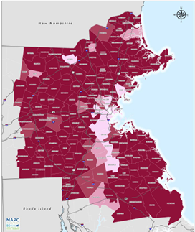
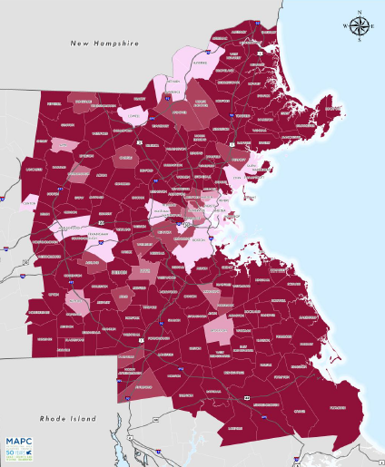
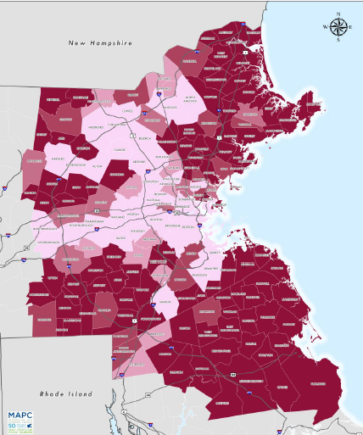

On average, MA residents of color, particularly Latinos and Blacks, do have lower incomes and higher rates of poverty than White residents do, but these differences do not fully explain the racial and ethnic segregation.
Predicted v Actual Black*
Predicted v Actual Hispanic*
Predicted v Actual Asian*
Source: Fair Housing and Equity Assessment for Greater Boston, MAPC

Slide 21
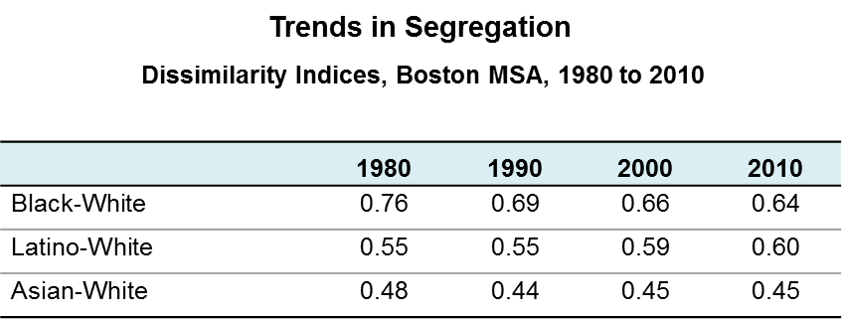
Trends in Segregation
Racial segregation in U.S. neighborhoods has declined over the past several decades but it remains very high. Meanwhile, income segregation has risen sharply from the relatively low levels in the 1970s. Large metropolitan areas, including Boston and Springfield, are among the nation’s most segregated regions.
Source: John R. Logan and Brian Stults. 2011. “The Persistence of Segregation in the Metropolis: New Findings from the 2010 Census” Census Brief prepared for Project US2010.

Slide 22
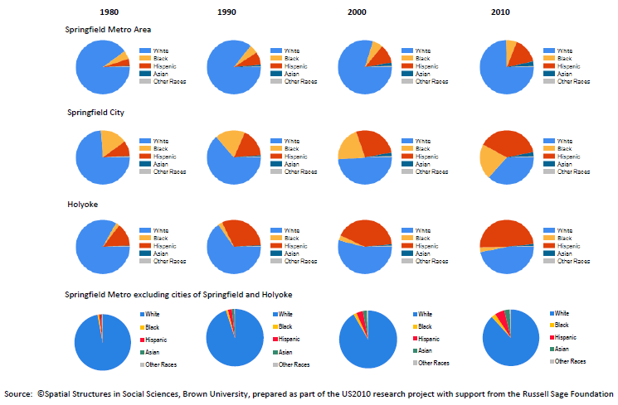
Racial Change in the Springfield Metro Area , 1980-2010

Slide 23
Segregated Communities Create Segregated Schools
Nearly 62% of the region’s Black school age children live in just four municipalities: Boston, Brockton, Randolph, and Lynn, all majority minority communities.
The City of Boston is home to nearly 44% of the region’s Black school age children and 23% of its Latino children, fewer than 3% of the MAPC region’s Non-Hispanic White children live there.
The consequence of offering elementary and secondary public education within municipal boundaries is that White children are highly unlikely to come into contact with children of color either in their communities or within their schools

Slide 24
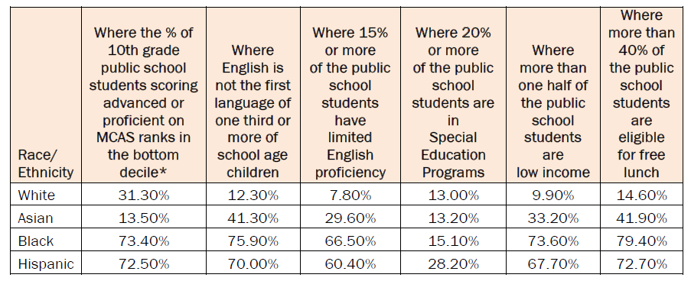
Characteristics of Students in Public Schools Attended by the MAPC region’s Black, White, Asian, and Hispanic Students

Slide 25
High levels of racial separation are rooted in public and private discriminatory actions of the past…
but they are maintained – and often exacerbated – by current conditions. These include:
Discrimination or differential treatment in the housing, mortgage and insurance markets;
Exclusionary zoning, land use, and school policies at the state and local levels;
Government policies affecting the location of, and access to, subsidized housing;
Limited affordable housing and a lack of housing diversity in many communities; and
Infrastructure investments.

Slide 26
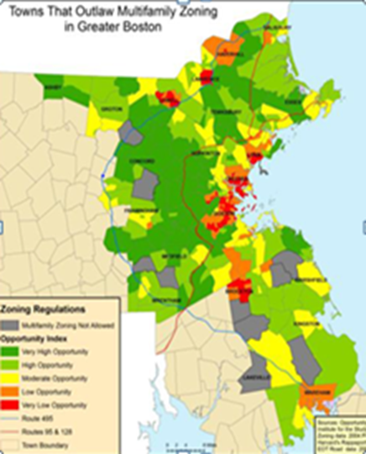
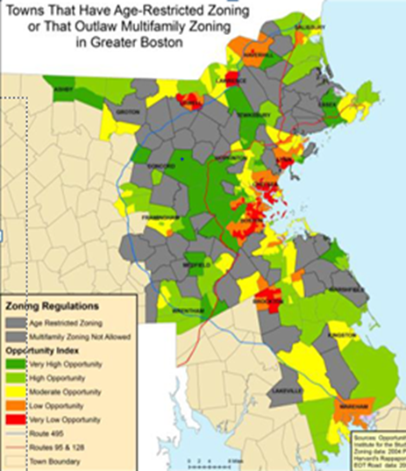
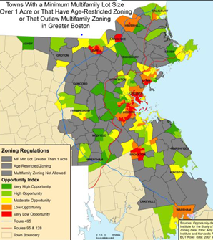
Restrictive Zoning

Slide 27
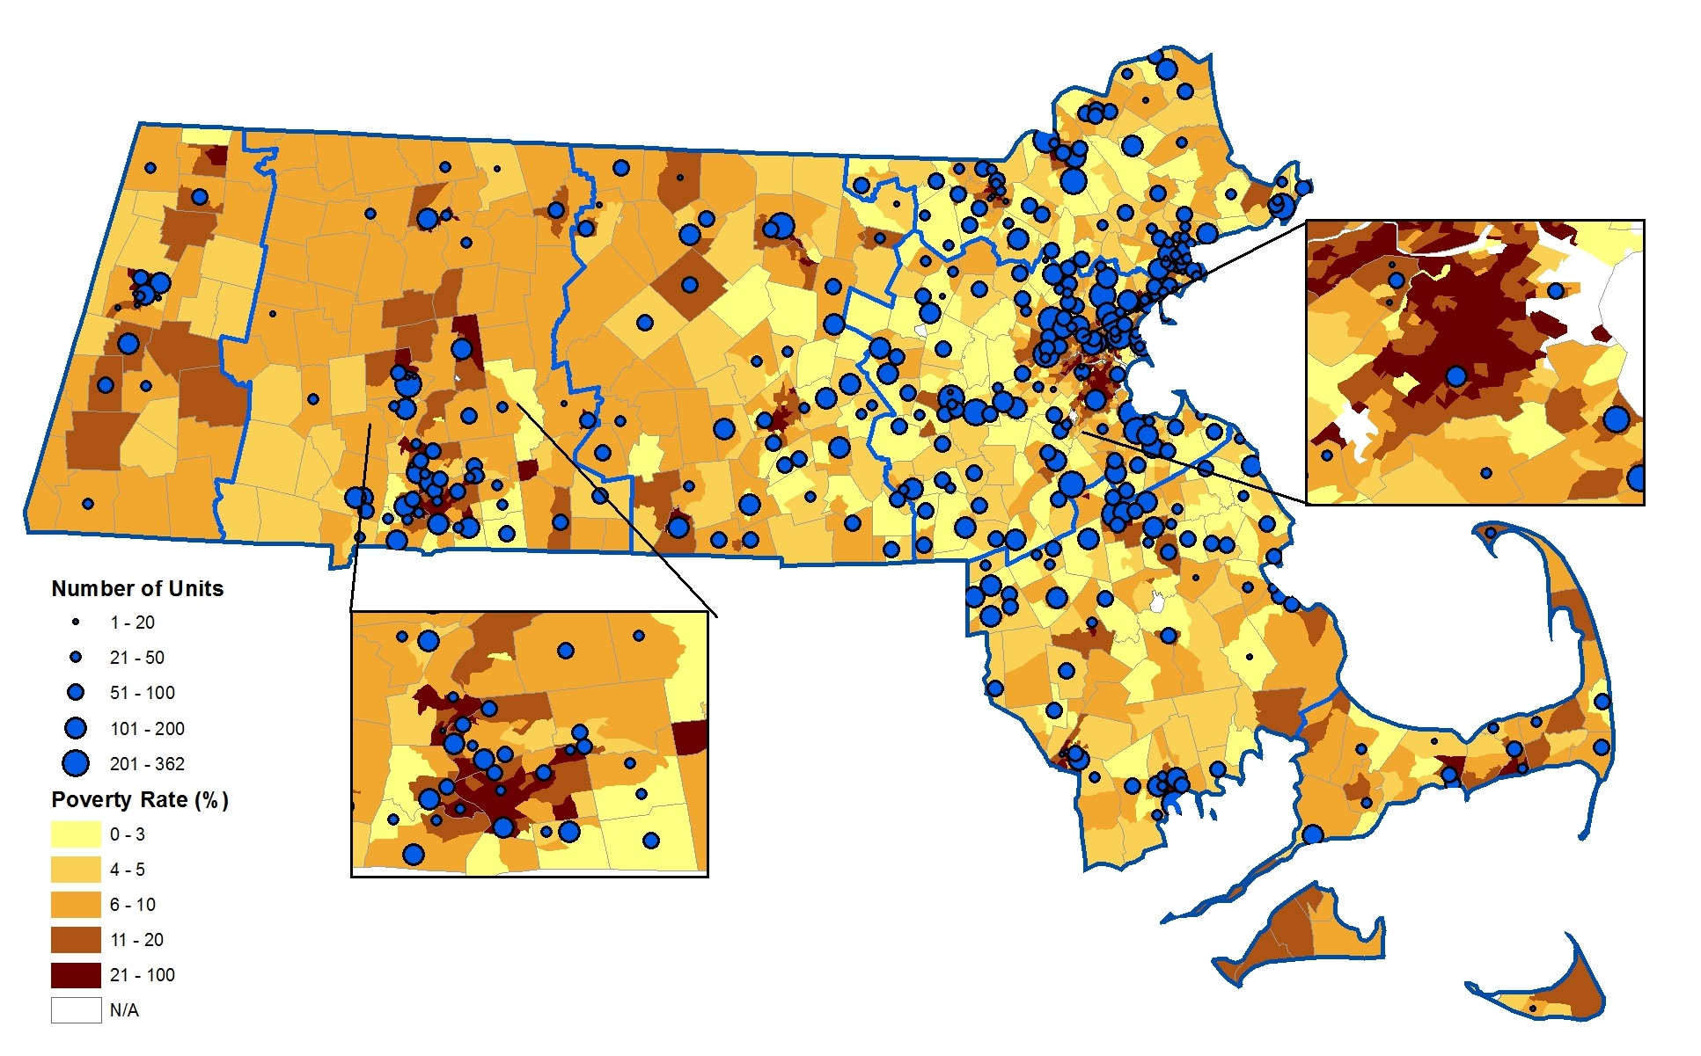
Elderly public housing overlaid on tract poverty rate

Slide 28
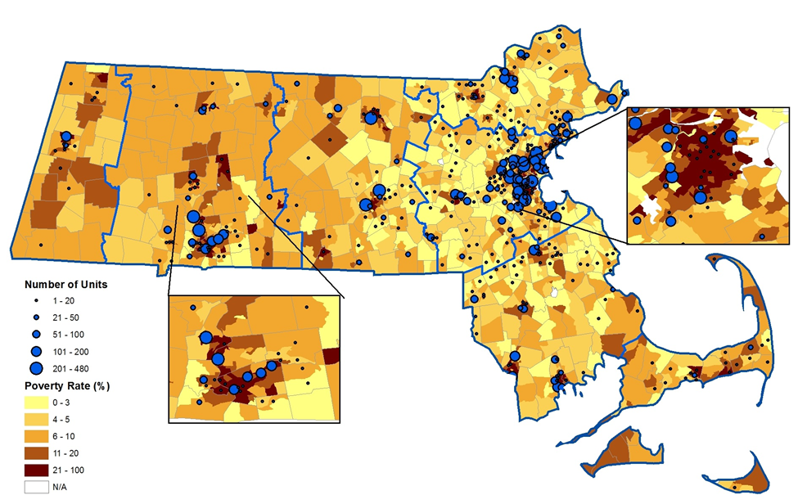
Family public housing overlaid on tract poverty rate

Slide 29
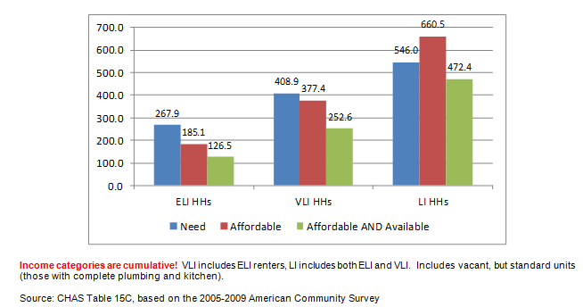
Number of Affordable Rental Units Needed
Massachusetts Affordable Rental Housing Needs, Supply

Slide 30
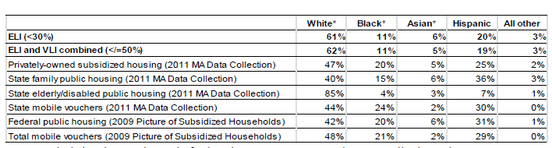
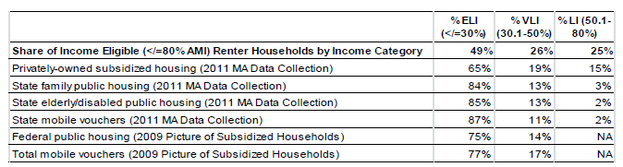
Who is Being Assisted with Federal and State Housing Subsidies?
Distribution of Households by Race/Ethnicity
Distribution of Households by Income Category
Source: DHCD 2011 State Data Collection and HUD 2009 Picture of Subsidized Households

Slide 31
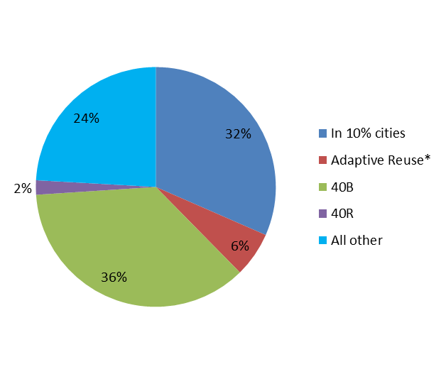
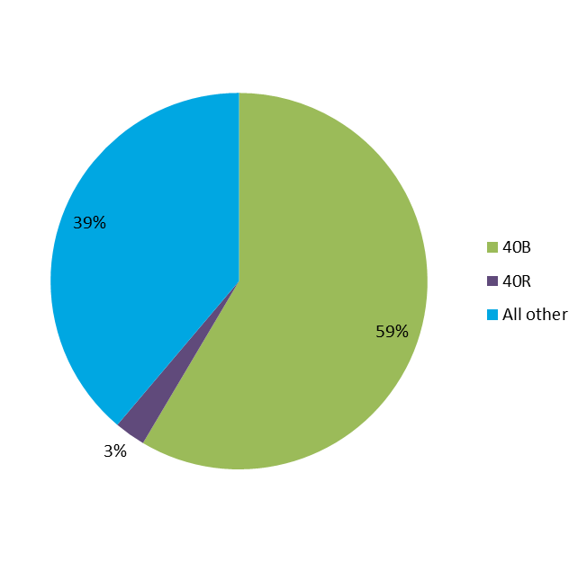
How are We Growing Our Mixed Income Inventory?
New Market Rate and Mixed Income Development in MA 2001-2012
New Market Rate and Mixed Income Development in MA 2001-2012 excluding adaptive reuse and development in cities over the “10%” threshold
Source: MA 2013 Analysis of Impediments to Fair Housing Choice

Slide 32
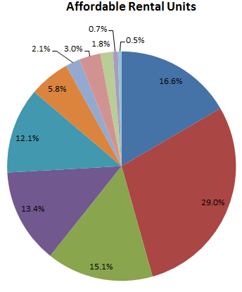
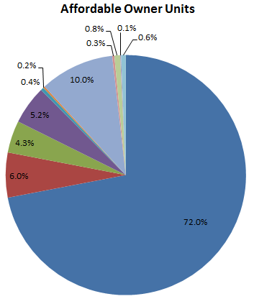
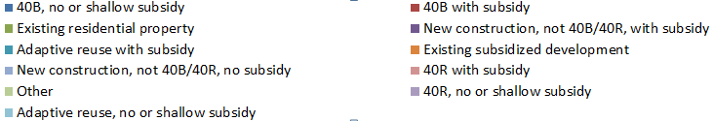
Tools Used to Create Affordable Units 2001-2013*
*Excluding Boston
Source: MA 2013 Analysis of Impediments to Fair Housing Choice

Slide 33
Recommendations
Multiple strategies needed on many fronts.
Invest in people, invest in places, support linkages
Mixed income, mixed race neighborhoods:
Successful income integration in a neighborhood setting may be more difficult than in a housing project context.
Expand awareness of rental opportunities in high opportunity, non-impacted areas.
Expand pool of landlords participating in HCV program.
Improve the effectiveness of the voucher program. (e.g., prohibit source of income discrimination, administer vouchers regionally, expand outreach to landlords and tenants, implement small area fair market rents (FMRs).
Improve schools in all communities.
Preserve and expanding the safety net. The importance of having affordable housing options (both market rate and long term affordable) in a variety of community types and locations is vital.
Develop better metrics to define/measure success

Slide 34
Recommendations
Mixed income, mixed race developments:
Multiple strategies needed on many fronts.
Invest in people, invest in places, support linkages
Mixed income housing is well designed, well-managed, adequately financed, and competitive in the marketplace.
Have sufficient market rate units to create a critical mass
Don’t emphasize the income mixing; emphasize the development’s other amenities (but don’t lie about it!)
Develop better metrics to define/measure success

Slide 35
Want More Info?
  Massachusetts 2013 Analysis of Impediments to Fair Housing http://www.mass.gov/hed/docs/dhcd/hd/fair/2013analysis.pdf
  MAPC Fair Housing and Equity Assessment for Metropolitan Boston https://www.chapa.org/sites/default/files/Full_Fair%20Housing%20and%20Equity%20Assessment%20for%20Metro%20Boston_0.pdf
  HUD Summary of new AFFH Rule: http://www.huduser.org/portal/sites/default/files/pdf/AFFH_Final_Rule_Executive_Summary.pdf
  Kirwan Institute Opportunity Mapping Report: http://kirwaninstitute.osu.edu/initiatives/opportunity-communities/mapping/massachusetts-opportunity-mapping-resource-site
  Massachusetts Interagency Agreement Regarding Housing Opportunities for Families with Children
  http://www.mass.gov/hed/docs/dhcd/hd/fair/affirmativefairhousingp.pdf
  MAPC Fair Housing and Equity Assessment for Metropolitan Boston https://www.chapa.org/sites/default/files/Full_Fair%20Housing%20and%20Equity%20Assessment%20for%20Metro%20Boston_0.pdf
Comments, questions: bsheud@gmail.com

Slide 37
*Includes only those tenant-based (mobile) state vouchers and federal tenant-based (mobile) Housing Choice vouchers administered by regional nonprofits on behalf of DHCD. The DHCD share of total federal Housing Choice Vouchers is about 29 percent.
Source: DHCD 2011 Housing Data Collection

Slide 38
