Slide 1
Healthy Built Environments
Making the Health and Vitality Connection
Smart Growth and Health

Slide 2
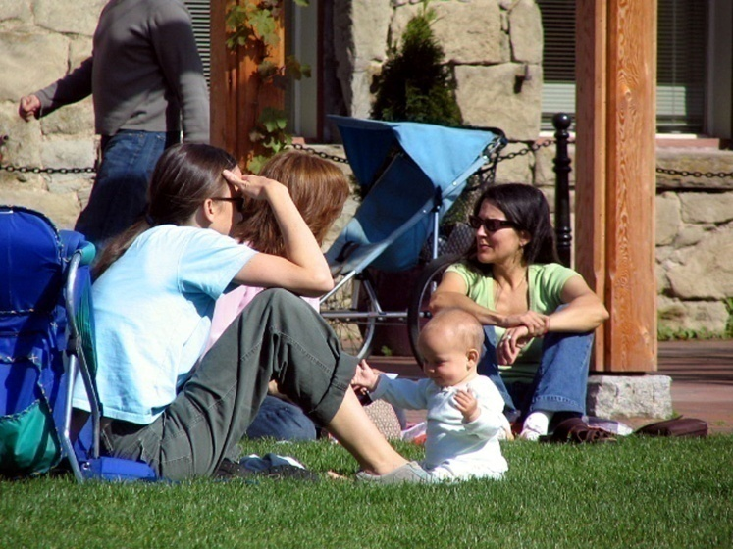
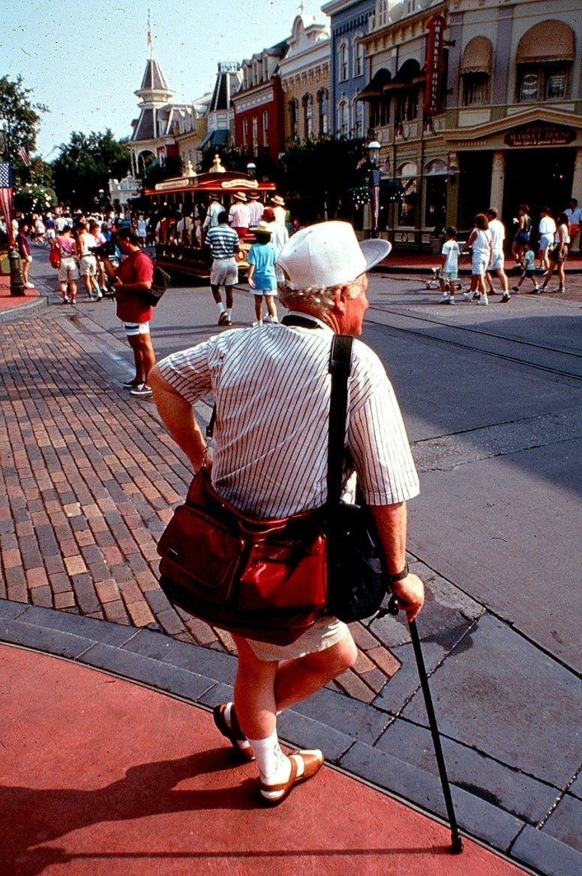
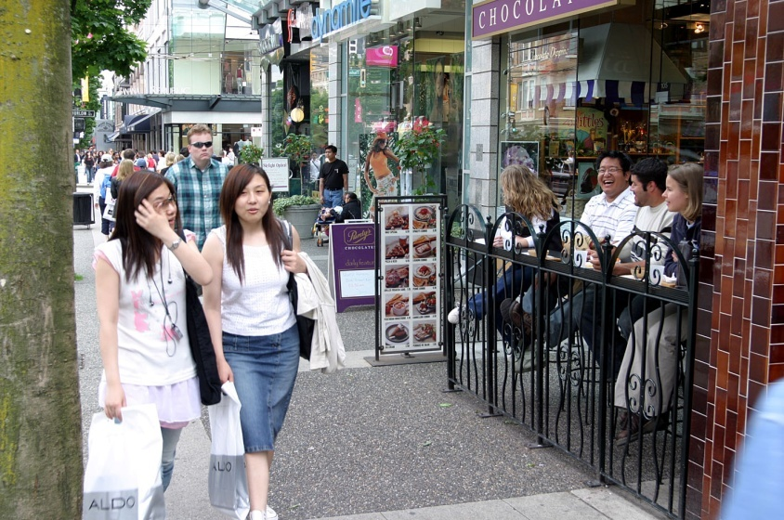
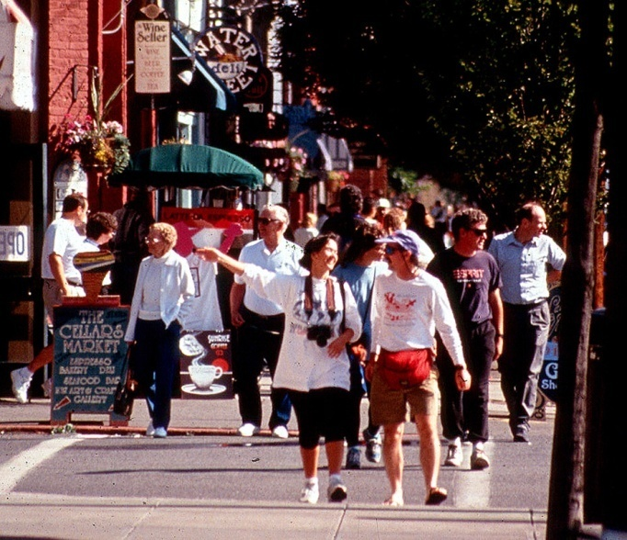
What most people want…

Slide 3
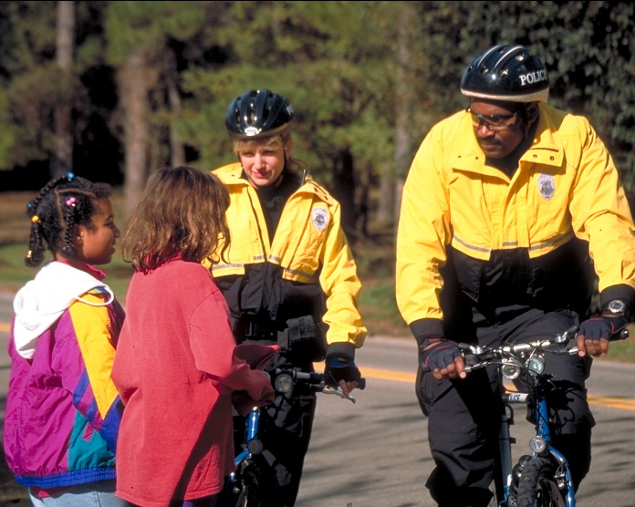
What most people want…

Slide 4
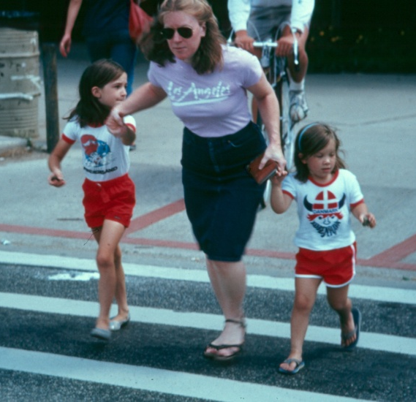
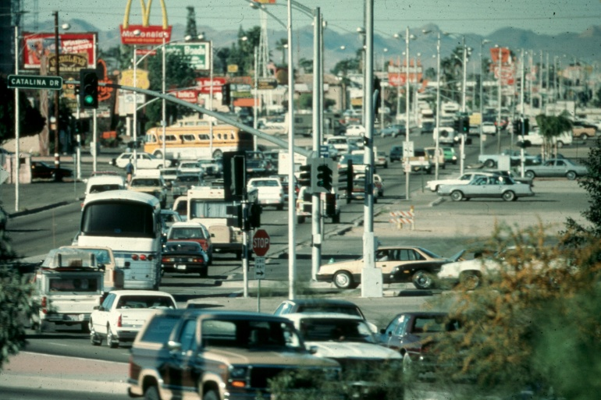
What we ended up with…

Slide 5
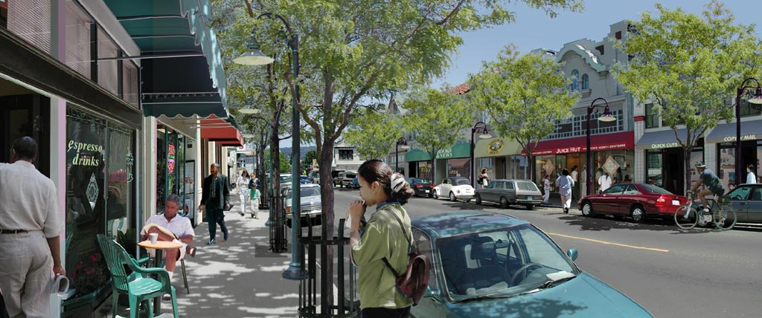
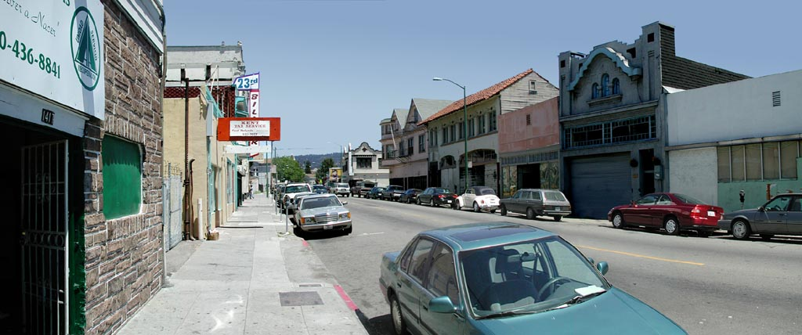
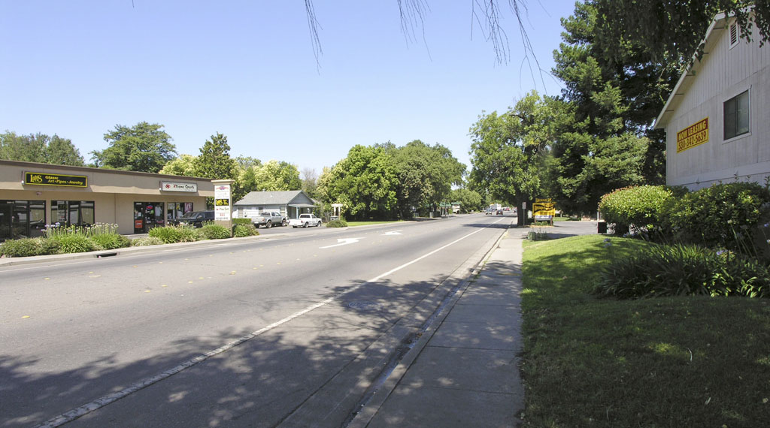
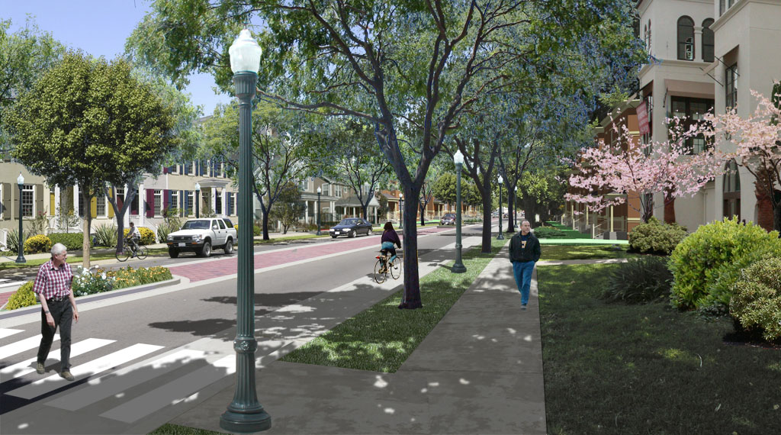
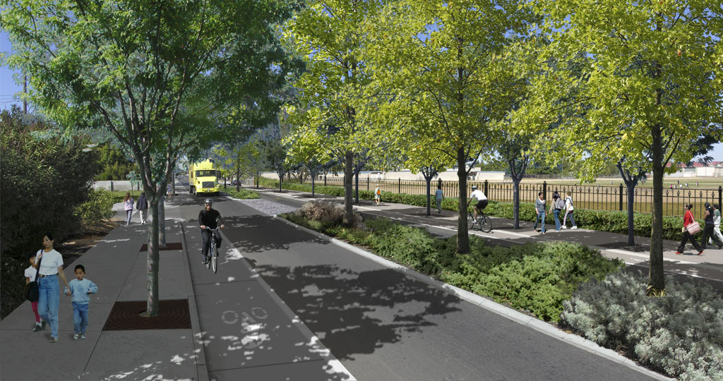
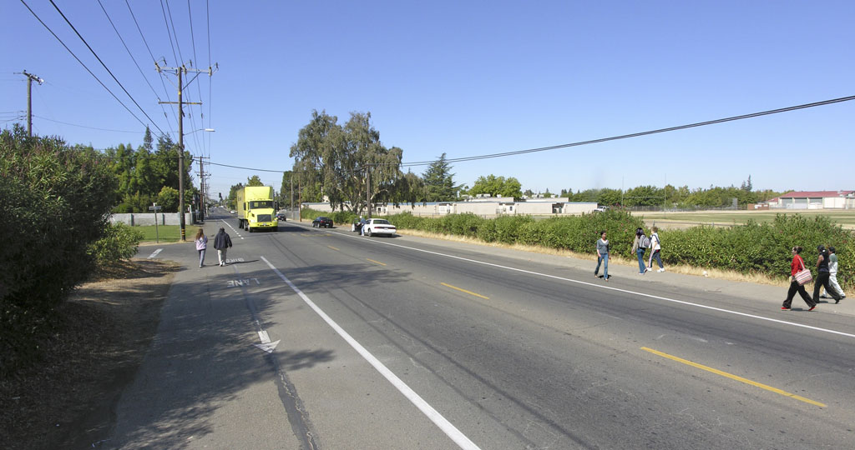
The Health and Smart Growth connection
Dan Burden
Director of Inspiration and Innovation
Blue Zones, LLC

Slide 6
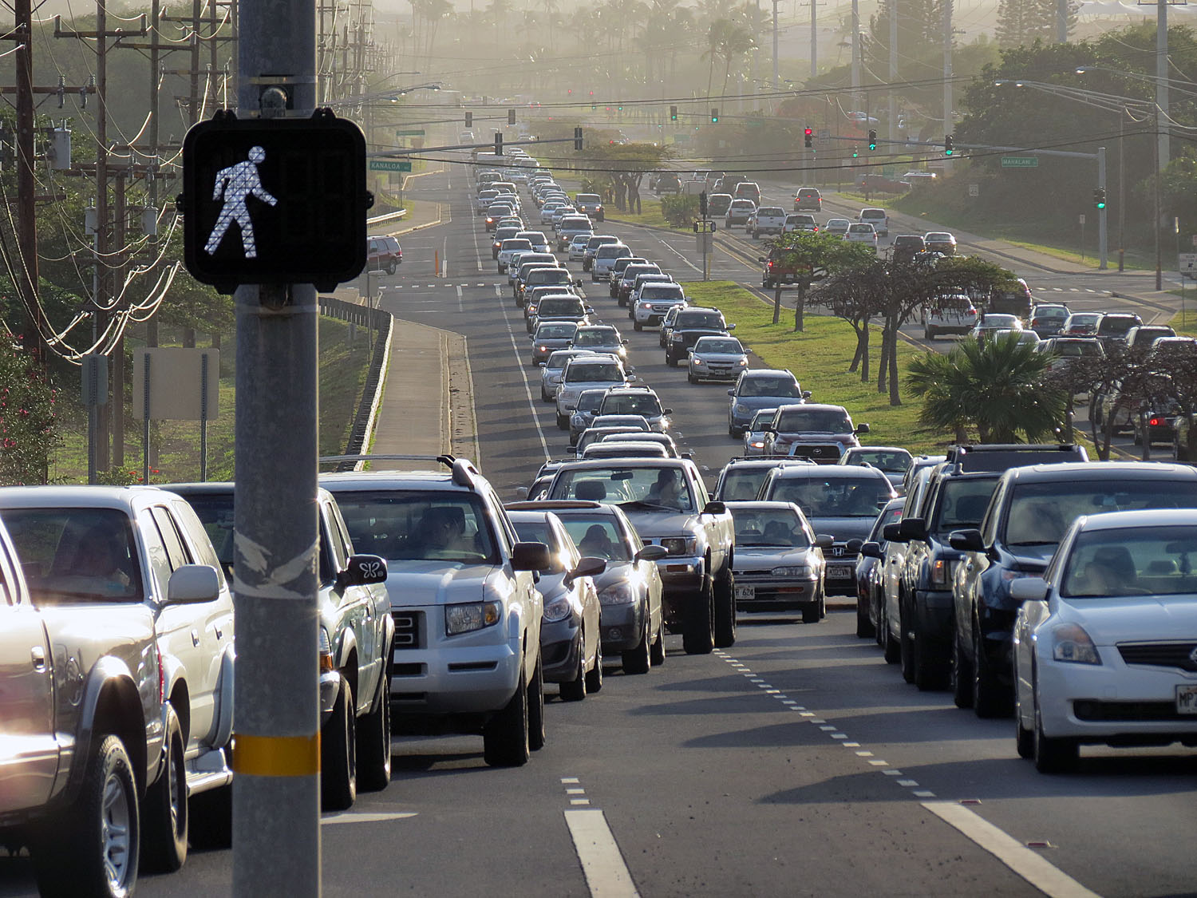

Slide 7
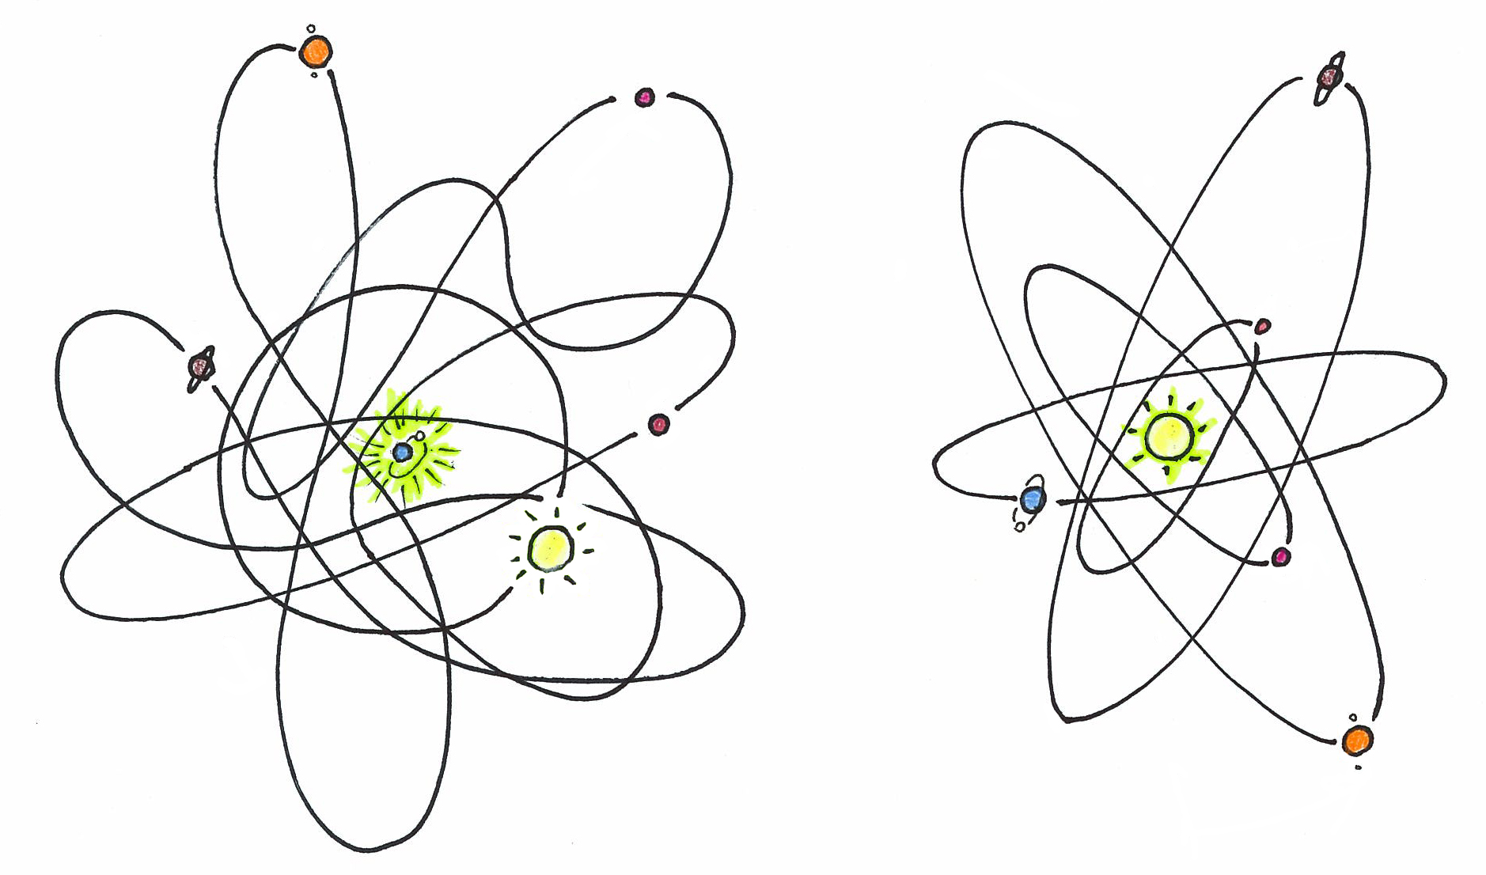
Courtesy of Ian Lockwood

Slide 8
Courtesy of Ian Lockwood

Slide 9
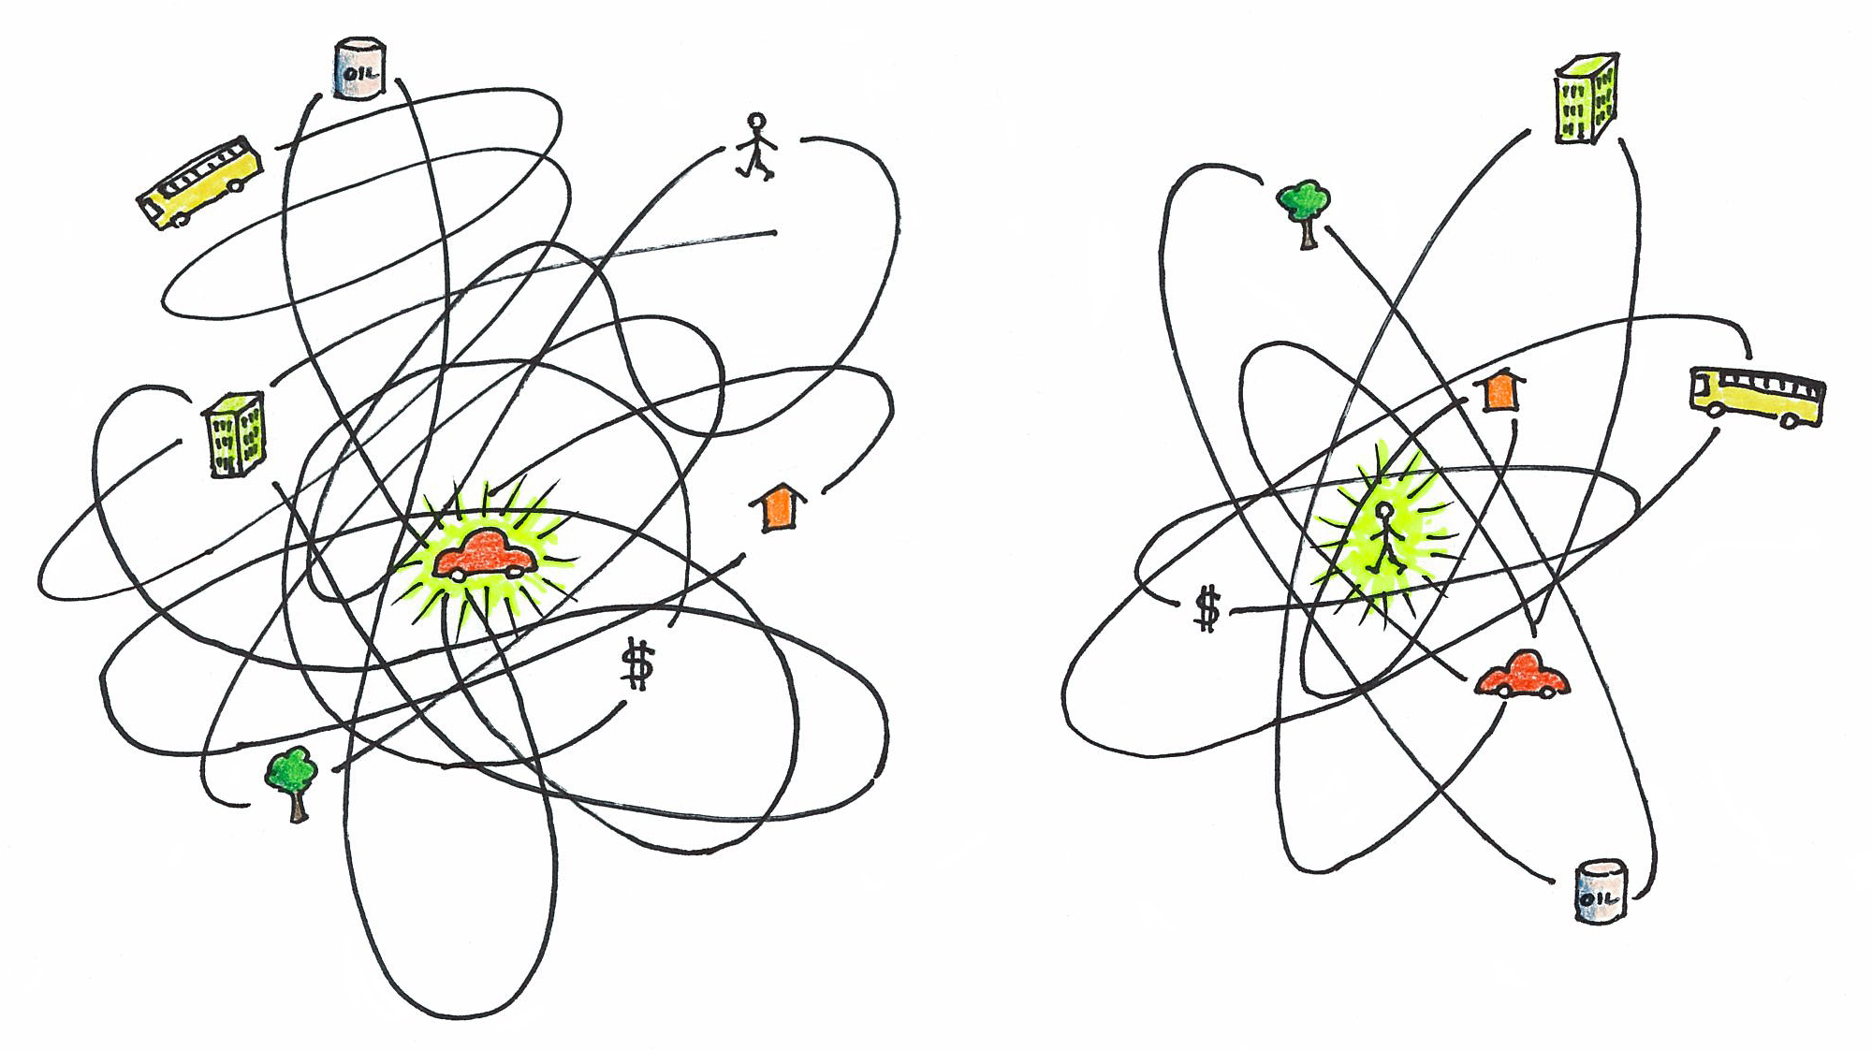
Courtesy of Ian Lockwood

Slide 10
Courtesy of Ian Lockwood

Slide 11
Litmus Test:
Does the “change” reward the short trip and active transportation?
Change: change in policy, street design, land use, operations, transit initiative, etc.

Slide 12
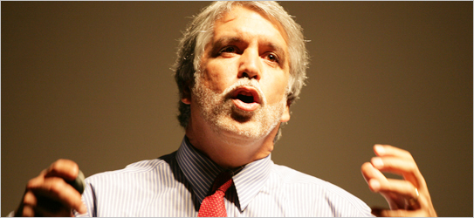
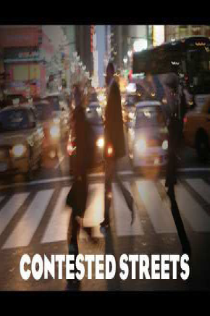
As North Americans What can we learn from nation’s with less money, less dependency on oil?
“We can have a city that is very friendly to cars.
Or a city that is very friendly to people.
But we cannot have both.”
- Enrique Peñalosa, Mayor of Bogotá Columbia
-Co-winner of 2000 Stockholm Environment Award
From living hell to living well:
A radical campaign to return streets from cars to people in Colombia’s largest city is now a model for the world

Slide 13
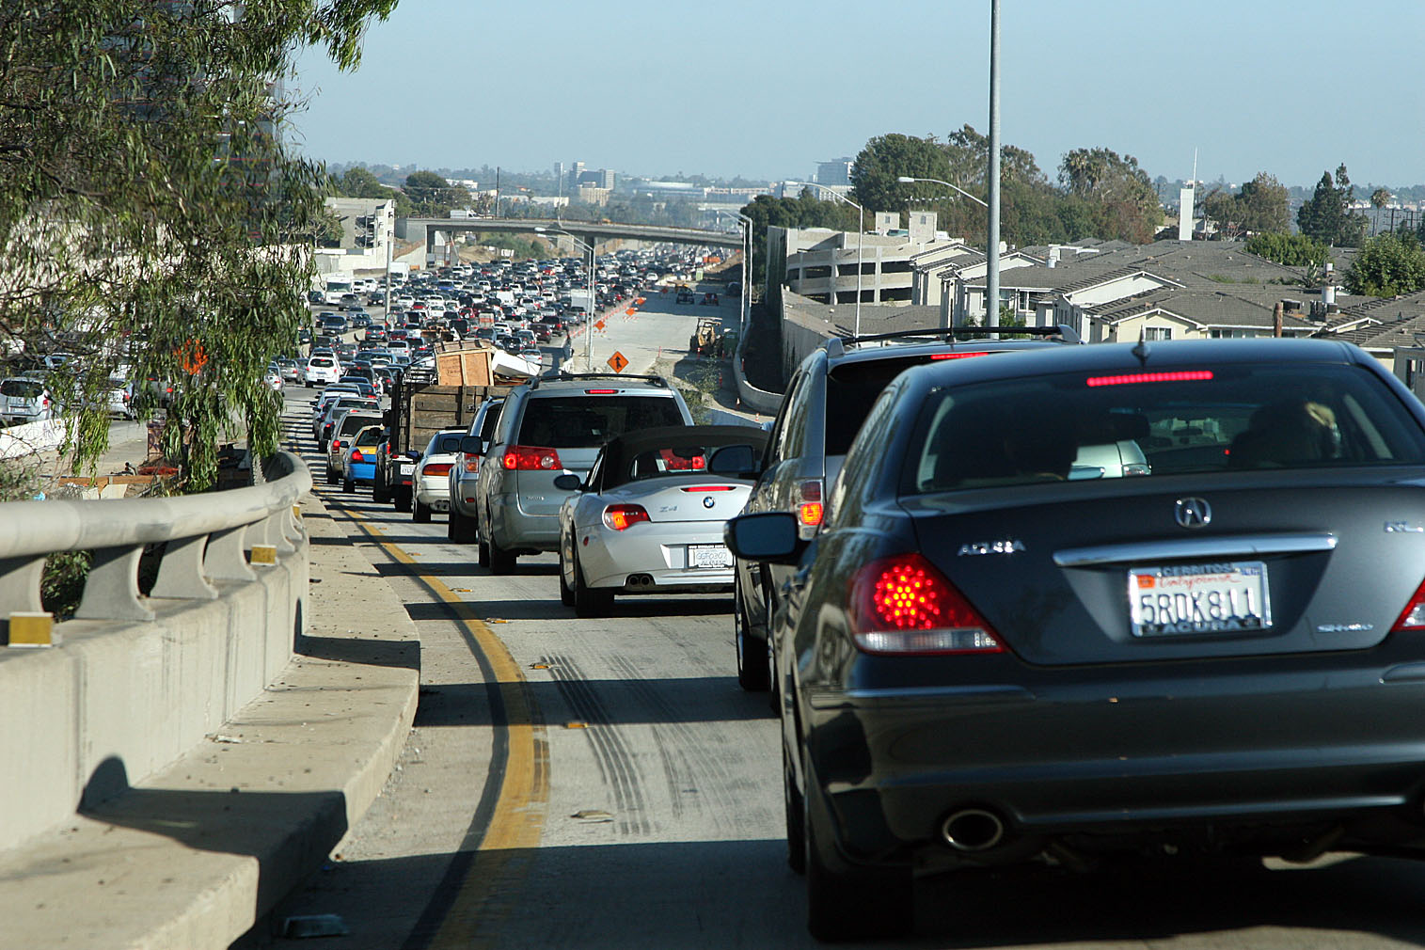
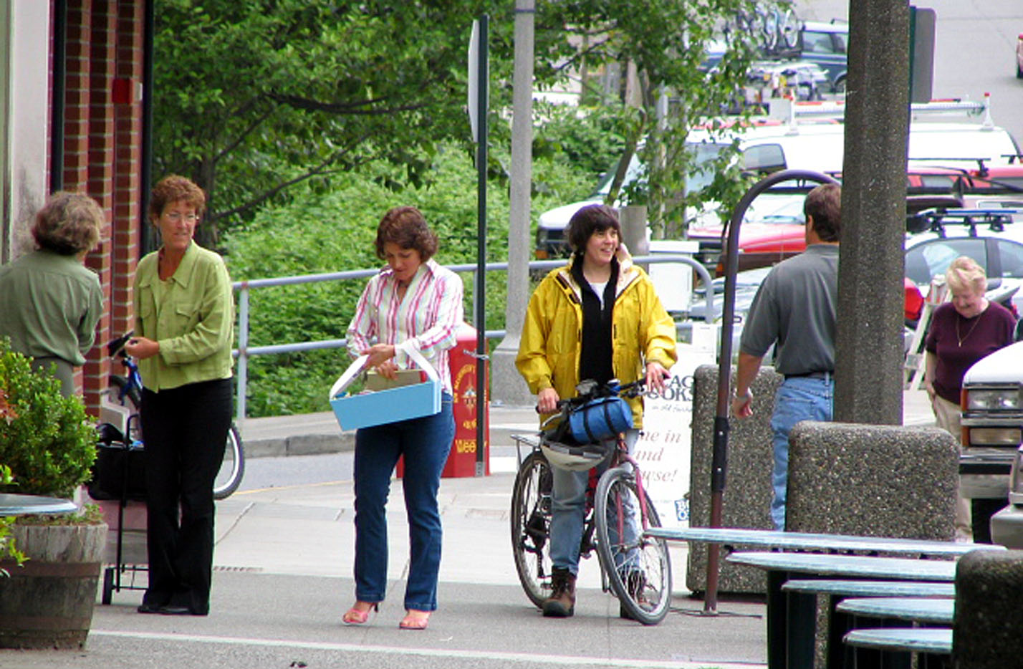
If you plan cities for cars and traffic, you get cars and traffic.
If you plan for people and places, you get people and places.

Slide 14
“How can you know what to try with traffic until ….”
“Automobiles are often conveniently tagged as the villains responsible for the ills of cities and the disappointments and futilities of city planning. But the destructive effects of automobiles are much less a cause than a symptom of our incompetence at city building.
The simple needs of automobiles are more easily understood and satisfied than the complex needs of cities, and a growing number of planners and designers have come to believe that if they can only solve the problems of traffic, they will thereby have solved the major problems of cities.
Cities have much more intricate economic and social concerns than automobile traffic. How can you know what to try with traffic until you know how the city itself works, and what else it needs to do with its streets? You can't.”
Jane Jacobs, Death and Life of Great American Cities , 1961

Slide 15
How do we overcome the fear of change?

Slide 16
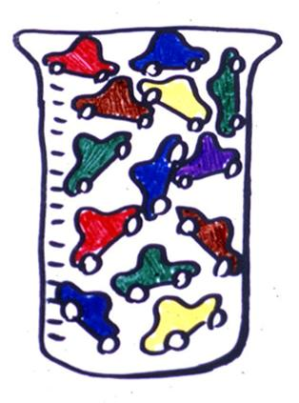
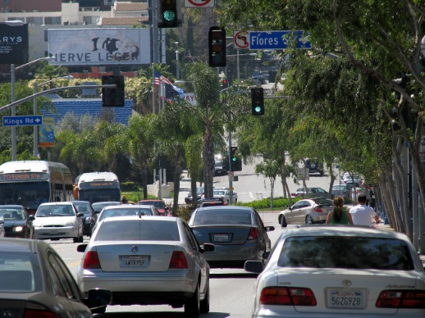
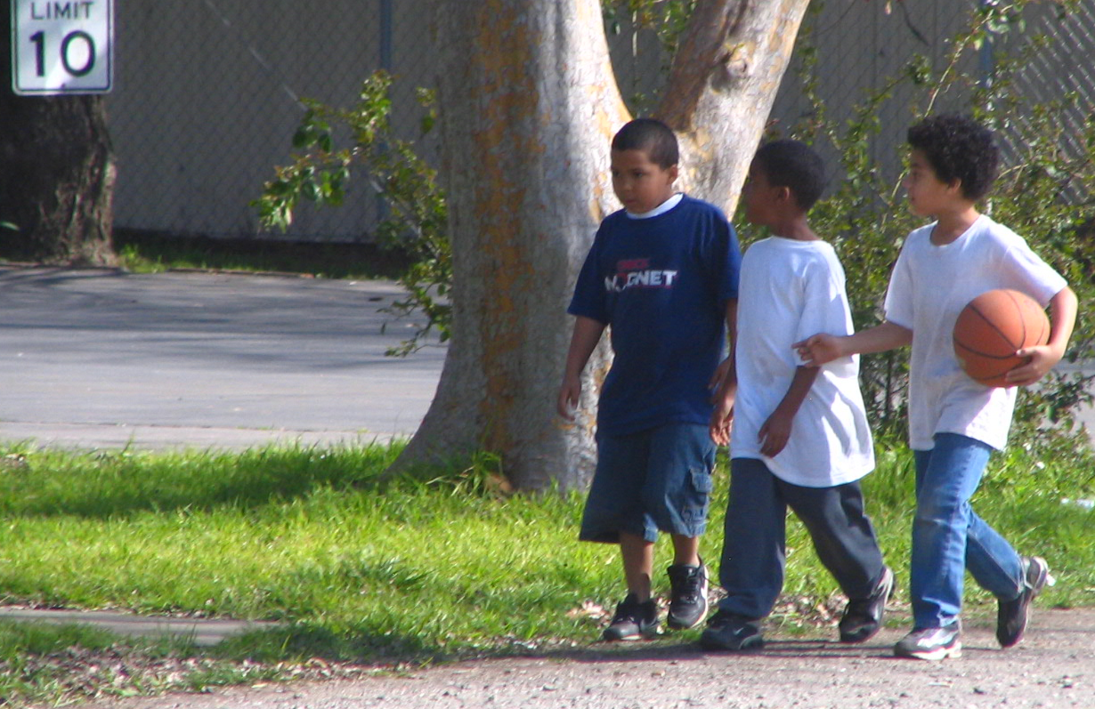
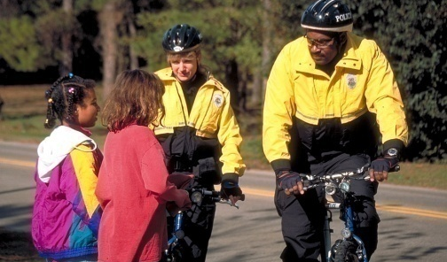
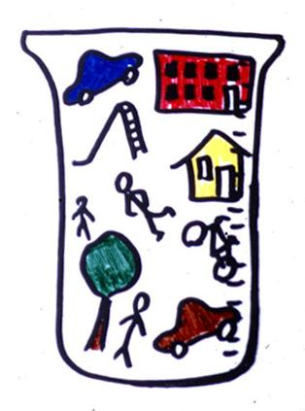
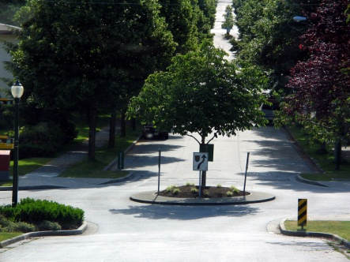
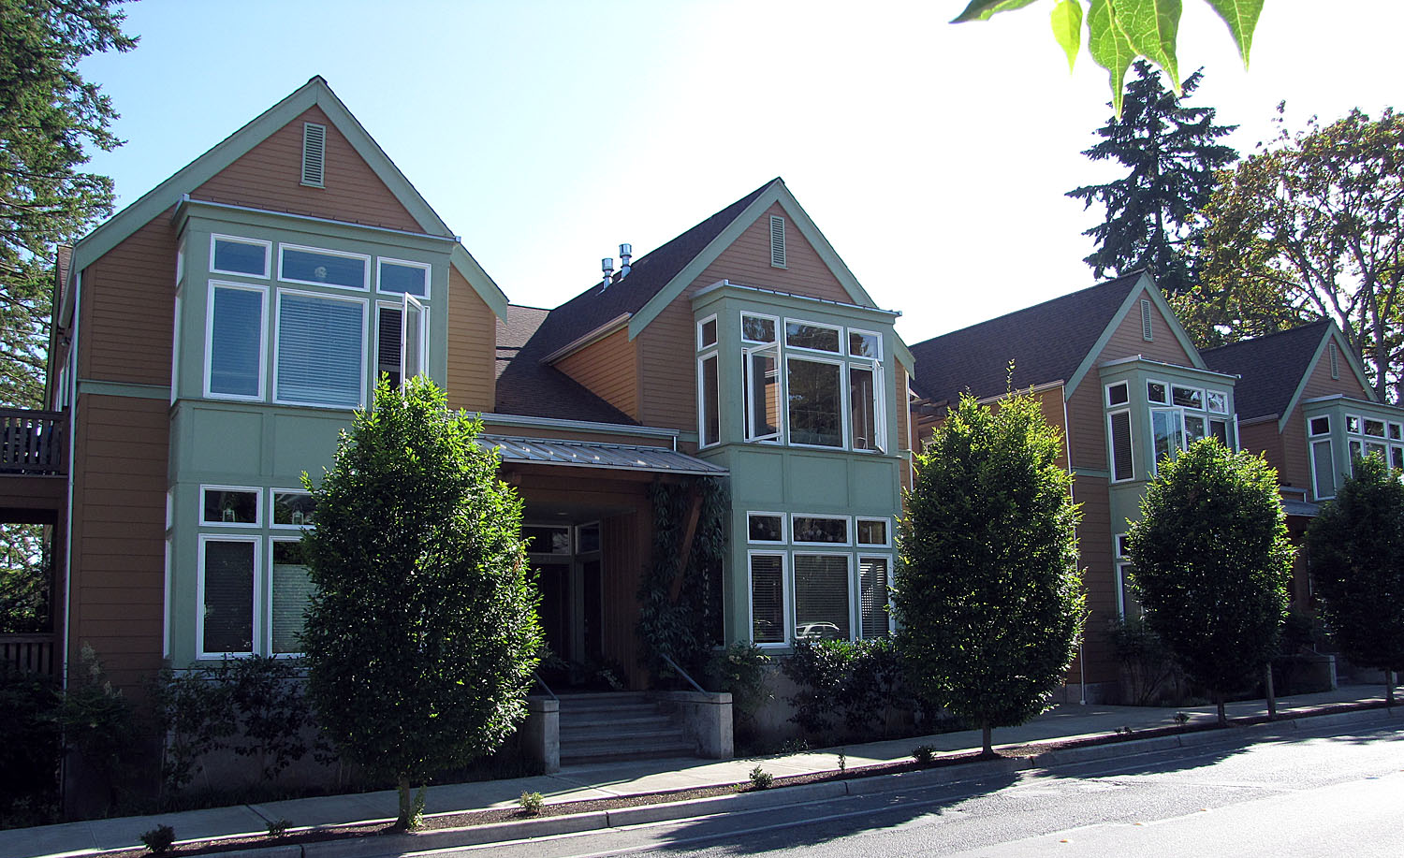
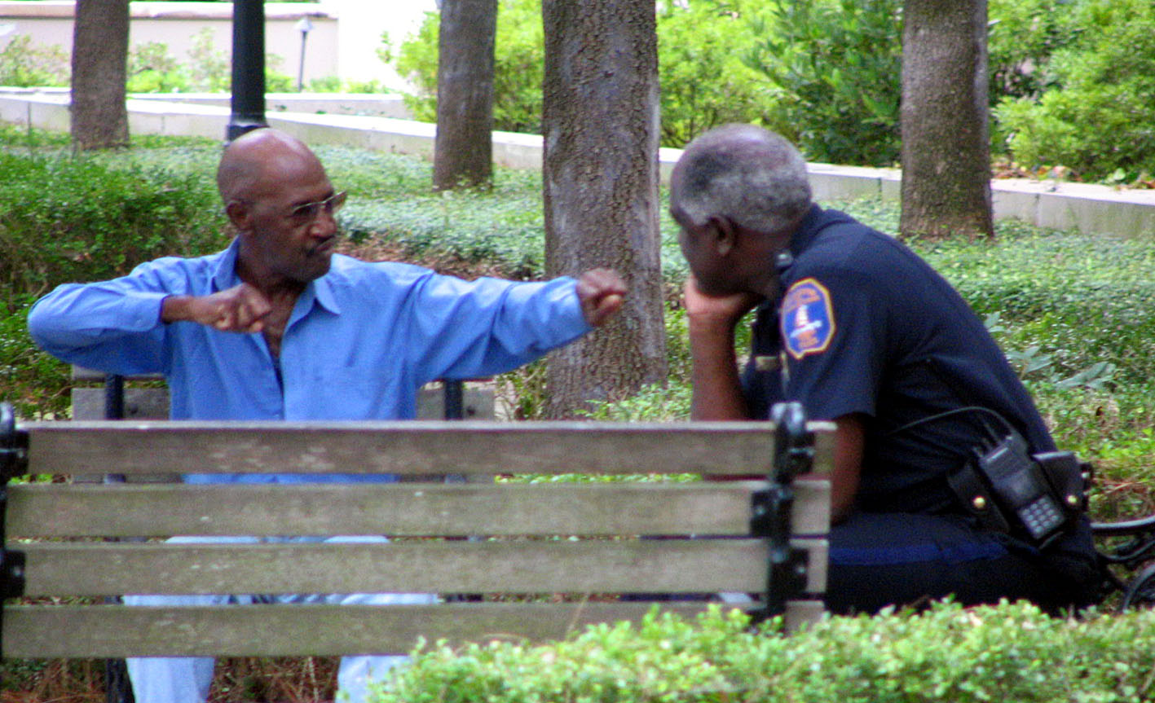
Following that philosophy led to this, redundantly.
The simple needs of automobiles are more easily understood and satisfied than the complex needs of cities, and a growing number of planners and designers have come to believe that if they can only solve the problems of traffic, they will thereby have solved the major problems of cities.
A new beaker and measure will lead to this.

Slide 17
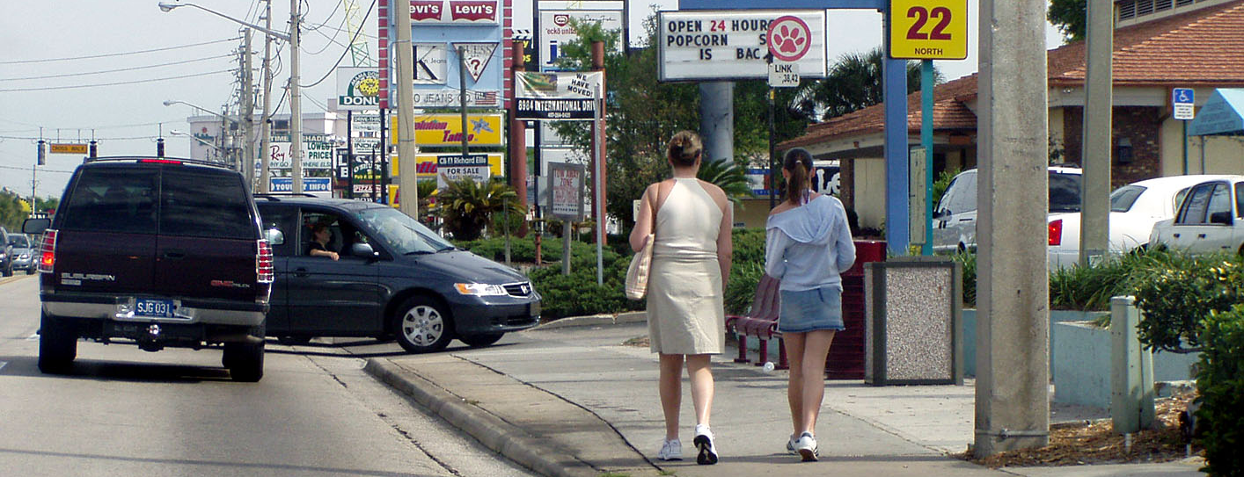
Where would you rather walk? Why?

Slide 18
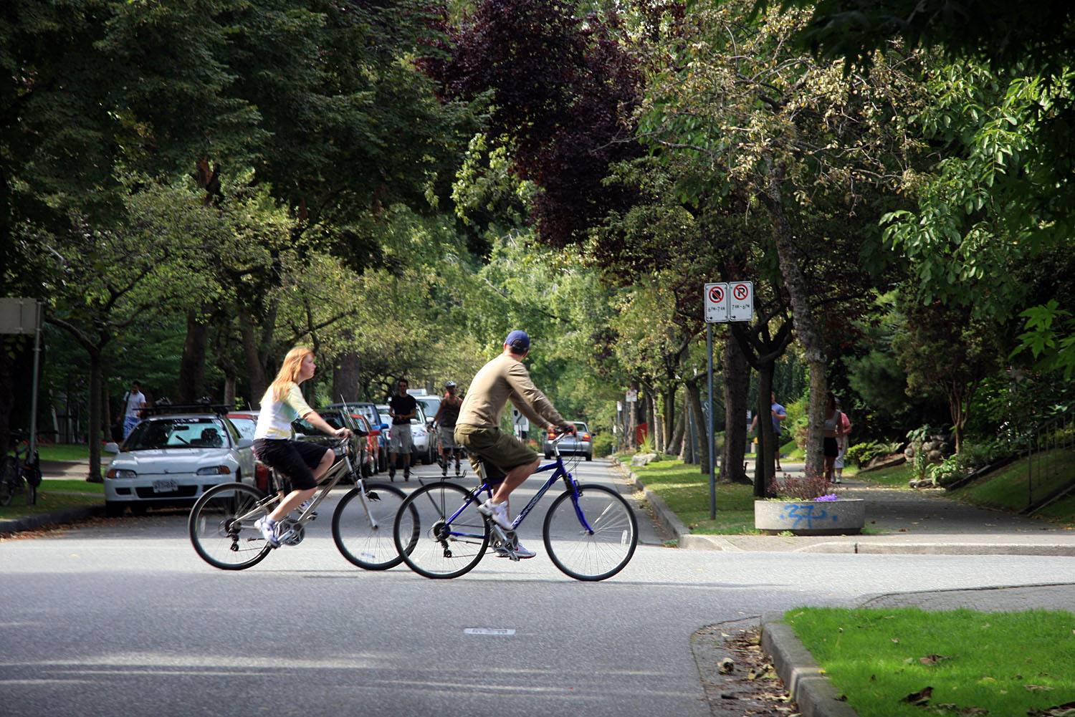
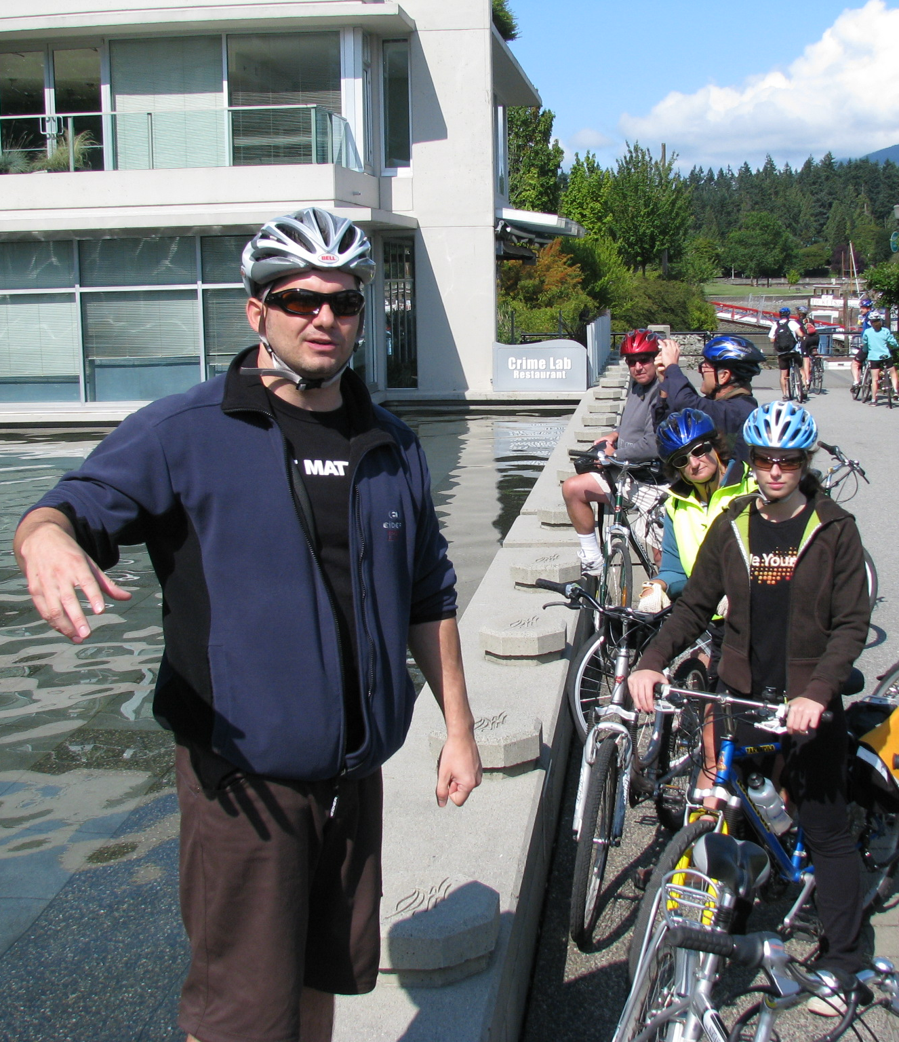
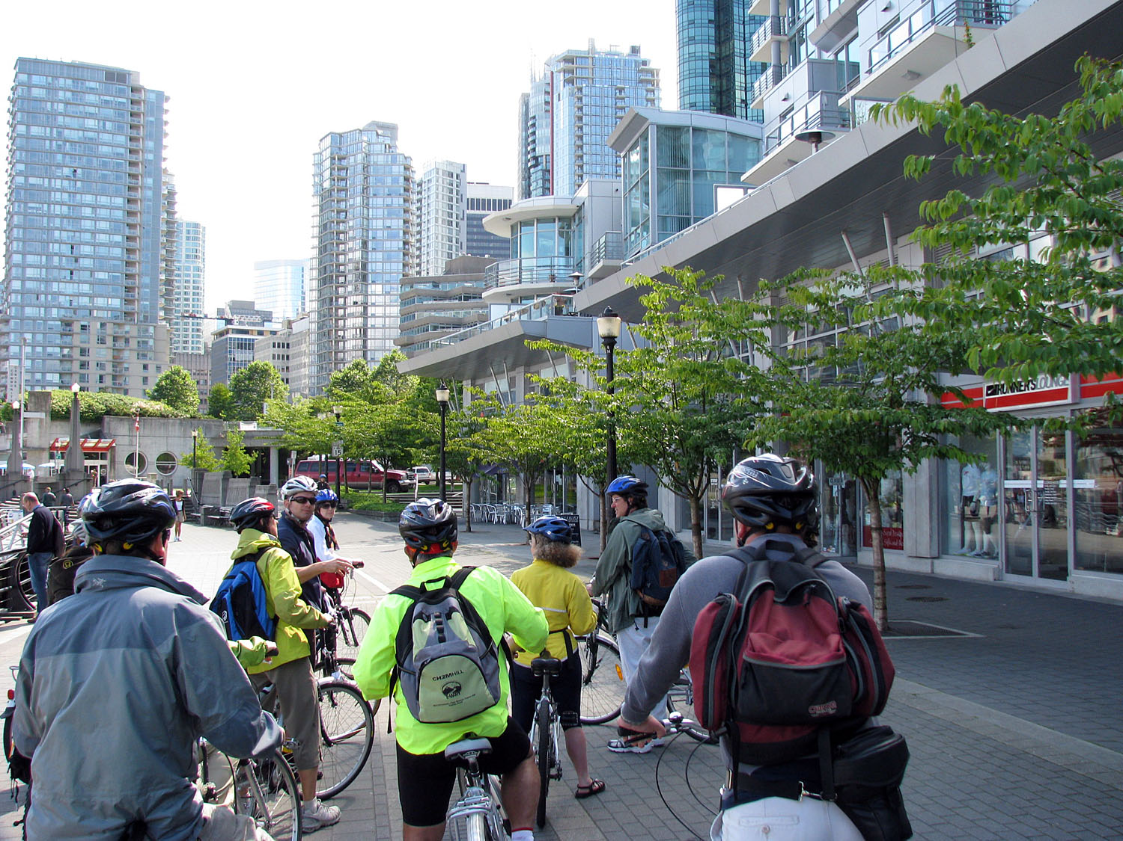
Density
Connectivity (compact block patterns)
Compact intersections
Design (right size, right scale streets)
Access (Mixed Use, small parks, plazas)
Density
Connectivity (compact block patterns)
Compact intersections
Design (right size, right scale streets, parks, plazas)
Access (The Right Mix -- Mixed Use, small parks, plazas)
Mix the New with the Old

Slide 19
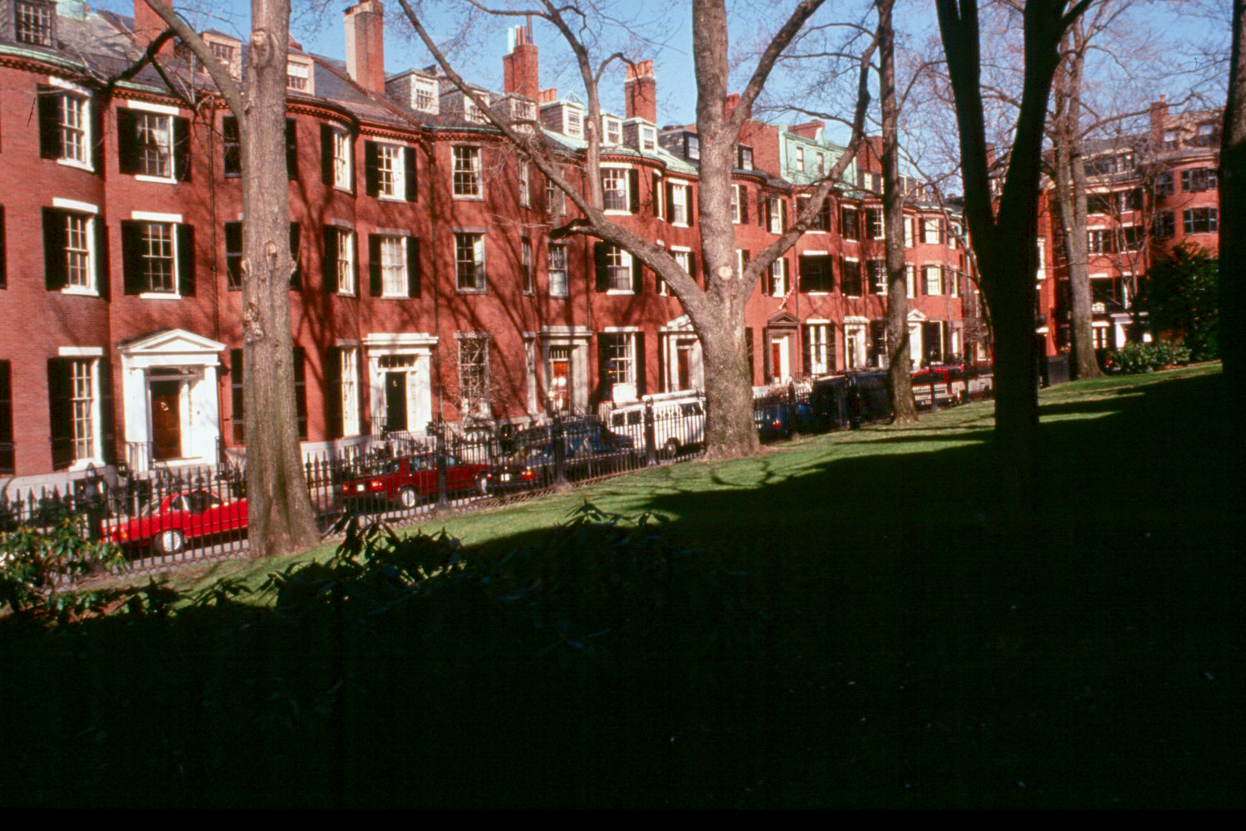
America’s First Development
1550 feet from THE CHEERS BAR, 6 other bars, 8 deli’s, 4 banks, 3 hardware stores, 2 florists, 18 restaurants, 5 churches, grocer, pharmacist, medical and dozens more.
Beacon Hill, Boston

Slide 20
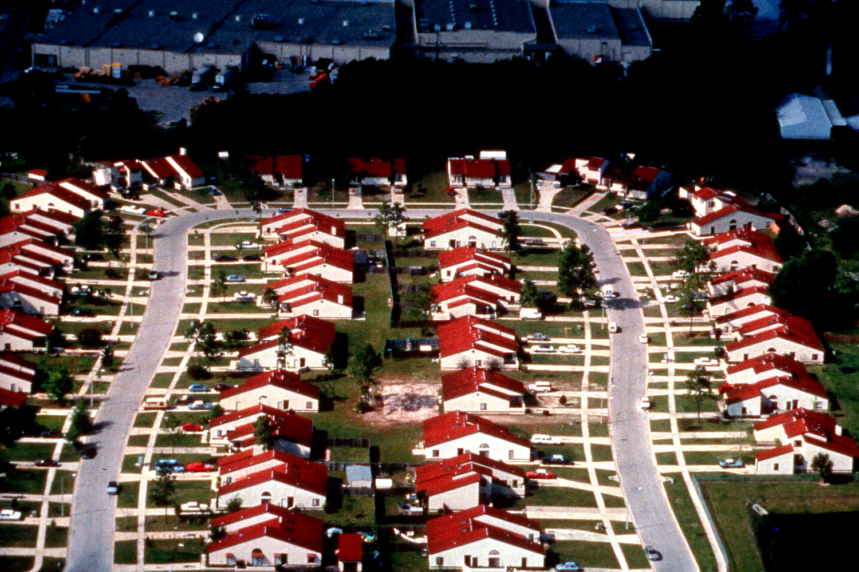
1550 feet from
NOTHING
Orlando, Florida

Slide 21
How many units per acre is pictured here?

Slide 22
Make the Connections

Slide 23
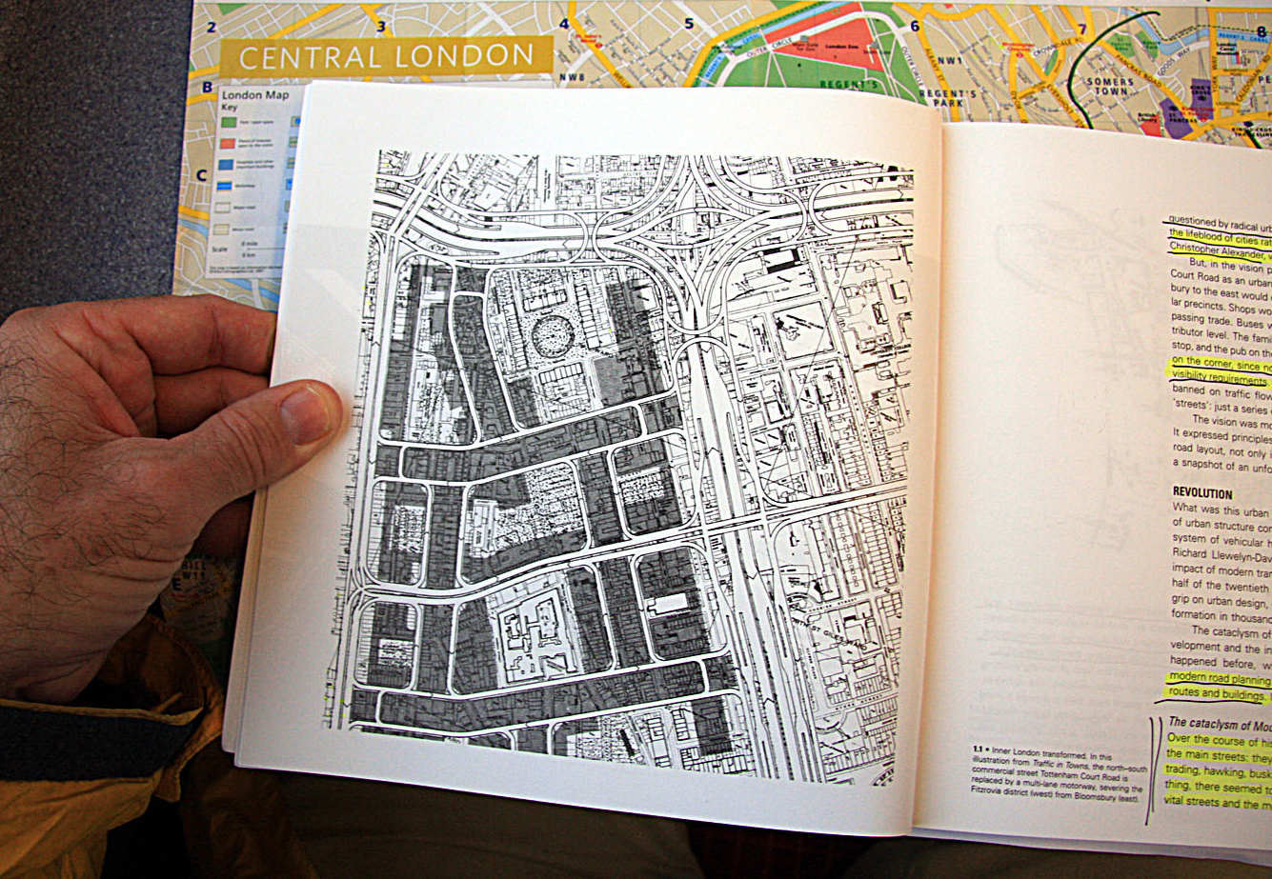

Slide 24
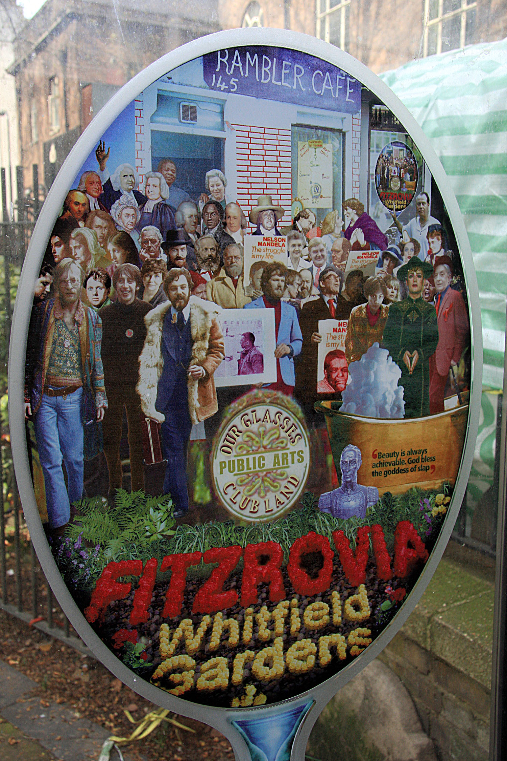
Among other things Tottenham Court and Fitzrovia gave birth to or inspired
Karl Marx, Utilitarianism (greatest happiness for the greatest number),
Vagabondism, John Wesley and the Methodist Church, birth control, Charles Dickens, Charles Darwin, George Bernard Shaw, Dylan Thomas, Desmond Morris, Picasso, Salvador Dali, Yates, Gertrude Stein, Whistler and Augustus John.
Anesthesiology, Anti-slavery, the liberation of Venezuela, reformism, campaigns for women’s rights
and, of course, Boy George also had roots or blossomed here.

Slide 25
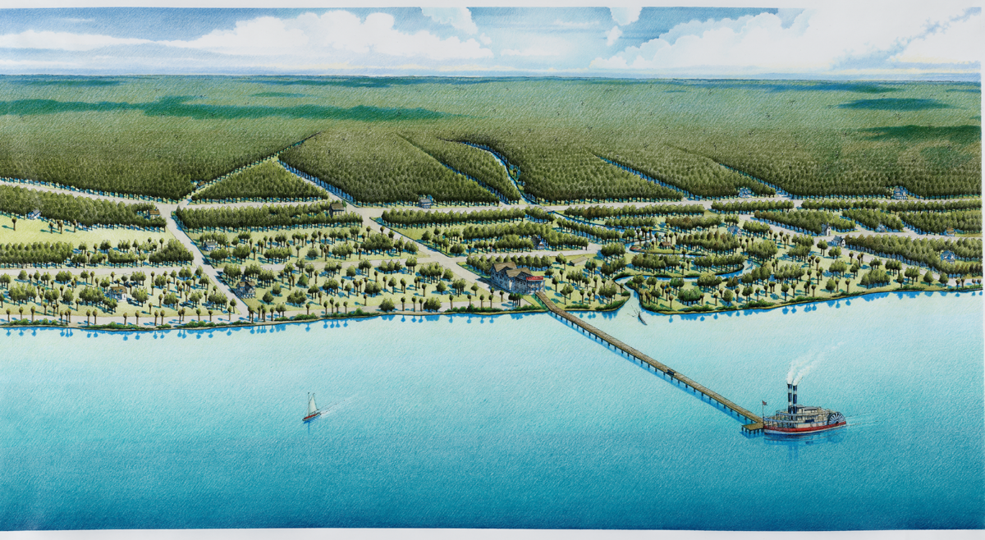
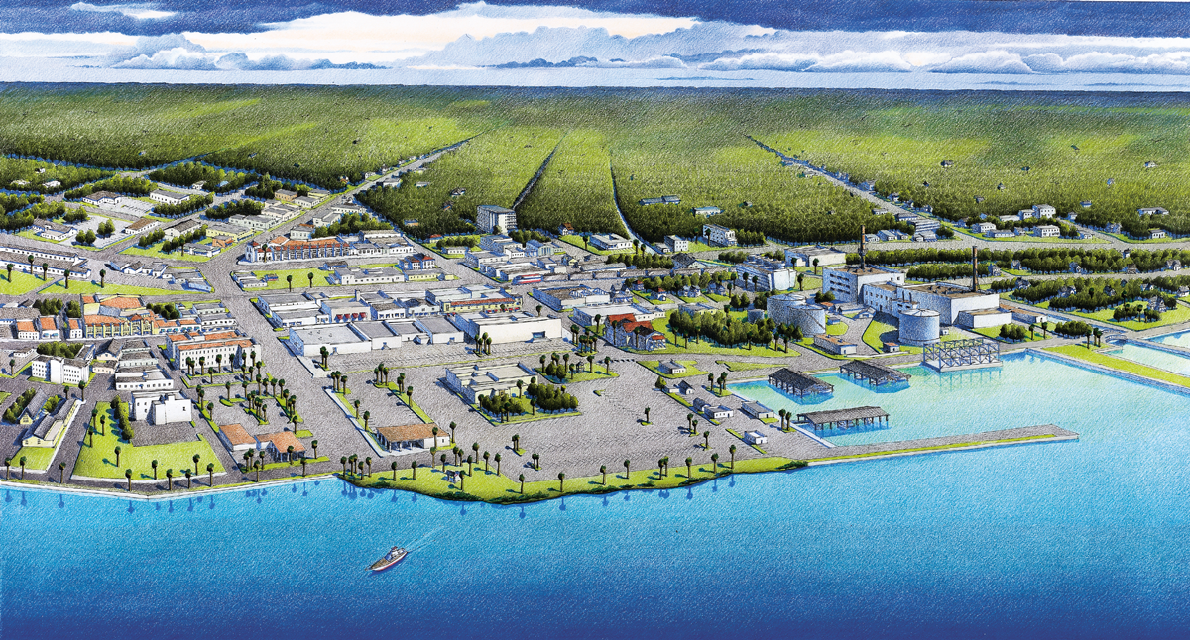
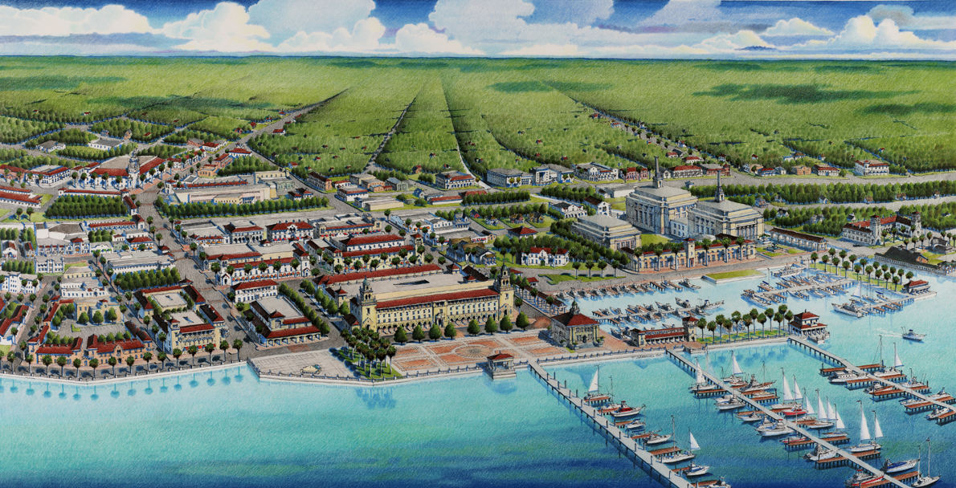

Slide 26
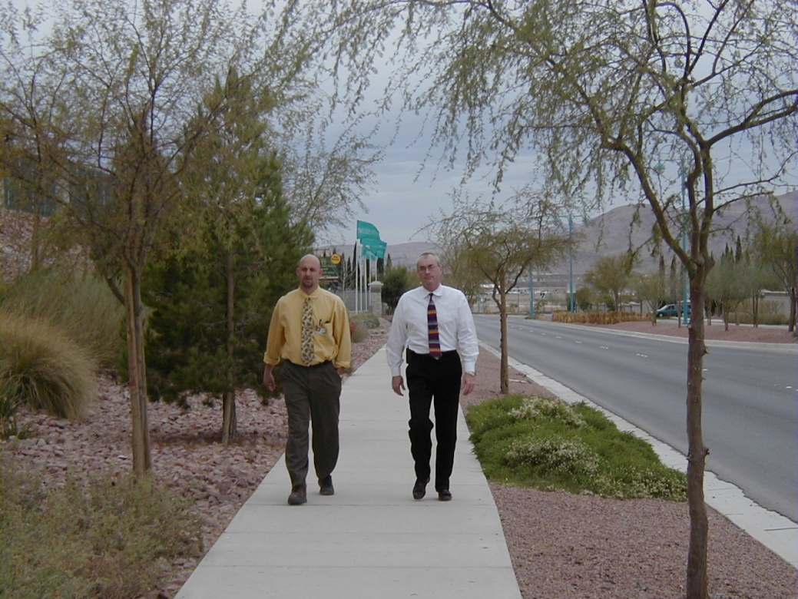
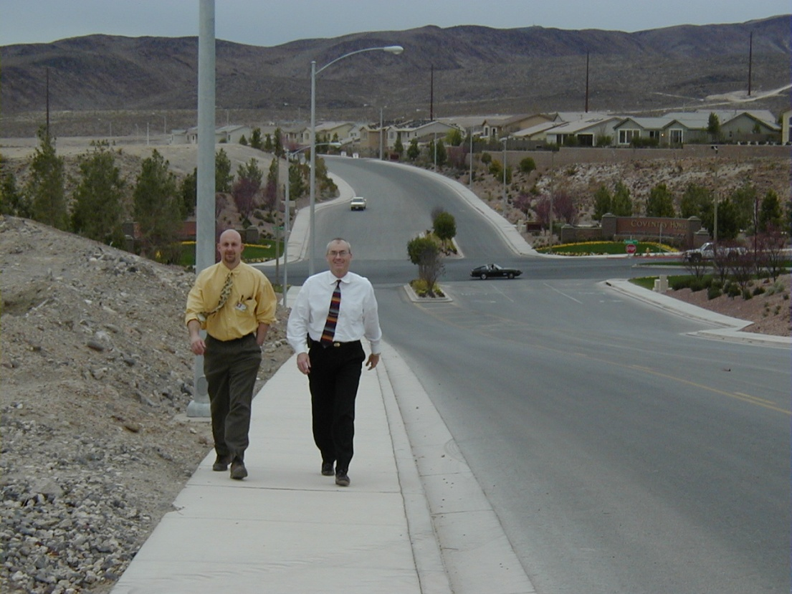
We all have
choices
People report that they would not walk in the lower photo unless forced to by circumstance
People say they choose to walk in the above setting
Henderson, Nevada

Slide 27
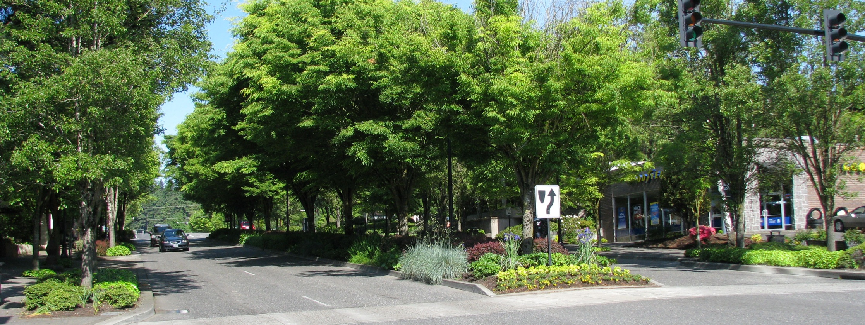
Downtowns or dense mixed use yield villages yield an 800% increase on yield per acre

Slide 28
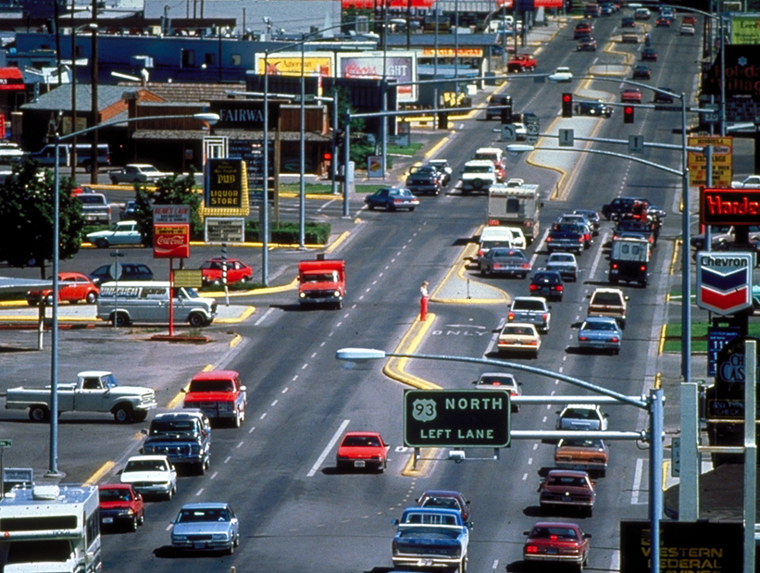
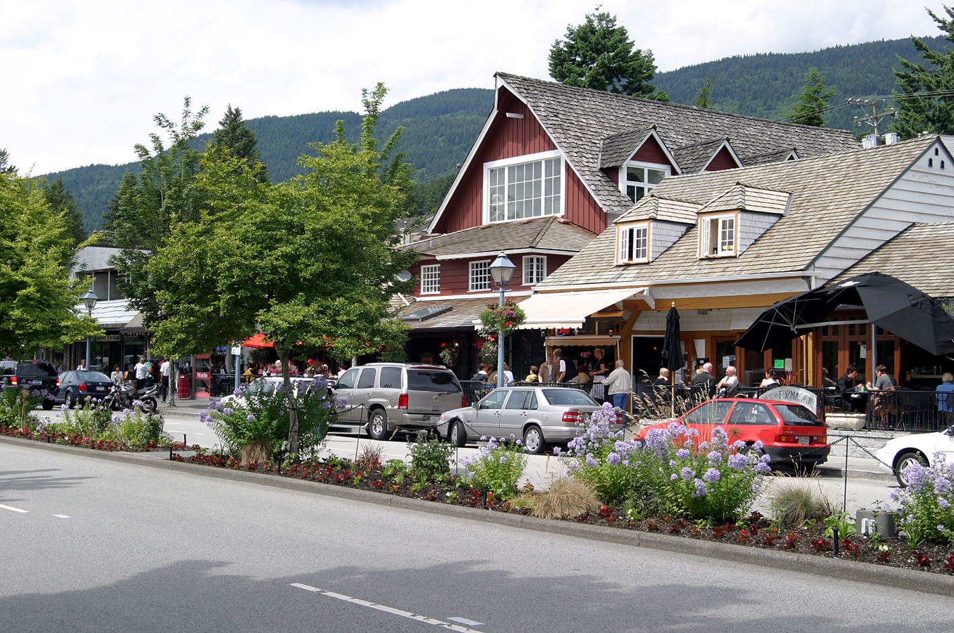
$30-65/sq ft
Marine Drive, Dundarave, B.C.
Canada
Highway 93, Missoula, Montana
$5-15/sq ft
USA

Slide 29
Marine Drive, Dundarave, B.C.

Slide 30
Smart Growth
How do you get projects on the ground? (demonstration/pilot projects, restriping projects, etc.)
How do you challenge the status quo and make change?
How do you change bureaucratic culture…be an agent of change…?
How do you address and apply Complete Streets streets when streets are already narrow?
Share “new” tools i.e. Modern Roundabouts and other tools.

Slide 31
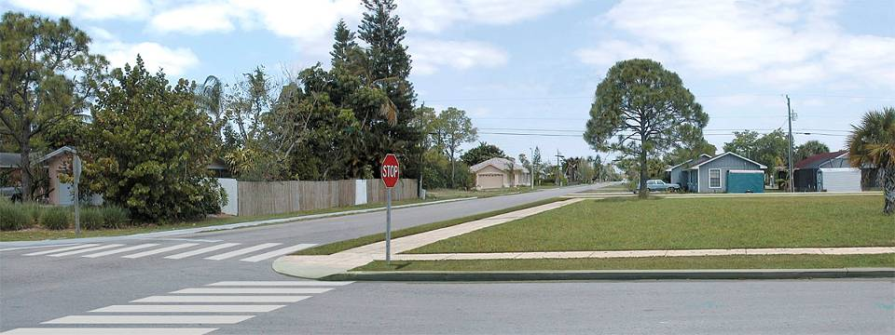
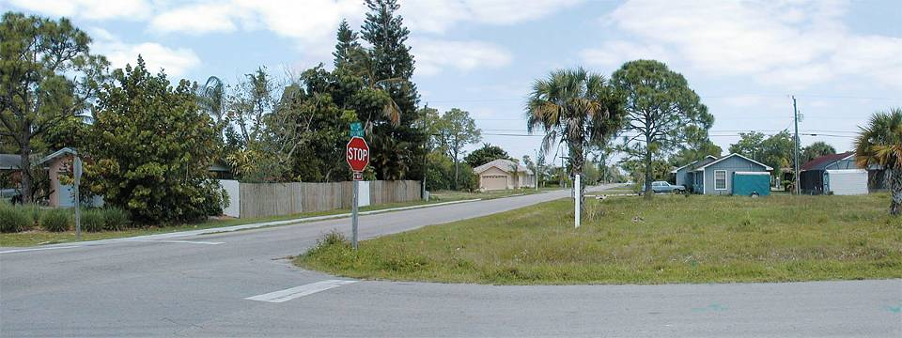
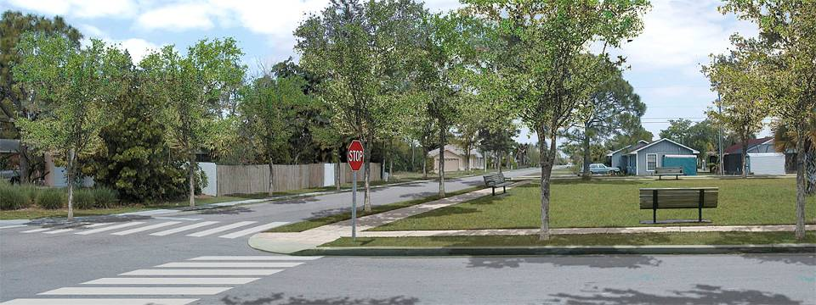
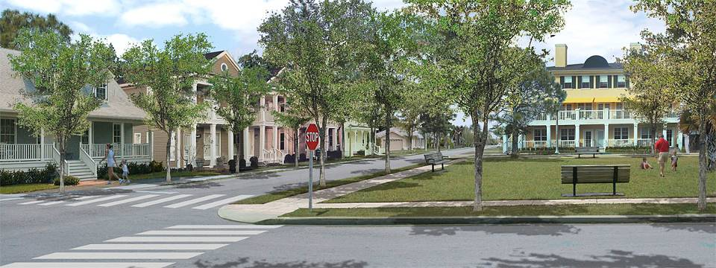
Smart Growth
Focus on lessons of walkability
Urban-Advantage.com

Slide 32
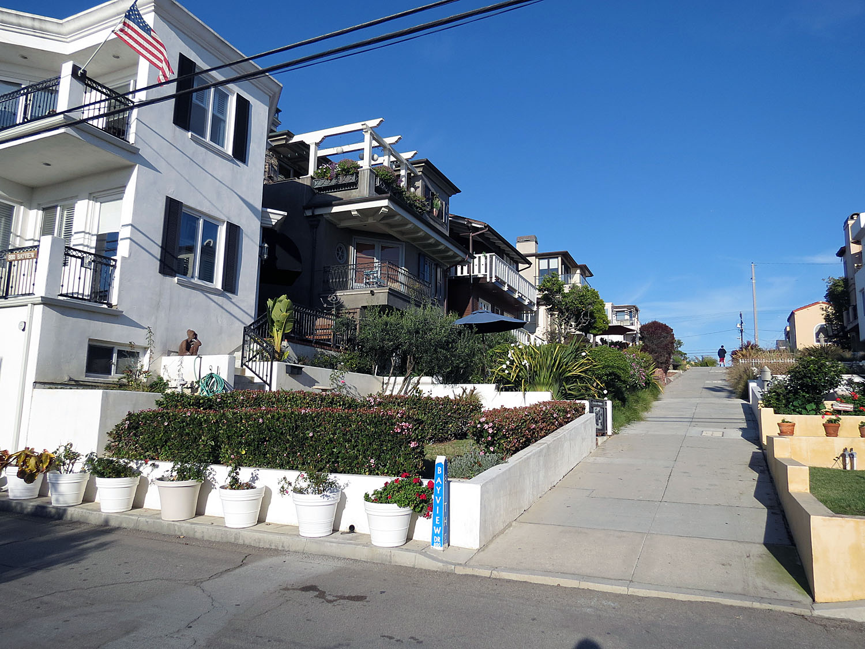
Manhattan Beach, Ca

Slide 33
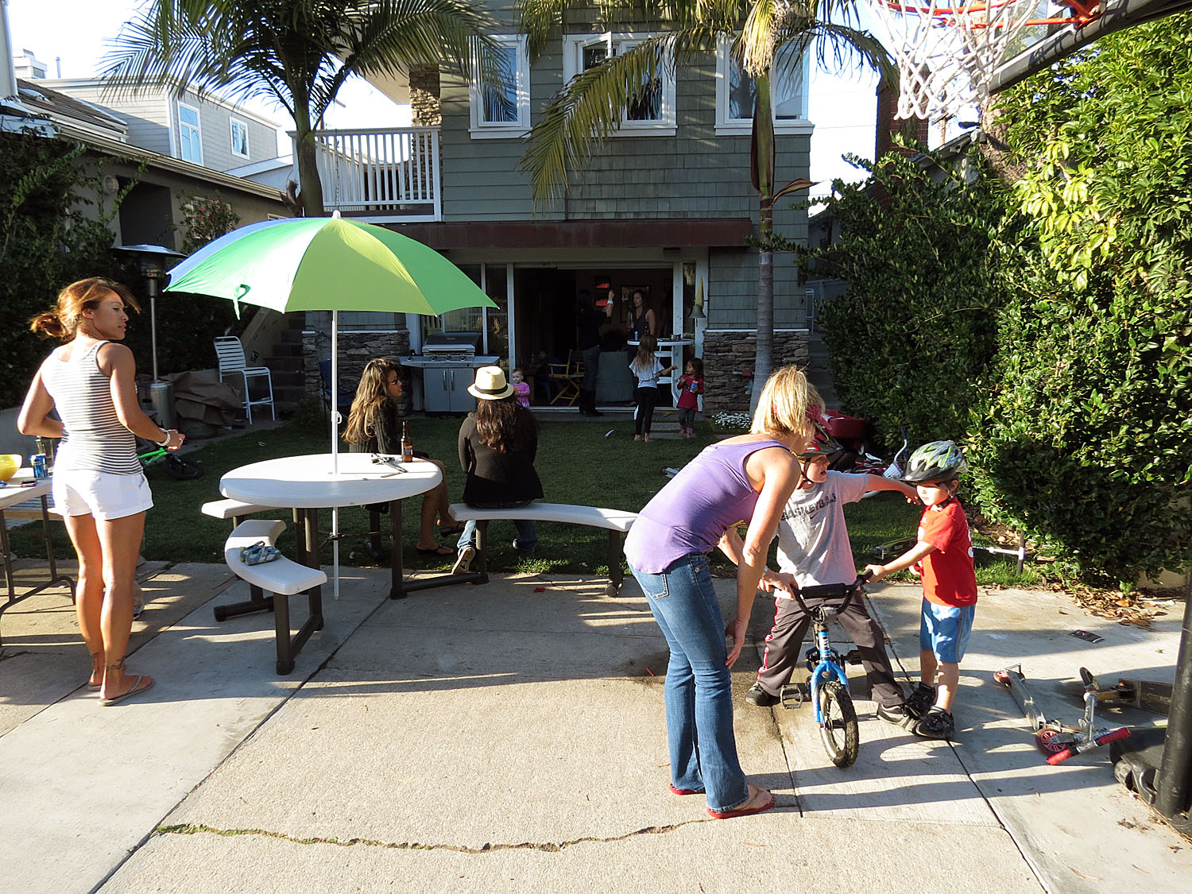
Manhattan Beach, Ca

Slide 34
Manhattan Beach, Ca

Slide 35
Manhattan Beach, Ca

Slide 36
Manhattan Beach, Ca

Slide 44
Source: Fisher & Hall Urban Design
Once we understand the context of a place, its history, its culture, its climate, its topography, its land settlement patterns, then we can start the design process in earnest.
Now that we know the new land use, we can design the street!
Petaluma, California

Slide 45
Before and After
Espanola Way, circa 1986

Slide 48
Smart Growth
How do you get projects on the ground? (i.e. pogo park, demonstration/pilot projects, restriping projects, etc.)

Slide 50
Smart Growth
How do you challenge the status quo and make change?
Answer
One incremental model project at a time.
Try to make all new projects model projects.
Gain permission to review all street projects for assessing complete streets, placemaking
Naples, Florida

Slide 51
Smart Growth
How do you change bureaucratic culture…be an agent of change…?
20 Technical walking audits
Mobile Study Tours
Advocacy Training Courses
Full day new engineers courses

Slide 52
Complete Streets

Slide 54
Trees and Behavior
5-15 mph increase in speed
Birmingham, Michigan

Slide 55
Narrow Lanes and Safety
"Unlike previous papers, Noland's is not a localized study or one reflecting unusual roadway types. It is specific to collectors, and it applies to all roads of this category throughout the US.
Noland states bluntly,
'as more arterial and collector lane widths are increased up to 12 ft or more, traffic fatalities and injuries increase....’
These results are quite stunning as it is general practice to 'improve' the safety of roads by increasing lane widths.‘
Evidence that showed narrowing traffic lanes reduce motorist speeds. The journal Accident Analysis and Prevention (http://www.sciencedirect.com/science/journal/00014575) has this article 'In-Press.'

Slide 56
West Palm Beach, Florida

Slide 57
20 Feet
Olive Avenue, West Palm Beach, Florida – Former 3-lane, One-Way
Ten foot travel lanes

Slide 60
Bridgeport Way, University Place, Washington
Trees provide an edge, buffering people on foot from moving autos
A small forest preserve park of 4 acres
Medians provide ground cover to absorb 20 percent of noise

Slide 61
Bridgeport (1999)
Bridgeport Way, University Place, Washington

Slide 63
Houston, Texas
Neighborhood Collector
Neighborhood Collector
Anywhere in California

Slide 64
Olive Avenue, West Palm Beach, Florida
Five to Two lane conversion

Slide 65
Smart Growth
Share “new” tools i.e. Modern Roundabouts and other tools.

Slide 66
Can handle 25,000 vehicles per day
Can handle 25,000 vehicles per day

Slide 67
Smart Growth
Share “new” tools i.e. Modern Roundabouts and other tools.

Slide 68
Smart Growth
Share “new” tools i.e. Modern Roundabouts and other tools.

Slide 75
America’s First School Roundabout

Slide 76
Speed reductions of 3-7 mph are common
Crashes are reduced 20-60%
Hartford, Connecticut

Slide 77
78 Feet
Speeds above (35-45)
Speeds below (18-22)
La Jolla Boulevard, Bird Rock, San Diego, California (Five to two lane conversion, before). Four signals and one four-way stop being removed. Back-in Angled parking to be added. (23,000 ADT)
14 Feet

Slide 78
LaJolla Boulevard, Birdrock, San Diego, CA

Slide 79
LaJolla Boulevard, Birdrock, San Diego, CA

Slide 82
Bridgeport Way, University Place, Washington
Trees provide an edge, buffering people on foot from moving autos
A small forest preserve park of 4 acres
Medians provide ground cover to absorb 20 percent of noise

Slide 83
Bridgeport (1999)
Bridgeport Way, University Place, Washington

Slide 84
University Place, Washington

Slide 87
Roundabout
Trees
Trees
On-Street Parking
Mini-Circle
Ground Cover
Inset Parking
Choker

Slide 91
Sidewalk
5’ feet wide
Edge
Median
Width Varies
6’ feet
10’ feet
7’ feet

Slide 92
Smart Growth
How do you address and apply Complete Streets streets when streets are already narrow?

Slide 93
Target Speed

Slide 94
Chico, CA Nord Avenue

Slide 95
Chico, CA Nord Avenue

Slide 96
Chico, CA Nord Avenue

Slide 97
Chico, CA Nord Avenue

Slide 98
Chico, CA Nord Avenue

Slide 99
Chico, CA Nord Avenue

Slide 100
1878

Slide 103
Thames Street

Slide 105
Attractive lamps
Eyes on street
Shore line
Parking buffer
Furniture zone 4-8 feet
Properly scaled signs
Walk/Talk Zone 15-25 feet (comfortable width)
Great Street

Slide 106
Winter Park Village
The Breakdown

Slide 111
Lee Rd.
K Mart
Orlando Avenue
Solana Ave.
Winter Park
Vo Tech
Webster Ave.
Winter Park
Village
Denning Dr.

Slide 112
Lee Road Extension
Mixed Use Redevelopment
Lee Rd.
K Mart
Orlando Avenue
Webster Ave.
Winter Park
Village
Residential Redevelopment
W.P.V. Development
Denning Dr.

Slide 113
Effective public participation can lead to shortened times to construction
The Sammamish public works director was told it would take 10 years to go from concept to concrete.
Bulldozers were moving dirt on this unfunded project in 300 days.
Sammamish, Washington
228th Avenue

