Slide 1
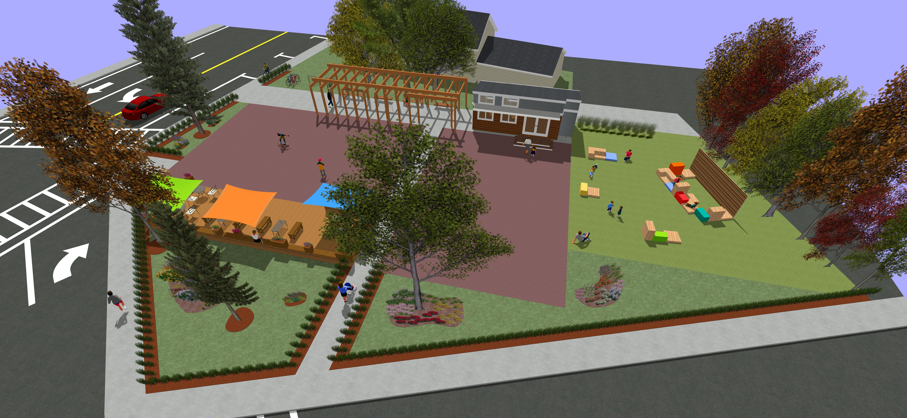
Commonwealth
Places
www.Patronicity.com
Jonathan Berk
New England Director Patronicity
jonathan@Patronicity.com
617-750-6008

Slide 2
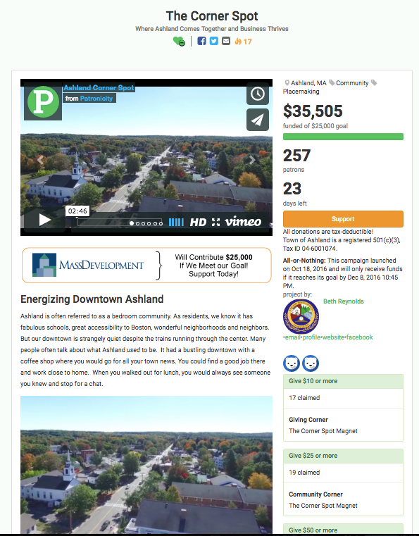
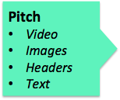
Crowdfunding Example

